Slide 1
Visual Analogy and Metaphor
Raymond Veon
Assistant Dean for Arts Education,
Caine College of the Arts
Utah State University

Slide 2
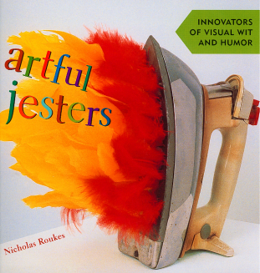
Visual Analogy
Analogy: 1. [n] similarity in some respect between things that are otherwise dissimilar: "the operation of a computer presents an interesting analogy to the working of the brain".
A visual analogy is the same as the definition above but uses visual forms or imagery to establish similarity.
Creating effective visual analogies can be approached in three steps:
Identify similar shapes/structures or functions contained in unrelated objects or images
Create a single shape from objects A and B.
Verify that the viewer can clearly identify both objects in the visual analogy.

Slide 3
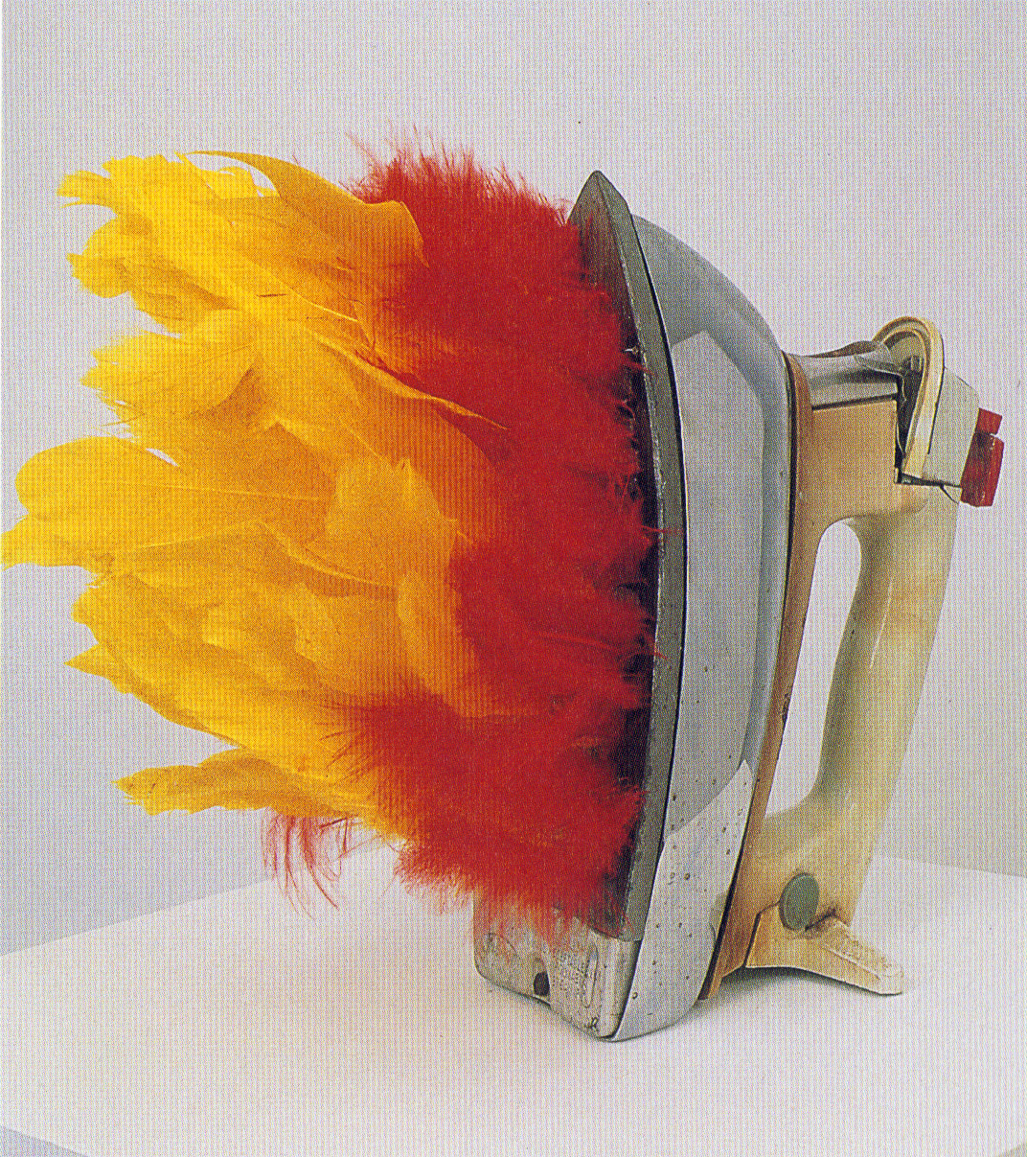
This sculpture by African American artist Willie Cole is based on a visual analogy. Visual analogies are based on similarities between how something looks (its structure) or how something works (its function).
The visual analogy shown in this sculpture is based on the:
A. The structural similarity between the feathers and fire
B. The functional similarity between the feathers and fire
C. The structural similarity between the feathers and steam
D. The functional similarity between steam and fire

Slide 4
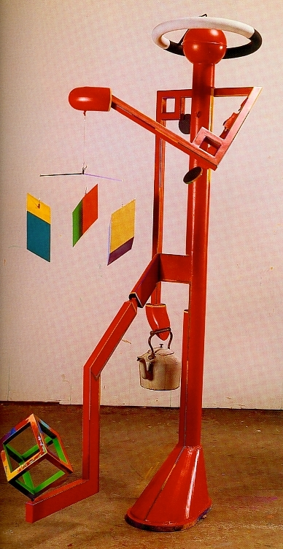
Visual Analogy
Robert Hudson, Hot Water 1982, steel and paint
Creating effective visual analogies can be approached in three steps:
Identify similar shapes/structures or functions contained in unrelated objects or images
Create a single shape from objects A and B.
Verify that the viewer can clearly identify both objects in the visual analogy.

Slide 5
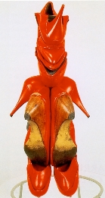
Visual Analogy
“ Willie Cole forages through detritus in the form of abandoned household objects and appliances and recombines their parts into totems with unexpected anthropomorphic power. “ -- James Yood
3 Steps:
Identify similar shapes/structures or functions contained in unrelated objects or images
Create a single shape from objects A and B.
Verify that the viewer can clearly identify both objects in the visual analogy.

Slide 6
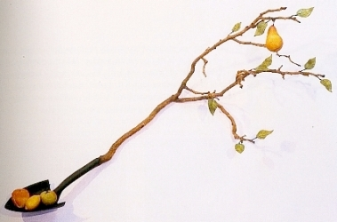
Visual Analogy (weak) and Metaphor (strong)
“The sense of wonder that I experienced
as a young boy lying in a freshly plowed
furrow still leaves me awestruck at the
magnitude of the garden’s endless biotic
enterprise. The garden has enriched my
spirit and given me the means and the
meaning to express myself.” --Victor Cicansky
Metaphor – which in a way adds a “conceptual” layer on top of a visual analogy – is a powerful way to discover, make, and convey suggestive, generative, open-ended meaning.

Slide 7
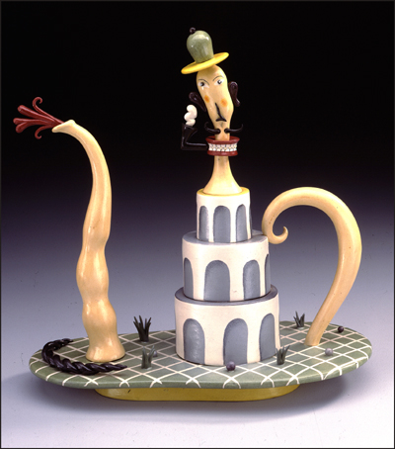

Slide 8
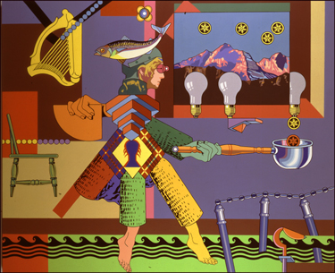
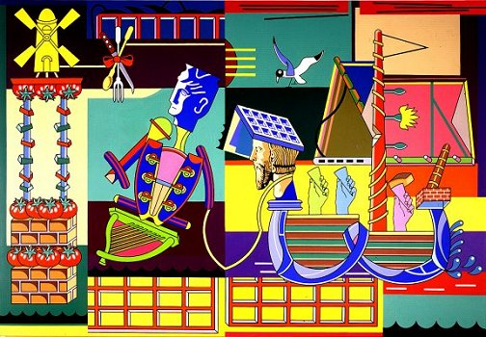
Notes:
Sometimes it is hard to decode all of the analogies/metaphors and whether they are structural or functional – this image presents a heavy cognitive load….takes a lot of time with image, to become familiar with it…..notice how VTS builds up skills to sustain inquiry, that support higher level understandings of artworks – such as the higher level metaphorical content – of course kids will sometimes make metaphorical interpretations of an image during a vts session – othertimes it will be more literal

Slide 9
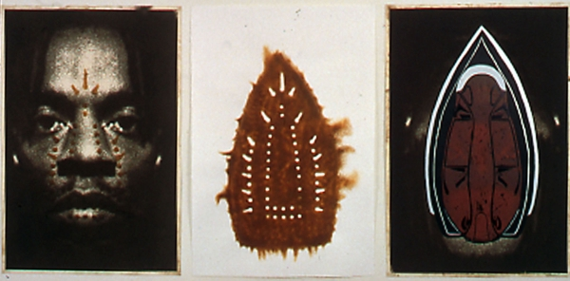
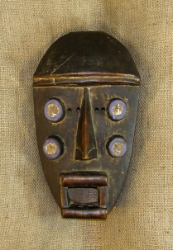
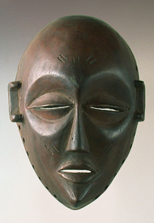
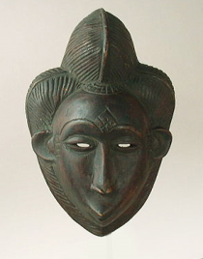
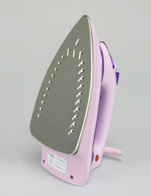
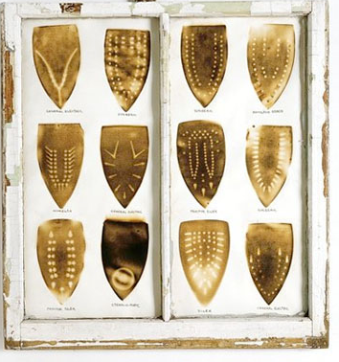
A: Works by African American Artist Willie Cole. B: Source imagery used by Cole in his work, including African masks, irons used for clothes (a symbol of labor), and diagrams showing how to load African slaves into slave ships
A
B
44. Compare the artwork in A to the source imagery used to create it in B. Cole’s artwork is based on both metaphors and visual analogies to his source material. Write a short essay that addresses that includes the following:
A. Describe the visual (structural) analogy between Cole’s use of the iron image and African masks.
B. Describe the functional analogy between Cole’s use of the iron image and the function of an iron.
C. Describe the visual and functional analogy between Cole’s use of the iron and the shape and function of slave ships.

