Slide 1
The Three Languages of Art
From Realism through Abstraction to Non-Representational Art

Slide 2
ABSTRACTION –A different way of seeing and making art
1. How to create abstraction in art class.
Below, I’m going to talk about Theo van Doesburg, the artist that inspired our project, and the process we’ll go through to create our art work.

Slide 3
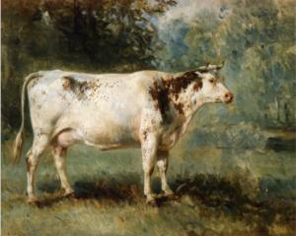
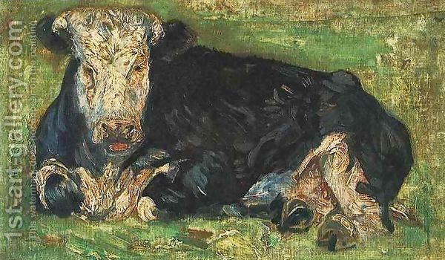
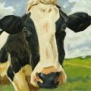
A Cow
As painted realistically or representationally by 3 artists
Vincent van Gogh, Cow

Slide 4
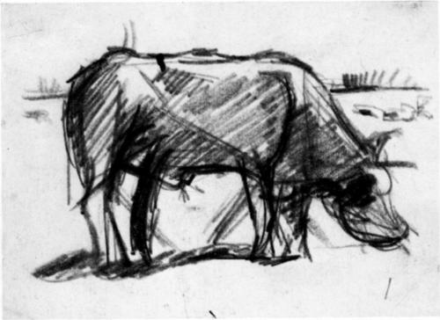
Theo van Doesburg’s The Cow, c. 1916

Slide 5
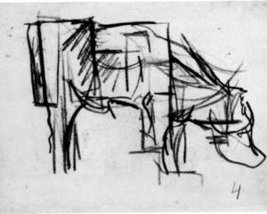
Abstraction of a Cow, 1916

Slide 6
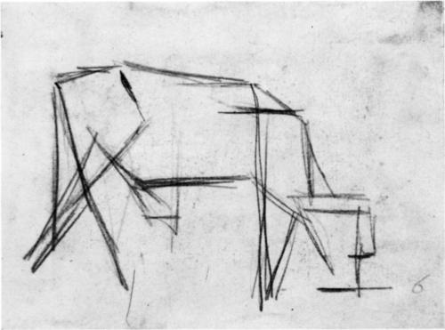
Theo van Doesburg’s Composition (The Cow), 1917

Slide 7
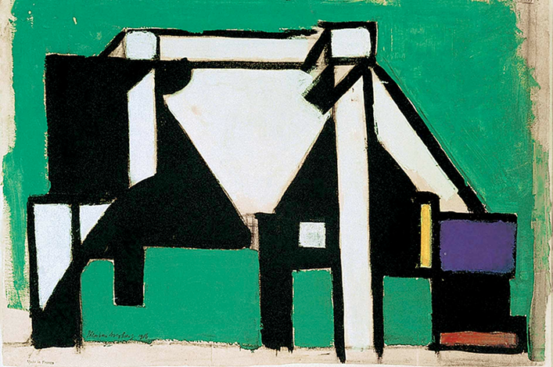
Theo van Doesburg (C.E.M. Kupper). Composition (The Cow). c. 1917

Slide 8
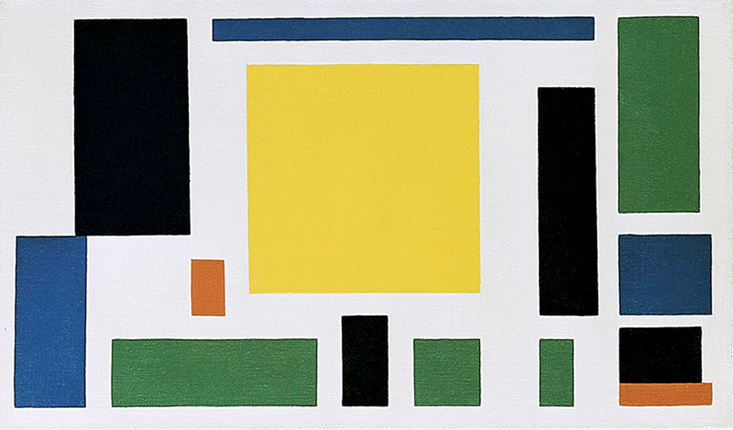
Theo van Doesburg (C.E.M. Kupper). Composition (The Cow). c. 1917

Slide 9
1
2
3
The Process of Abstraction
4
5

Slide 10
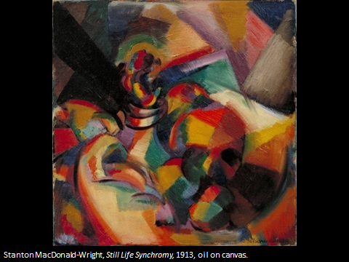
What type of Art is This?

Slide 11
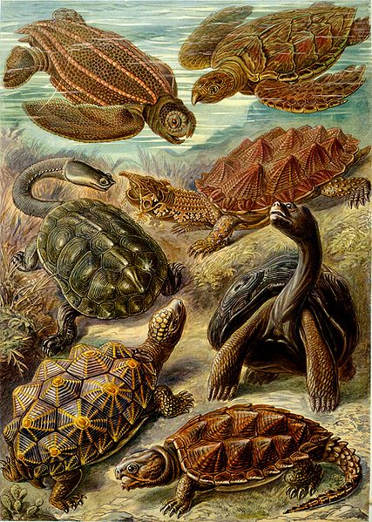
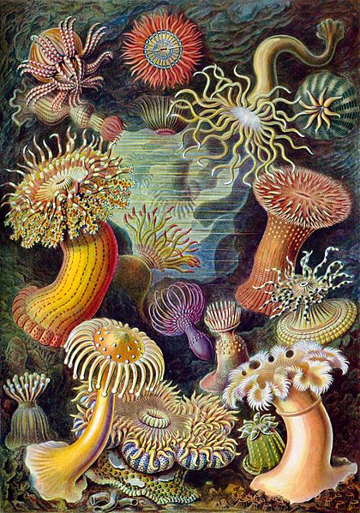
What type of Art is This?
Sea anemones and Turtles from Ernst Haeckel's Kunstformen der Natur (Art forms of Nature) of 1904

