Slide 1
THE VISUAL LANGUAGE OF ART – HOW ART COMMUNICATES TO US
(Art and its Appearance)
The Three Languages of Art

Slide 2
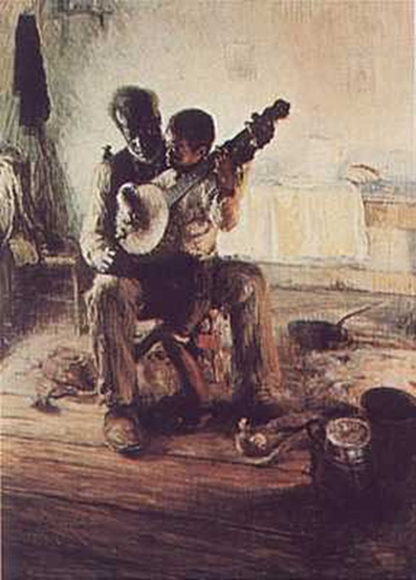
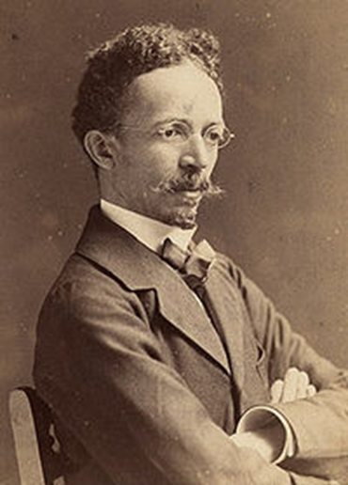
Henry Ossawa Tanner The Banjo Lesson, 1893

Slide 3
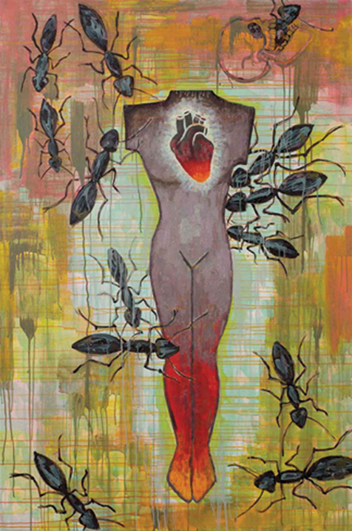
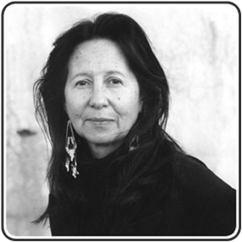
-Abstract Art aims to simply the form of an object or idea
Jaune Quick-to-See Smith , Made in America, 2009

Slide 4
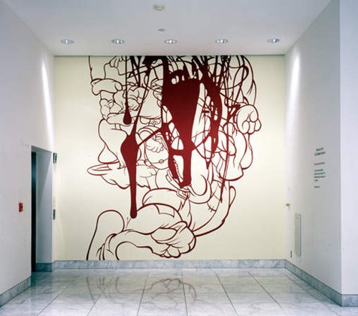
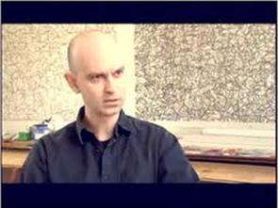
-Nonrepresentational Art (non-objective or non-figurative) does not aim to represent the appearance of things or people in reality, instead it focuses on pure form.
Arturo Herrera, When Alone Again, 2001

Slide 5
What is abstraction?
*abstraction is the process of turning a realistic object into something that is representational and fairly simple, but others wouldn’t be able to tell immediately what it represents. For instance, one could use lines, colors, and shapes to create a work of abstraction.

Slide 6
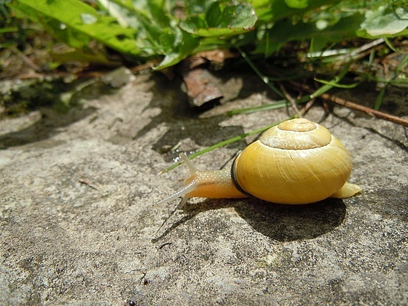
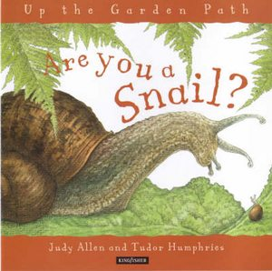
Photograph of a snail--as realistic or representational as you can get…
Examples
A realistic snail painting, an illustration for the cover of this book…

Slide 7
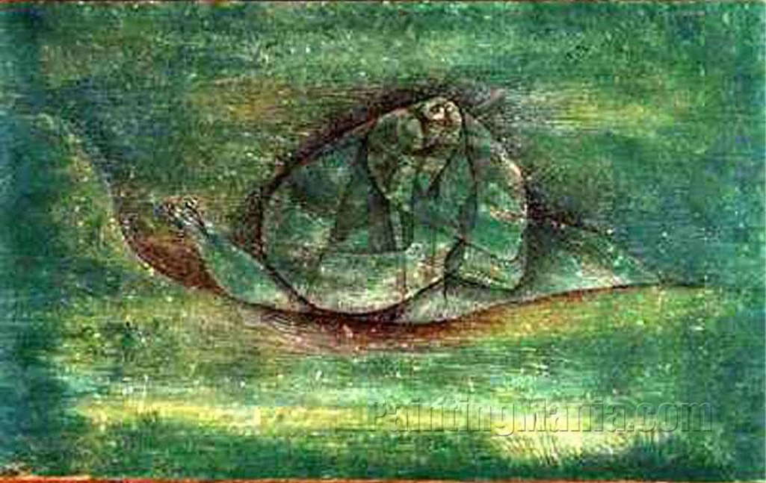
Paul Klee (1879-1940): Oil Painting, 'Snail‘ -- an abstracted painting

Slide 8
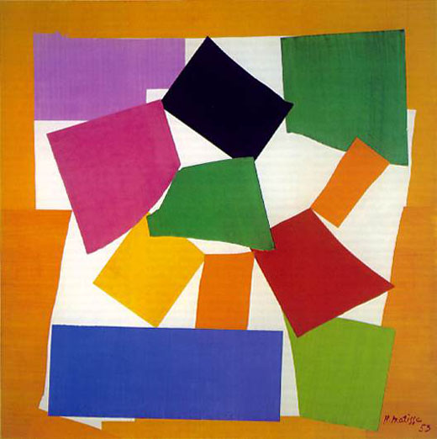
Henri Matisse, ‘Snail,” 1953,
A totally Non-Representational Image

Slide 9
What were the steps you completed in producing a series of drawings that started out realistic and transitioned to something abstract?
1. In phase 1, I simply chose an object in the classroom, the wooden human figure, and drew it out using gesture drawing and hatching to make it look as real to the original figure as possible.
2. Then, in phase 2, I began to abstract it by making the shading (hatching) into geometric shapes, and simplifying the outline into straight lines. But the picture still looks a bit realistic.
3. After, in phase 3, I further simplified it and “broke” the figure apart into separate shapes. In this panel, I have more control over what I want it to be like. Gradually, I’m trying to make the figure more and more abstract and away from realism.
4. Lastly, in phase 4, I changed some of the diagonal lines into horizontal lines, and outlined the figure with a sharpie. Then, just like Theo van Doesburg’s art piece “The Cow”, I made the color scheme of mine consisting of only black, white, three colors of my choice (in which I chose peach, light blue, and red), and a background color (purple).

Slide 10
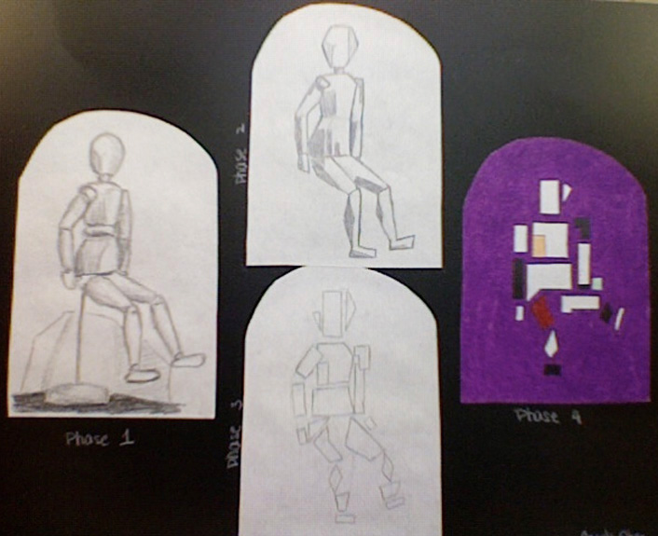
Representational
Abstract
Non-Representational

Slide 11
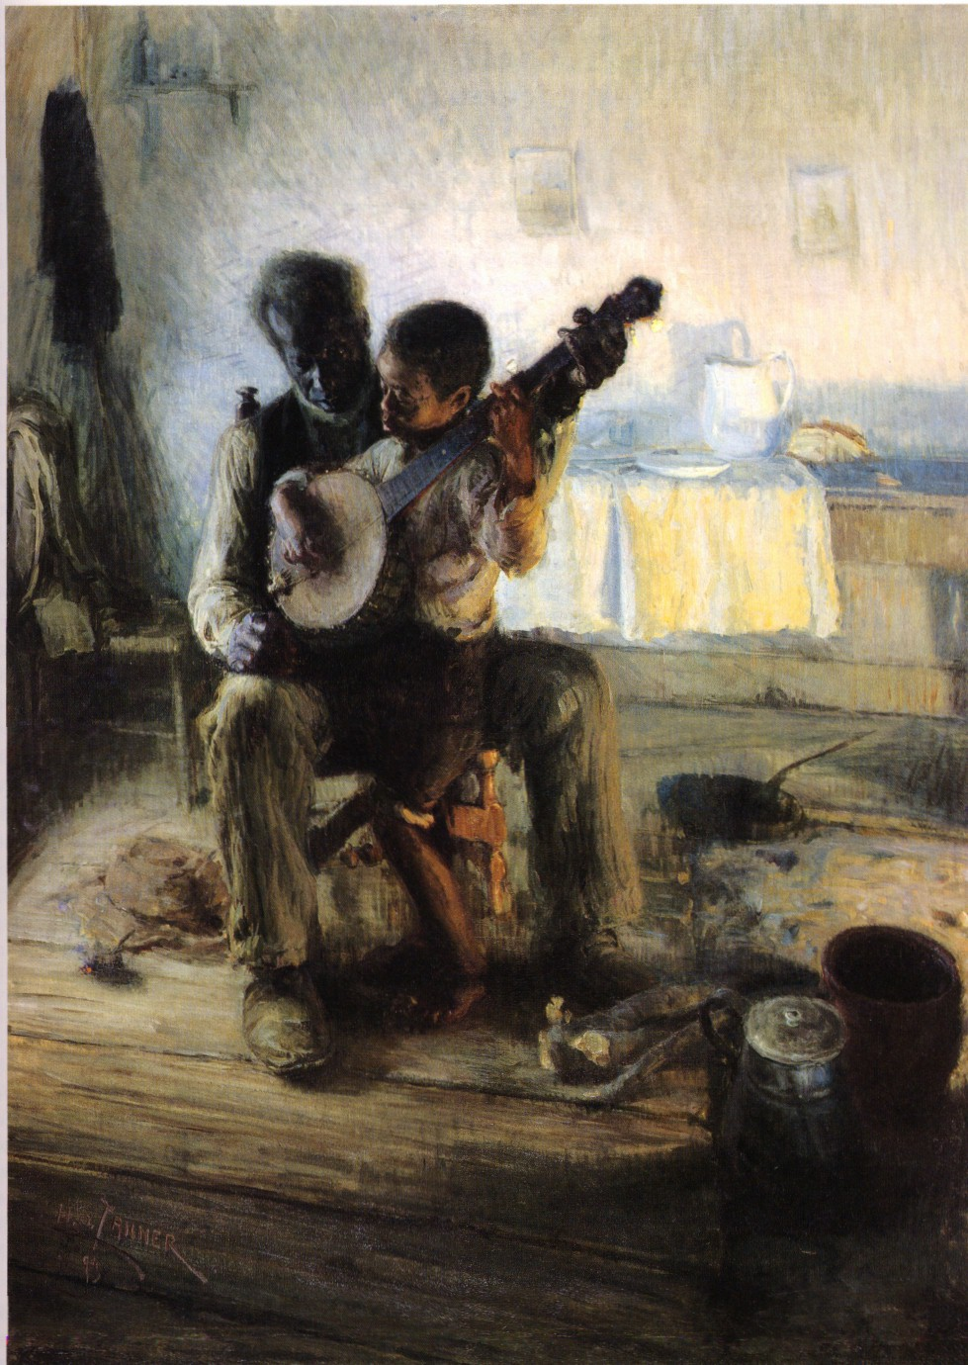
What type of Art is This?
Henry Ossawa Tanner The Banjo Lesson, 1893 –

Slide 12
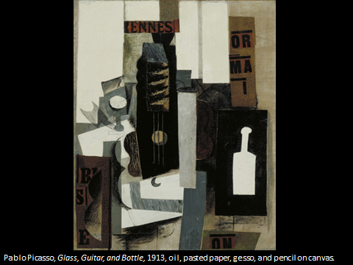
What type of Art is This?

Slide 13
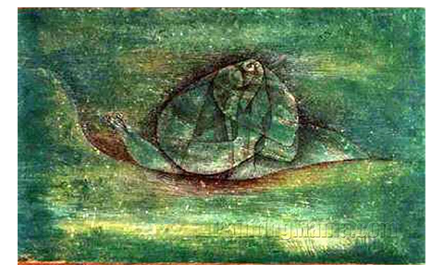
Abstract Painting of a Snail—
Paul Klee (18 December 1879 29 June 1940) was a Swiss painter of German nationality. His highly individual style was influenced by movements in art that included expressionism, cubism, and surrealism. He was, as well, a student of orientalism. Klee was a natural draftsman who experimented with and eventually mastered color theory, and wrote extensively about it. His works reflect his dry humor and his sometimes child-like perspective, his personal moods and beliefs, and his musicality. He and his friend, the Russian painter Wassily Kandinsky, both taught at the German Bauhaus school of art and architecture.
See this 3 min. video of Paul Klee’s work at: http://www.youtube.com/watch?v=CzkwPUR2onk

