Slide 1


Unpacking Common Core State Standards for ELA &Literacy
for the Arts
Agenda:
1. Overview of the Common Core State Standards for Literacy, as relevant to the arts
2. What applies? What does not? What do we already do? How can we do it better?
3. Arts Education Advocacy
March 2012 by Carol Brown
(with slight modifications by R. Veon)

Slide 2
www.igniteart.weebly.com
Common Core and the Arts

Slide 3
Workshop Objectives
To build a clear understanding of the Common Core Standards in ELA & Literacy and it’s key teaching shifts by modeling, and then analyzing, an art-strategy that addresses these (VTS/MTS).
Describe further the 6 Common Core instructional shifts, including demonstrating text complexity/vocabulary tiers.
Provide time for you to reflect on your own teaching/programs. What are you already doing that addresses these? Where do you need to focus on tweaking/expanding your practice. How?
Advocacy: Consider language and strategies for advocating/framing your teaching/programs in light of how they support CCS. To whom? How?
Consider the unique properties of learning in the arts to help address these standards and shifts.

Slide 4
The goal of the Common Core is to make every American student eventually
become CCR. The term CCR stands for:
Creedence Clearwater Revival
√
B. College and Career Ready
C. Crystallized Carbon Reactors
D. Charming Cultural Raconteurs

Slide 5
The percentage of American college students needing remediation in
reading and writing as freshmen is:
99%
B. 1%
C. 20%
√
D. 40%

Slide 6
As of today, 45 states have adopted the Common Core. Two of the holdouts
are:
Texas and Alaska
√
B. Kansas and Arizona
C. South Carolina and California
D. This is a trick question. There are only 45 states.

Slide 7
The Common Core stresses higher level thinking skills. The words
analyze and analysis are used how many times in the Literacy Standards and
Performance Task Exemplars :
1
B. 10
C. 100
√
D. 291

Slide 8
Which state was the model for the high level of educational standards
that was the model for the Common Core?
Texas
√
B. Massachusetts
C. New York
D. California

Slide 9
Overview of Instructional Shifts
http://engageny.org/resource/common-core-in-ela-literacy-an-overview/

Slide 10
Shift Happens
Shift 1 PK-5 | Balancing Informational & Literary Texts
Shift 2 6-12 | Building Knowledge in the Disciplines
Shift 3 | Staircase of Complexity
Shift 4 | Text-Based Answers
Shift 5 | Writing from Sources
Shift 6 | Academic Vocabulary

Slide 11
Shift # 1: Balanced Informational and Literary Texts
Students read a true balance of informational and literary texts. Elementary school classrooms are, therefore, places where students access the world (science, social studies, the arts and literature) through text.
At least 50% of what students read is informational.

Slide 12
Shift #2:
Knowledge in the Disciplines
Content area teachers outside of ELA classroom emphasize literacy experiences in their planning and instruction.
  You are still evaluated on arts-centered learning under Teacher KEYS/SLO (which are aligned to CCSS)
Students learn through domain-specific texts in classrooms – rather than referring to the text, they are expected to learn from what they read.

Slide 13
Shift #3: Staircase of Complexity
In order to prepare students for the complexity of college and career ready texts, each grade requires a “step” of growth on the “Staircase.”
Students read the central, grade appropriate text around which instruction is centered.
Teachers are patient, create more time and space for this close and careful reading, and provide appropriate and necessary scaffolding and supports so that it is possible for students reading below grade level.

Slide 14
Shift #4: Text-based Answers
Students have rich and rigorous conversations which are dependent on a common text.
Teachers insist that classroom experiences stay deeply connected to the text on the page.
Students develop habits for making evidentiary arguments both in conversation, as well as in writing to assess comprehension of a text.

Slide 15
A Text Could Be….
Words
Works of art
Script (published or student generated)
Graphs
Graphics
Diagrams
Charts
Illustrations
Storyboards
Captions
Sheet Music Reading

Slide 16
Shift #5: Writing from Sources
Writing needs to emphasize use of evidence to inform or make an argument rather than the personal narrative and other de-contextualized prompts.
While the narrative still has an important role, students develop skills through written arguments that respond to the ideas, events, facts, and arguments presented in the texts they read.

Slide 17
Shift #6: Academic Vocabulary
Students constantly build the vocabulary they need to access grade level complex texts.
By focusing strategically on comprehension of pivotal and commonly found words and less on esoteric literary terms, teachers constantly build students’ ability to access more complex texts across the content areas.

Slide 18
School age:
Predictive capacity
(number of words
expected to be learned
per year)
Emergence:
10-18 months
(words heard per hour)
Cumulative, by age 3
(collection of spoken
words)
…by
age
5:
Anna
616
500
750 (2 per day)
5 affirmative
11 prohibitive
2,000
Public
assistance
Sophie
1,251
700
3,000
Office and
Hospital
Workers
(not mgmt)
1500 (4 per day)
12 affirmative
7 prohibitive
James
2,153
1,100
5,000
3,000 (8 per day)
Col. profs
32 affirmative
5 prohibitive

Slide 19

Tier 3: glossary word:
Multisyllabic
Specific to a subject area
Latin or Greek-based
topography, photosynthesis, Isoceles triangle,
sedimentary, oxygenated, cartographer
Tier 2: Words of education, business,
government, religion:
Components: Prefix, root, suffix
Latin-based
elevation, formation, protrude, expansive,
isolated, remote
Tier 1: Basic conversational words: Friends & family
1 or 2 syllables
Learned naturally, through exposure
hills, grass, rocks, land, sky, clouds, fly, climb,
green, high…

Slide 20
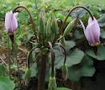
Recognizing Tier I, II, and III Words
The flower known as the dodecatheon was named by the great botanist and
taxonomist Carl Linnaeus. It is commonly called the Pride of Ohio. The technical
name for this flower is of Greek origin and means “twelve gods.” This alludes
to its interesting flowers, of which there are about a dozen. The sepals are
split into five parts and lean backward like an inside-out umbrella. There are
five stamens (filaments with anthers) in the center of the circle of petals. They
converge at their tips like a little volcano. The style projects above the petals
and the stamens.

Slide 21
Recognizing Tier I Words
The flower known as the dodecatheon was named by the great botanist and
taxonomist Carl Linnaeus. It is commonly called the Pride of Ohio. The technical
name for this flower is of Greek origin and means “twelve gods.” This alludes
to its interesting flowers, of which there are about a dozen. The sepals are
split into five parts and lean backward like an inside-out umbrella. There are
five stamens (filaments with anthers) in the center of the circle of petals. They
converge at their tips like a little volcano. The style projects above the petals
and the stamens.

Slide 22
Recognizing Tier II Words
The flower known as the dodecatheon was named by the great botanist and
taxonomist Carl Linnaeus. It is commonly called the Pride of Ohio. The technical
name for this flower is of Greek origin and means “twelve gods.” This alludes
to its interesting flowers, of which there are about a dozen. The sepals are
split into five parts and lean backward like an inside-out umbrella. There are
five stamens (filaments with anthers) in the center of the circle of petals. They
converge at their tips like a little volcano. The style projects above the petals
and the stamens.

Slide 23
Recognizing Tier III Words
The flower known as the dodecatheon was named by the great botanist and
taxonomist Carl Linnaeus. It is commonly called the Pride of Ohio. The technical
name for this flower is of Greek origin and means “twelve gods.” This alludes
to its interesting flowers, of which there are about a dozen. The sepals are
split into five parts and lean backward like an inside-out umbrella. There are
five stamens (filaments with anthers) in the center of the circle of petals. They
converge at their tips like a little volcano. The style projects above the petals
and the stamens.

Slide 24
The Academic Word List (AWL):
570 words not in the most frequently used 2,000 English words
AWL words occur frequently over a wide range of academic texts.
Grouped into ten subsets that reflect their frequency of use:
  Subset 1= highest frequency.
    i.e. analyze, distribute, proceed, process
  Subset 10 = the least frequent.
    i.e. adjacent, forthcoming, intrinsic, persist
Not restricted to a specific field of study; these words are useful for learners studying in disciplines as varied as literature, science, health, business, the arts, and law.

Slide 25
Vocabulary Activity:
With your group, select a word from one of the Subsets
Words with Multiple Meanings:
  Complete the handout.
  Select 6 words that could be used in collaborating with Science or Social Studies teachers.

Slide 26
Words with Multiple Meanings:
math/science/
social studies meaning
conversational meaning:
word
Visual:
Visual:
Arts sentence
math/science/SS sentence:
conversational sentence:

Slide 27
Academic Word List: Subset 1
analyze approach area assess assume authority available benefit concept consist context constitute contract data define derive distribute economy environment establish estimate evident factor finance formula function income indicate individual interpret involve issue labor legal legislate major method percent period principle proceed process policy require research respond role section sector significant similar source specific structure theory vary
Academic Word List: Subset 2
achieve acquire administrate affect appropriate aspect assist category chapter commission community complex compute conclude conduct consequent construct consume credit culture design distinct equate element
evaluate feature final focus impact injure institute invest item journal maintain normal obtain participate perceive positive potential previous primary purchase range region regulate regulate relevant reside resource restrict secure seek select site strategy survey tradition transfer

Slide 28
Academic Word List: Subset 3
alternative circumstance comment compensate component consent considerable constant constrain contribute convene coordinate core corporate correspond criteria deduce demonstrate document dominate emphasis ensure exclude
fund framework illustrate immigrate imply initial instance interact justify layer link locate maximize minor negate outcome philosophy physical proportion publish react register rely remove scheme sequence shift specify sufficient technical technique technology valid volume
Academic Word List: Subset 4
access adequacy annual apparent approximate attitude attribute civil code commit communicate concentrate confer contrast cycle debate despite dimension domestic emerge error ethnic grant hence hypothesis implement
implicate impose integrate internal investigate mechanism occupy output overall parallel parameter phase predict prior principal professional project
promote regime resolve retain series statistic status stress subsequent sum summary undertake

Slide 29
Academic Word List: Subset 5
academy adjust alter amend aware capacity challeng clause compound conflict consult contact decline discrete draft enable energy enforce entity equivalent evolve expand expose external facilitate fundamental generate generation image liberal license logic margin mental medical modify monitor network notion objective orient perspective precise prime psychology pursue ratio reject revenue stable style substitute sustain symbol target transit trend version welfare whereas
Academic Word List: Subset 6
abstract acknowledge accuracy aggregate allocate assign attach bond brief capable cite cooperate discriminate display diverse domain edit enhance estate exceed explicit federal flexible furthermore gender ignorance interval lecture migrate minimum ministry motive neutral nevertheless overseas precede presume rational recover reveal scope subsidy trace transform transport underlie utilize

Slide 30
Rules of Thumb
New learners need SIX (meaningful) exposures to a new word during the initial lesson and at least
THIRTY additional exposures during the ensuing month.
The chances of learning a word after a single exposure in context are 10-15%.
We learn most words through non-conscious effort, in
pursuit of information of interest.

Slide 31

Vocabulary-Content-Sentence (VCS)
Daily Practice:
assume benefit concept data economy factor indicate method proceed process policy role specific structure
Write a sentence about something we are learning this week, employing
one of these words. You may change the form of the words to fit your
sentence. Your sentence must be at least 8 words long. CONNECT THIS TO WRITING TASKS ON ARTS ASSESSMENTS.

Slide 32
A Plan for School-wide Vocabulary Instruction
EXPLICIT INSTRUCTION
“Focus 40” words from the Academic Word List
selected by grade level teachers: 1 word per week
2-3 words related to or associated with each of the “Focus 40”; each subject area teacher decides on related words
“
Subject-specific words, such as those found in a glossary
Students have more opportunities to read for a variety of purposes, including self-selected material.
Open Field
Elevated language used in class by teachers; students given
motive and opportunity to use elevated vocabulary in speech and
writing.
Academic Word List
IMPLICIT INSTRUCTION

Slide 33
Seven Guiding Principles for the Arts
Studying works of art as training in close observation across the arts and preparing students to create and perform in the arts
Engaging in a deep study of works of art across arts disciplines and preparing students to develop arts literacy and develop their own art
Studying the social, political, cultural and economic contexts of works of art while maintaining an in depth focus on each work, allowing students to gain a deeper understanding of the works of art, including their connections with other areas of knowledge and in the evolution of the art disciplines
Integrating the appropriate USNY cultural institutions to promote a rich study of the arts
Providing an explicit learning progression in the arts disciplines along the pre-K – Grade 12 continuum that is developmentally appropriate
Studying the arts associated careers, including the choices artists make as they design solutions and how aesthetics influence choices consumers make
Developing a lifelong curiosity about the arts, and understanding that art transcends time
http://engageny.org/resource/common-core-standards-and-the-arts/?au=teachers

Slide 34
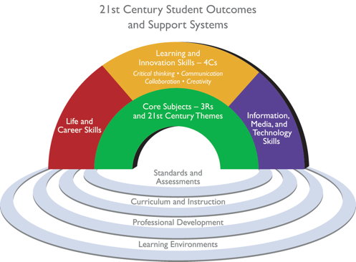
Learning in the Arts…
Exemplifies 21st Century Skills
Creativity
Collaboration
Communication
Critical Thinking/Problem Solving
  Are an entry point for at-risk and ELL students, as well as engage multiple intelligences.
  Sit as a pivot for transferability of skills and processes
  www.p21.org
http://engageny.org/resource/student-learning-objectives/

Slide 35
Let’s Read the Standards
Read the 10-10-6-6 ELA & Literacy Anchor Standards.
In a group of alike genres, please cross out the ones which do not apply to your teaching and learning.
For those you already do, please write an example

Slide 36
CCGPS:
What else should you do?
Who knows you are doing this?
Principal, Asst Superintendent for Curriculum and Instruction, School Board?
ADVOCACY
Questions/prompts

Slide 37
Shift #4: Text-based Answers
Students have rich and rigorous conversations which are dependent on a common text.
Teachers insist that classroom experiences stay deeply connected to the text on the page.
Students develop habits for making evidentiary arguments both in conversation, as well as in writing to assess comprehension of a text.

Slide 38
Shift #5: Writing from Sources
Writing needs to emphasize use of evidence to inform or make an argument rather than the personal narrative and other de-contextualized prompts.
While the narrative still has an important role, students develop skills through written arguments that respond to the ideas, events, facts, and arguments presented in the texts they read.

Slide 39
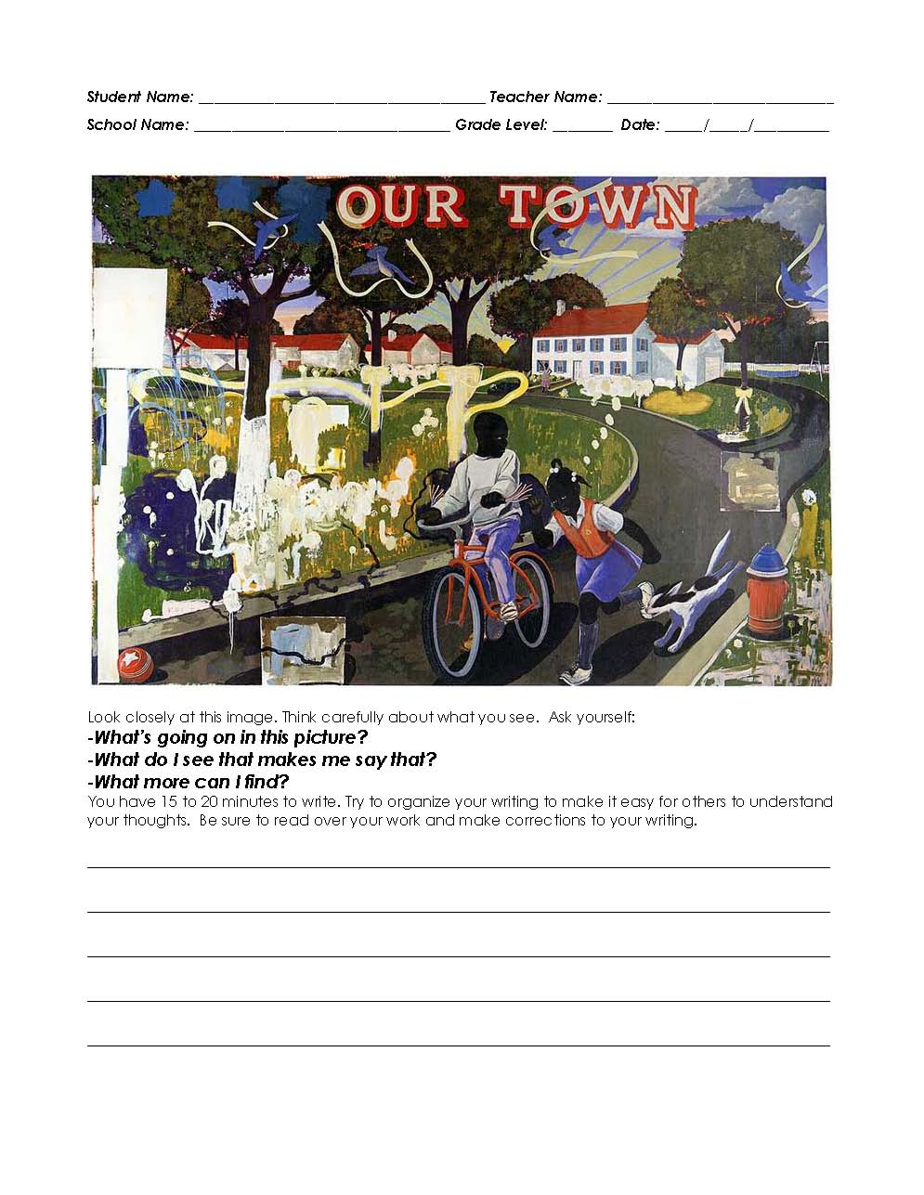
VTS Pre/Post Writing Assessments
All Pre Tests Should Now Be Complete
Pre/Post Test Due Date:
May 13th, 2011
Pre-Test on TOP
Post-Test on BOTTOM
MTS pilot this spring (PD opportunity)

Slide 40
Visual Thinking Strategies
Take a minute to look at this picture.
What is going on in this picture?
What do you SEE that makes you say that?
What more can we find.
Paraphrase! Point! Link!
  Teaches teachers how to lead inquiry-based lessons

Slide 41
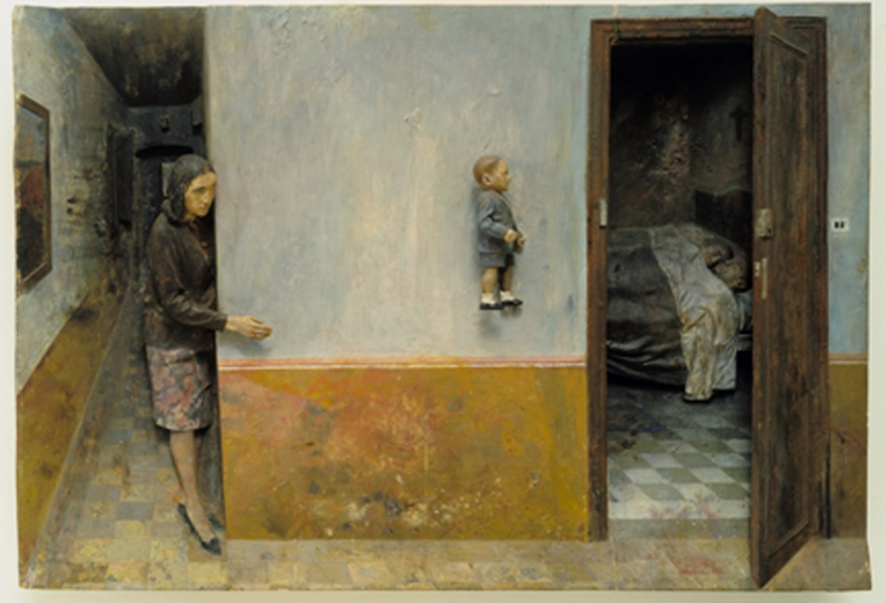

Slide 42
Visual Thinking Strategies
Ten lessons per year (Two 15 minute VTS sessions=1 lesson)
Increases writing skills
Over three years, raises reading/LA and math scores (12% and 16%, Grades 3-5 in Miami-Dade County)
Create confidence in student’s ability to comprehend complexity
Foster a desire to learn and take risks
Encourage students to value their own ideas while listening and building on the ideas of others

Slide 43
Visual Thinking Strategies
In order to write well, we must speak well—too little time is spent with students in conversation to allow speaking skills to develop
By paraphrasing, teachers build grammar, syntax, and vocabulary
Teaches how to make observations, draw inferences, and justify statements by citing evidence…skills useful in what other subject?

Slide 44
Critical Thinking in Music
Music Thinking Strategies

Slide 45
New District-Wide Unit and Lesson Plan Template
Develop in ArtsAPS Workshops to Share Online
UNIT PLAN Guide to Support Lesson Plan Implementation
Title of Unit: | Grade Level:
Curriculum Area: | Time Frame:
Content Standards:
Understandings: Begin with the end in mind by identifying what students should know and be able to do through . . . Overarching Understandings | Related Misconceptions
Essential Questions: Overarching Point beyond a unit to a larger, transferable idea. May link a topic to other topics and subjects. Example: What in Shakespeare’s plays make them “classic” literature? | Topical Can be answered by uncovering a unit’s content. They stay within the bounds of the topic. They can be answered as a result of in-depth inquiry. Example: After reading Merchant of Venice, answer the question: Is Shakespeare prejudiced?
Knowledge: Students will know . . .
Skills: Students will be able to . . .

Slide 46
My Professional Learning Center
Registration Guide
Home Page
Course Search
Course Registration
How to receive credit
Website: atlanta.truenorthlogic.com
http://igniteart.weebly.com and click on professional development
Agenda

Slide 47
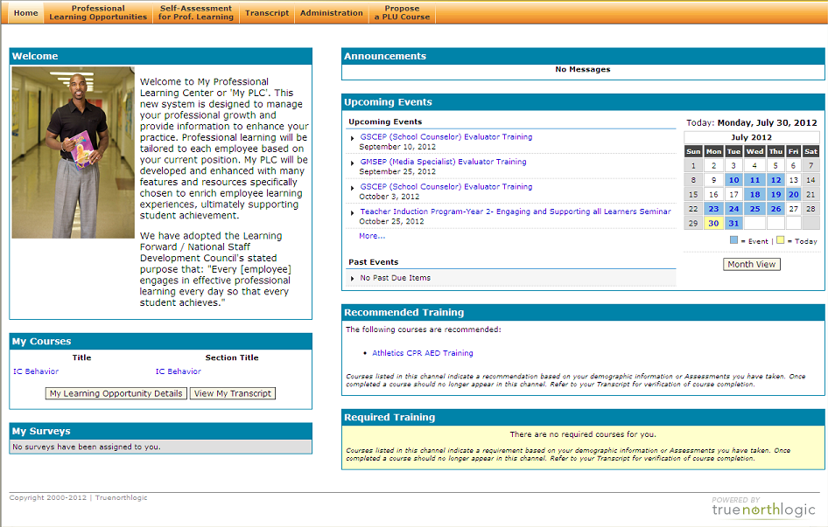
Home Page
Course Notification / Reminders (1)
These are the courses you are currently Registered for.
You are required to complete a Course Evaluation survey after each course in order to receive credit. Upon completion of the course the survey will be available to you after the Section end date.

Slide 48
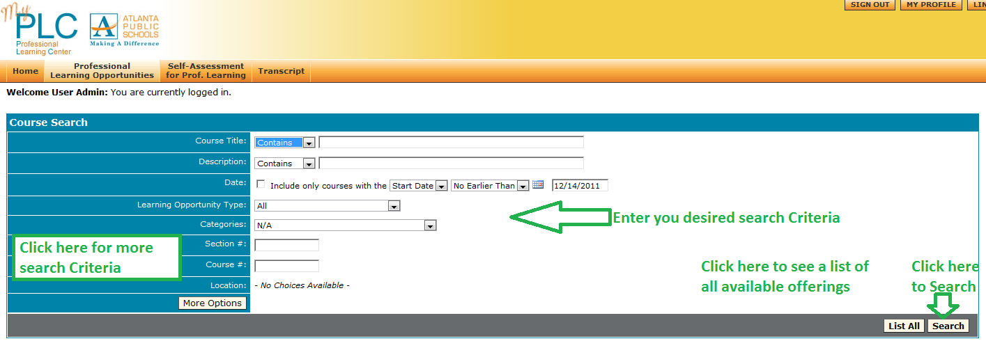
Course Search
Professional Learning Opportunities
The search results available to you are based on your profile location. All courses when created are targeted to it’s appropriate audience based on location.

Slide 49
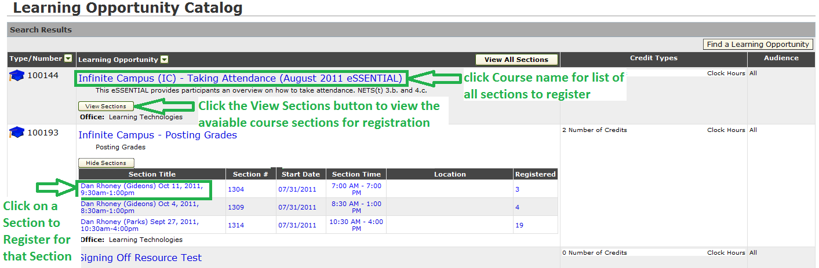
Course Search
Search Results
Click the Course Title in blue to register

Slide 50
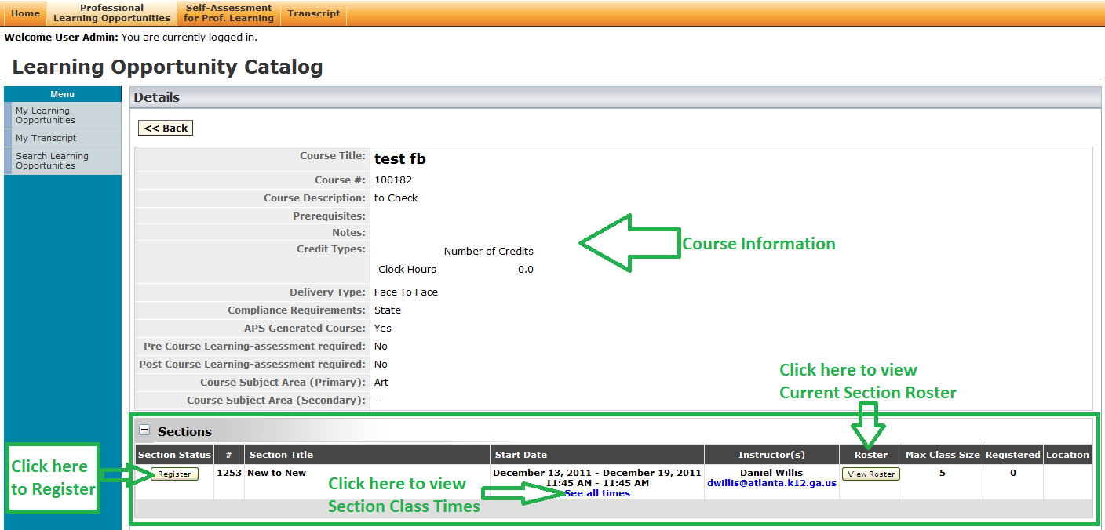
Course Registration
Instructor Led Course

Slide 51
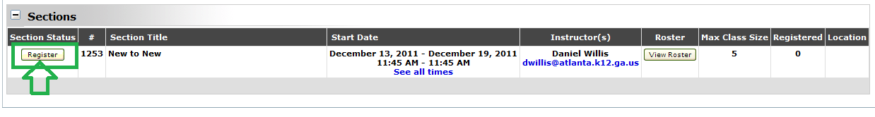
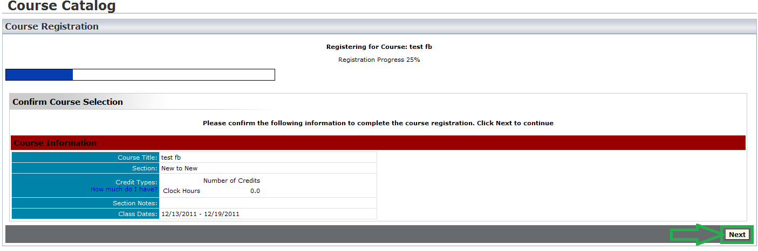
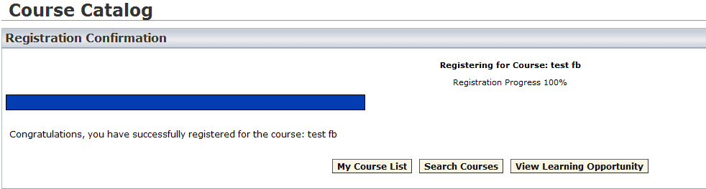
Course Registration
Instructor Led Courses
Step 1 click Register
Step 2 click Next
Registration Complete

Slide 52
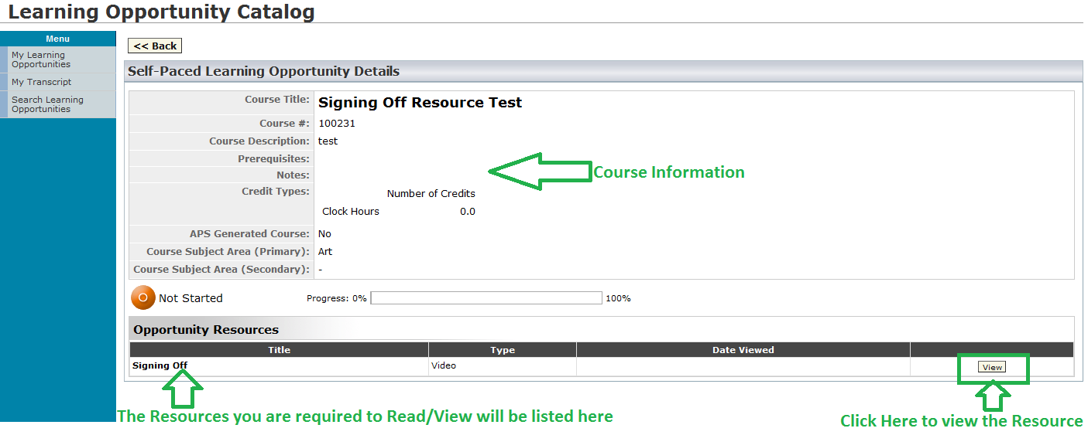
Course Registration
Self-Paced – Course

Slide 53
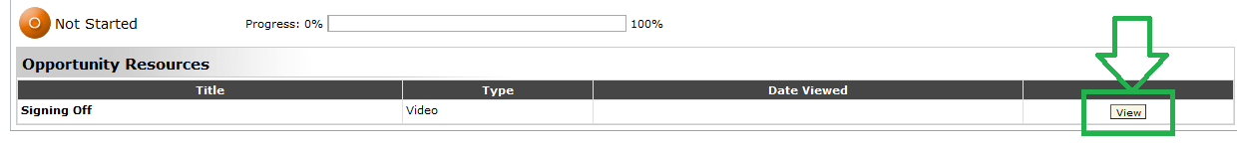
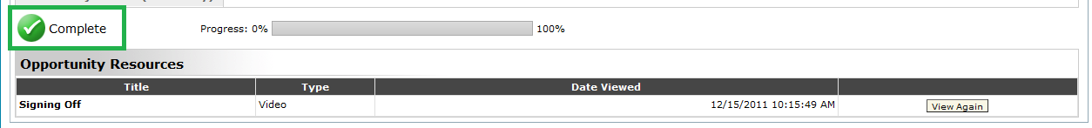
Course Registration
Self-Paced – Course
Step 1 click View
Step 2 Read/View the entire Resource
Self-Paced course is completed

Slide 54
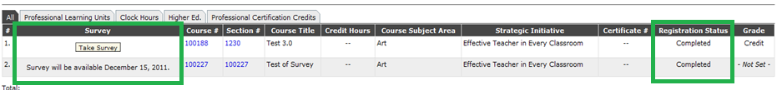
How to Receive Credit for a Course
Step 1 – For Instructor Led courses the instructor must mark you Complete. You can verify your completion status by viewing your Transcript. Once you are marked complete the course will appear on your Transcript.
Step 2 – You must complete the Course Evaluation survey. You can view the survey status on your Transcript under Survey. If the Take Survey button is available you can complete the survey, otherwise there will be a message informing you of when the survey will be available.

Slide 55
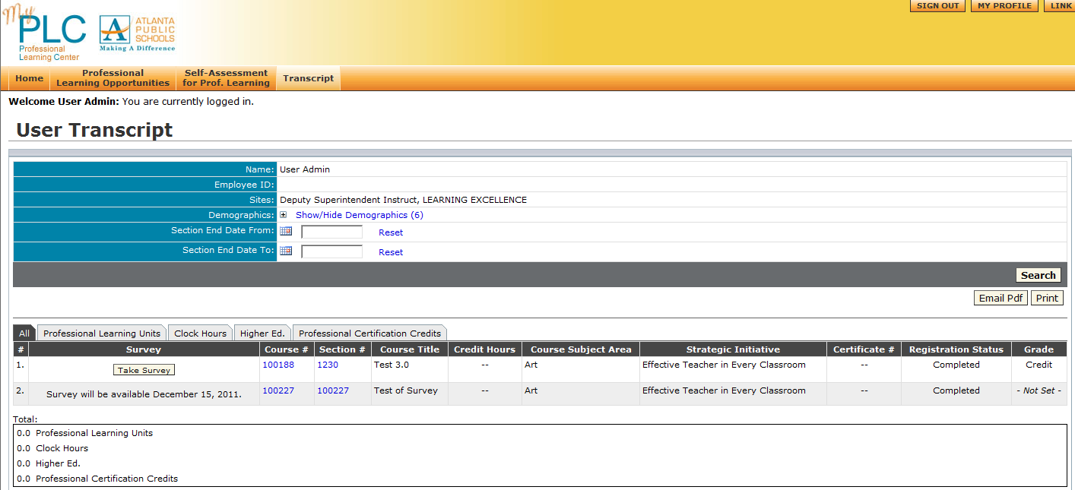
Transcript
Your Transcript Provides
Survey Status
Key Course Information
Completion Status
Credit Amount

