Slide 1

Introducing..
The Postmodern Principles of Art

Slide 2
The Postmodern Principles of Art
Appropriation
Gazing
Hybridity
Interaction of Text and Image
Juxtaposition
Layering
Recontextualization
Identity/ Representing

Slide 3

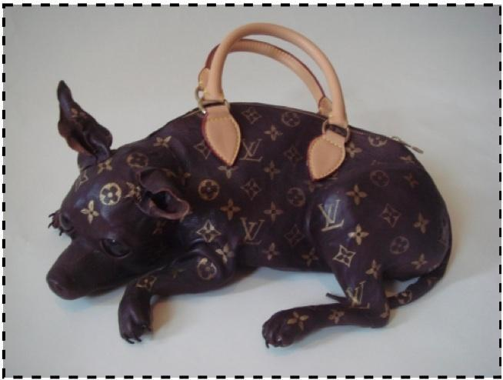
Appropriation
Appropriation – the removal of images or material from one context and its reuse in another very different context. A recycling of images, so to speak. Appropriation usually raises ideas about originality or authorship (plagiarism), or exposes
some unrecognized irony in the original. Sampling and excavation refer to similar type of borrowing practices used in creating music. Question of artist’s copyright are often a concern.
Artist: Meryl Smith
http://merylsmith.blogspot.com/

Slide 4
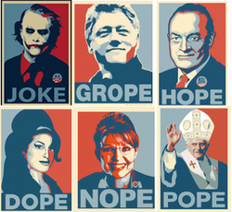
Appropriation---What has the artist appropriated or borrowed? How has the artist changed the subjects’ meaning?
Appropriation

Slide 5

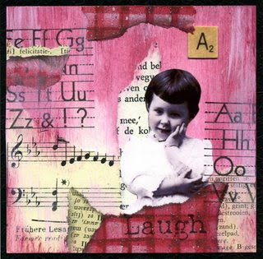
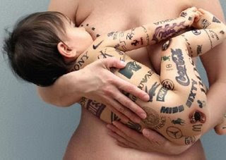
What sentiment do the below pictures convey?
Appropriation

Slide 6
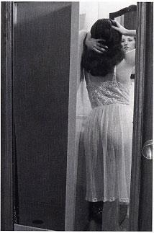
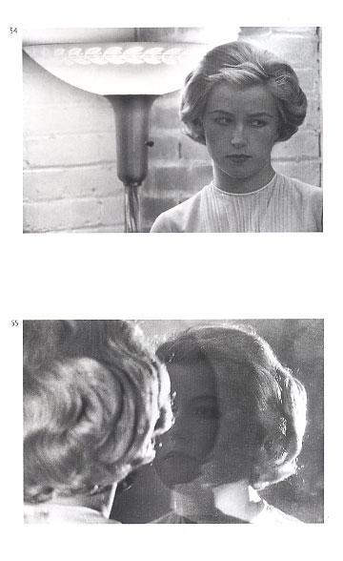
Gazing
Gazing – This is more than just mere seeing or looking with intent.
The “gaze” is frequently used to recognize that when talking about the act of
looking it is important to consider who is being looked at and who is doing
the looking. Gazing is concerned with social issues of knowledge, pleasure,
and power, and of controlling perceptions about what is “real” and “natural.”

Slide 7
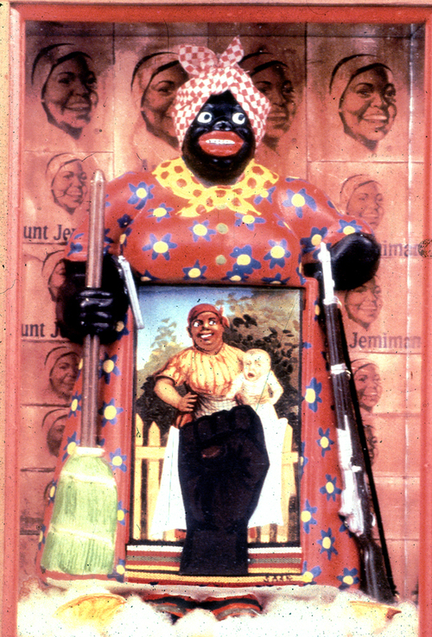
Gazing
In Betye Saar’s The Liberation of Aunt Jemima, the traditional meaning of the saccharine image is challenged when it is paired with an even more stereotypical depiction of a wide-eyed, red lipped African-American woman (holding a broom in one hand and a rifle in the other) and with a Black Power clenched fist.

Slide 8
GAZING----
“James Elkins offers ten different ways of looking at a figurative painting in a gallery (Elkins 1996, 38-9):
1.You, looking at the painting,
2. figures in the painting who look out at you,
3. figures in the painting who look at one another, and
4. figures in the painting who look at objects or stare off into space or have their eyes closed. In addition there is often
5. the museum guard, who may be looking at the back of your head, and
6. the other people in the gallery, who may be looking at you or at the painting. There are imaginary observers, too:
7. the artist, who was once looking at this painting,
8. the models for the figures in the painting, who may once have seen themselves there, and
9. all the other people who have seen the painting - the buyers, the museum officials, and so forth. And finally, there are also
10. people who have never seen the painting: they may know it only from reproductions... or from descriptions.”

Slide 9
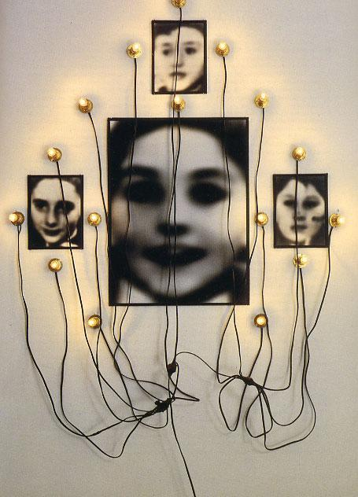
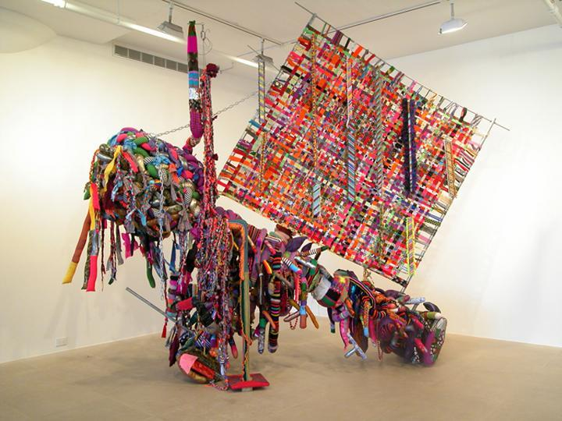
Hybridity
Hybridity – This refers to a combination or mixing of media in many
contemporary art works, i.e. video projections in a sculptural installation. The concept of hybridity also describes the cultural blending that is evident in many recent works.

Slide 10
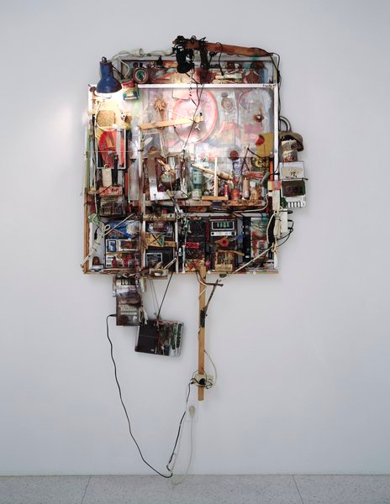
Hybridity
Combinations of still image, moving image, sound, digital media, and found objects.
Dieter Roth
Tonbild (Sound Picture)
1975-1988
oil, plexiglass, cassette players, wood; Polaroid photograph, ink on paper
overall installed 78.75 x 40.375 x inches
T. B. Walker Acquisition Fund, 1995
Copyright retained by the artist

Slide 11
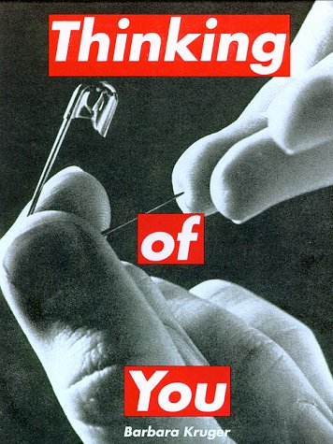
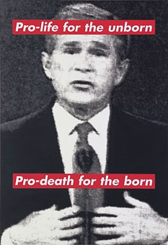
Interaction of Text and Image –
Barbara Kruger
http://www.eng.fju.edu.tw/Literary_Criticism/feminism/kruger/kruger.htm
Interaction of Text and Image – An action that creates a deliberate
disjunction between the meanings of an image and text when they are
combined. The text does not describe the image, nor does the image
illustrate the text, but their juxtaposition can generate new meanings
through association.

Slide 12
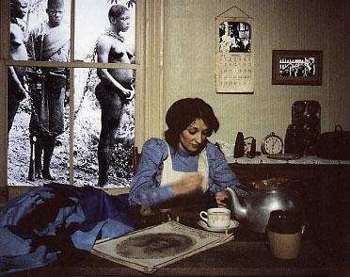
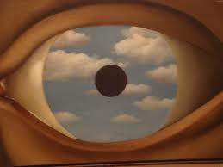
Juxtaposition –
Juxtaposition – the seemingly random placement or situating of images or objects in an art work. By juxtaposing images, artists intend that this clash causes a reaction of shock or surprise in the spectator.

Slide 13
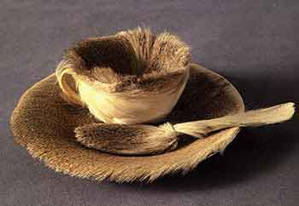
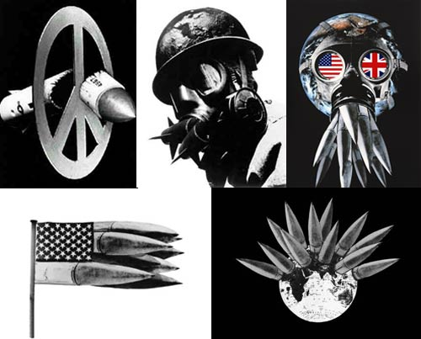
Juxtaposition
http://www.tate.org.uk/search/peter%20kennard
Object
Meret Oppenheim (Swiss, 1913–1985)
Peter Kennard

Slide 14
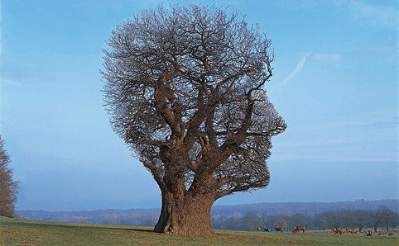
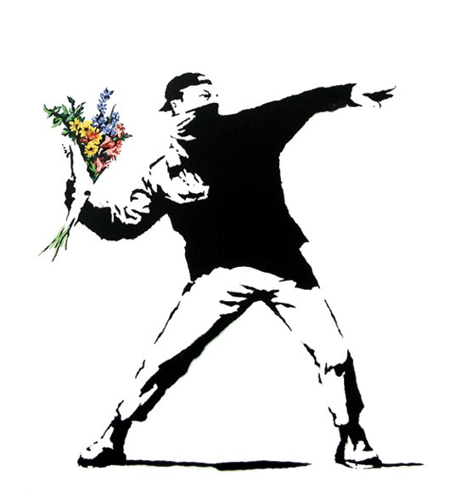
Juxtaposition
Banksy

Slide 15
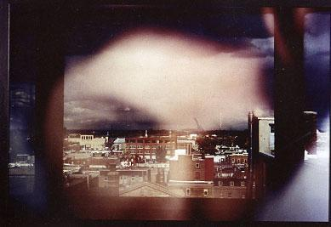
Layering
Layering – a strategy of piling images on top of one another to mirror the
complexity of the world and the unconscious mind. Multiple transparent
layers can evoke ideas of simultaneity, coincidence, and ambiguity.

Slide 16
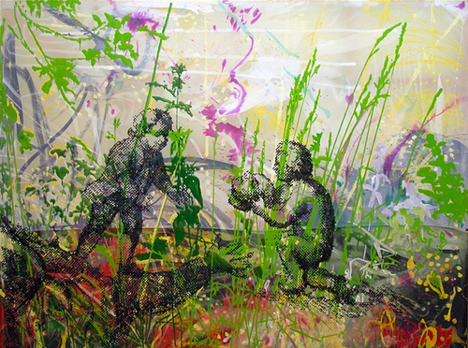
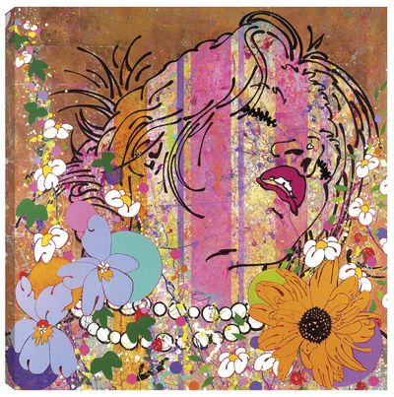
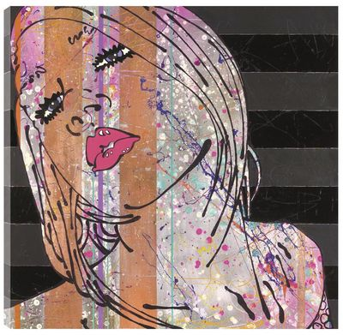
http://www.fineartblog.co.uk/?m=201007
Crush II’ by Louise Dear
Layering

Slide 17
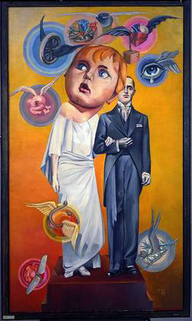
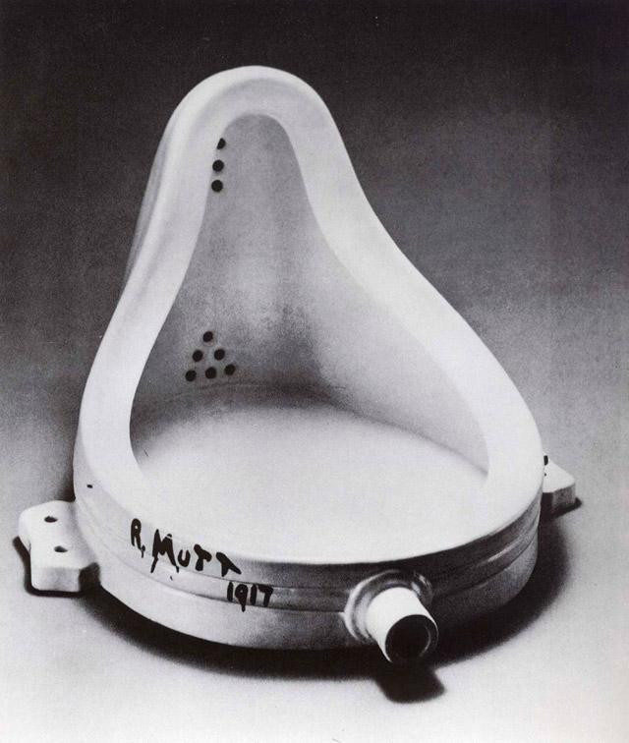
Recontextualization
– the placement of a familiar image in relation to
pictures, symbols, texts, or situations with which it is not usually associated, in
order to create new meanings.

Slide 18
Recontextualization
Hannah Hoch, one of the early Dada proponents of the new medium of photomontage created many provocative works by recombining found imagery. In Die Braut of 1927, winged objects swirl around the central image of a traditional bride and groom. The woman’s head is replaced by the oversized image of a young child’s face (Makela & Boswell, 1996). This simple visual move changes any potential romantic fantasy reading of the bridal couple, shifting focus to society’s degrading legal, religious, and cultural conventions regarding the status of women.

Slide 19
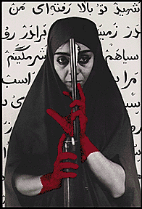
Identity (Representing)
the strategy of locating one’s artistic voice within one’s personal history and culture of origin.
Her work refers to the social, cultural and religious codes of Muslim societies and the complexity of certain oppositions, such as man and woman.
Shirin Neshat

Slide 20
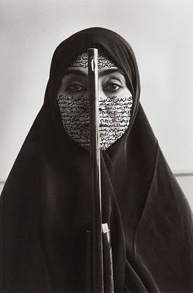
Identity (Representing)
Shirin Neshat
A common theme is that she uses sacred or well-known Iranian text written in beautiful calligraphy and paints them directly onto her subjects, in way saying what the women cannot say. Her photos are all about giving s voice to the women of Iran.

Slide 21
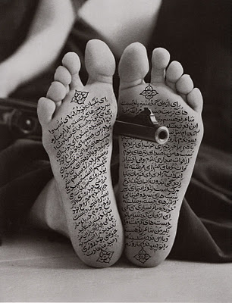
Identity (Representing)
Shirin Neshat
Neshat uses guns into a lot of her photos because she wishes to symbolize the violence in the lives of Iranian women and the pain that it causes them and their families.
Traditionally in Iran it is forbidden to bear the bottom of your feet, so writing calligraphy on exposed feet is controversial.

