Slide 1
My Professional Learning Center Registration Guide
Home Page
Course Search
Course Registration
How to receive credit
Website: atlanta.truenorthlogic.com
Agenda

Slide 2
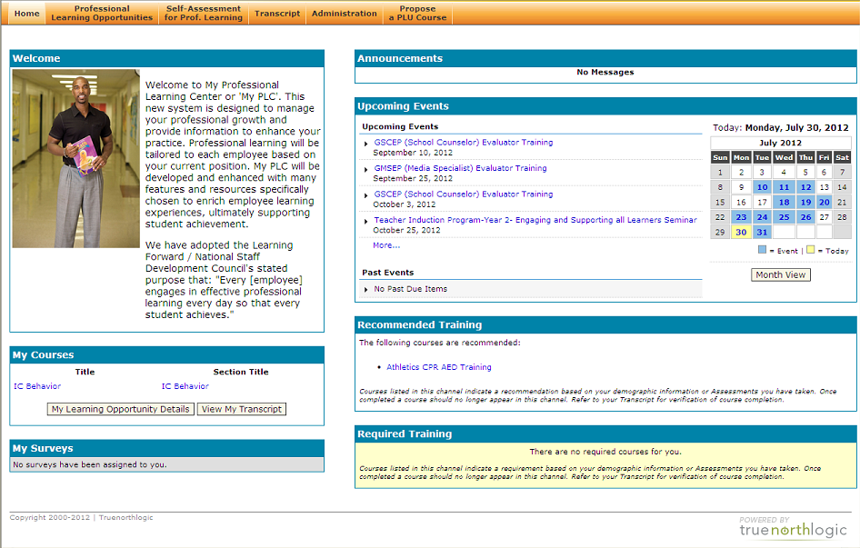
Home Page Course Notification / Reminders (1)
These are the courses you are currently Registered for.
You are required to complete a Course Evaluation survey after each course in order to receive credit. Upon completion of the course the survey will be available to you after the Section end date.

Slide 3
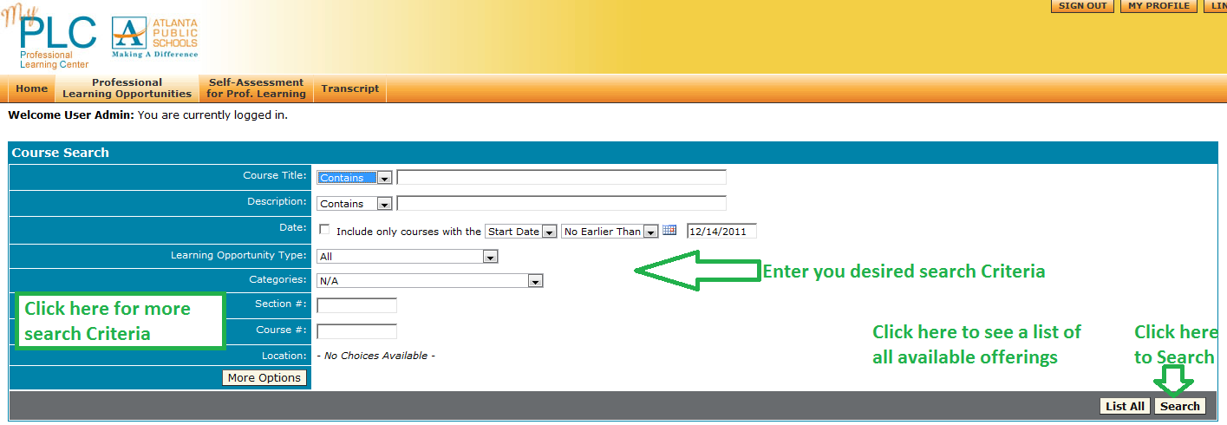
Course Search Professional Learning Opportunities
The search results available to you are based on your profile location. All courses when created are targeted to it’s appropriate audience based on location.

Slide 4
Course Search Search Results
Click the Course Title in blue to register

Slide 5
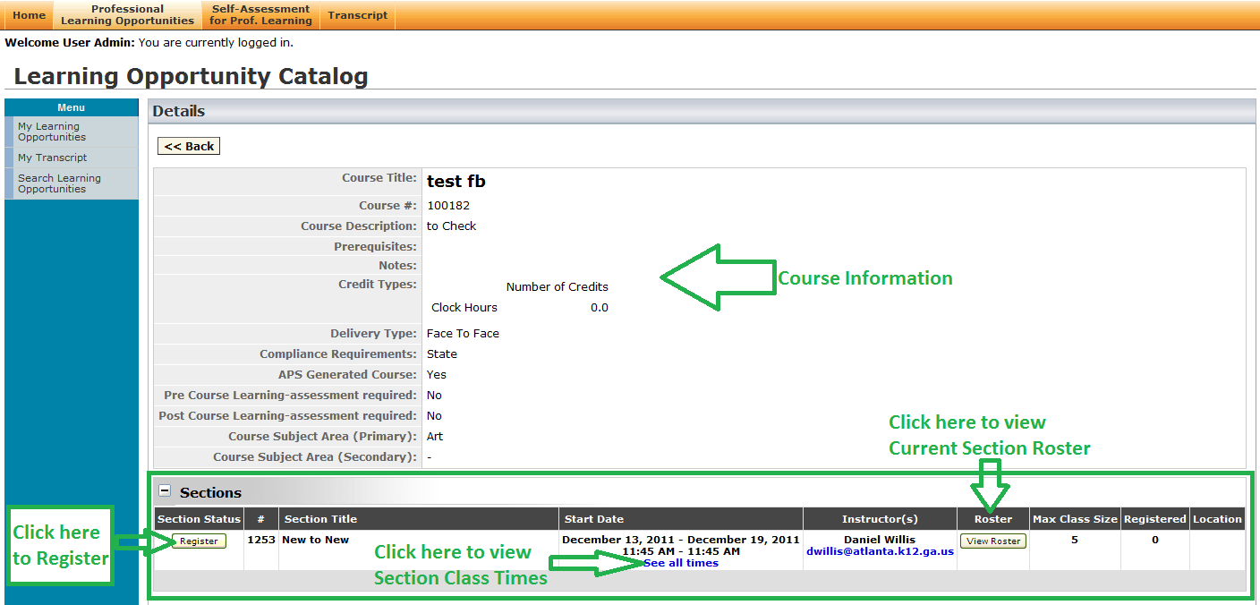
Course Registration Instructor Led Course

Slide 6
Course Registration Instructor Led Courses
Step 1 click Register
Step 2 click Next
Registration Complete

Slide 7
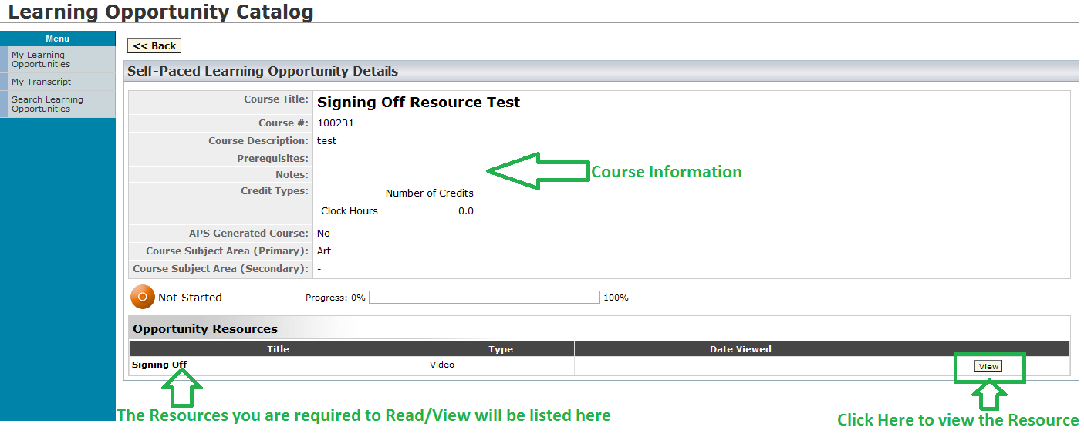
Course Registration Self-Paced – Course

Slide 8
Course Registration Self-Paced – Course
Step 1 click View
Step 2 Read/View the entire Resource
Self-Paced course is completed

Slide 9
How to Receive Credit for a Course
Step 1 – For Instructor Led courses the instructor must mark you Complete. You can verify your completion status by viewing your Transcript. Once you are marked complete the course will appear on your Transcript.
Step 2 – You must complete the Course Evaluation survey. You can view the survey status on your Transcript under Survey. If the Take Survey button is available you can complete the survey, otherwise there will be a message informing you of when the survey will be available.

Slide 10
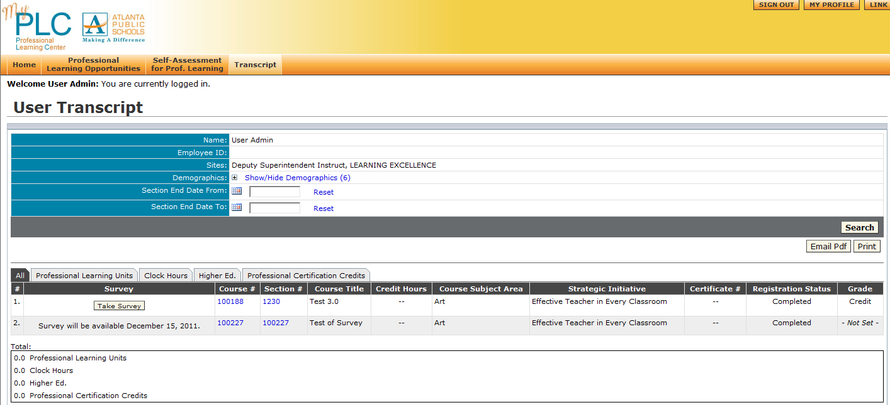
Transcript
Your Transcript Provides
Survey Status
Key Course Information
Completion Status
Credit Amount

