Slide 1
Louise Nevelson's Style of Found- Art Sculptures

Slide 2
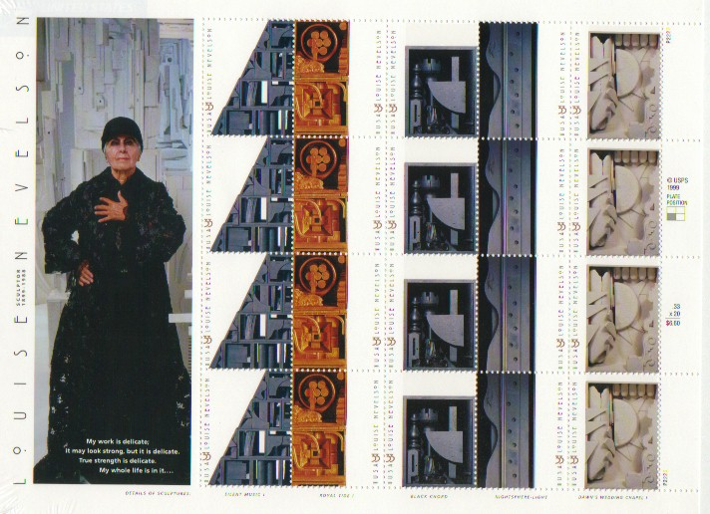
Additive Sculpture:
Additive sculpture is a process in which pieces of material are glued or joined together. As in modeling, assembled sculptures are built up.
Additive sculpture is also known as “constructing” and assemblage.

Slide 3
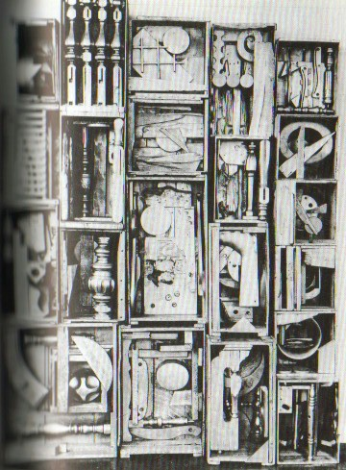
Louise Nevelson
Used assemblage to make her sculptures
This is a relief sculpture-- a type of sculpture that has forms that extend into space from a single plane.

Slide 4
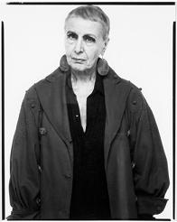
Louise Nevelson: Sculptor
“Architect of Shadows”

Slide 5
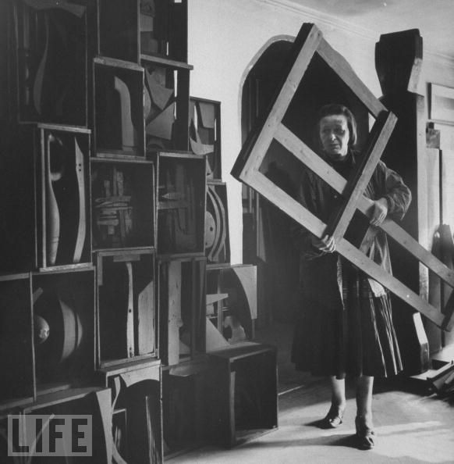

Slide 6
Louise Nevelson was a creator of wood assemblages made from found objects doused in paint. She worked hard to get recognition for her sculptures in the mostly male art world, and wished to be seen as more than just a ‘woman artist.’

Slide 7
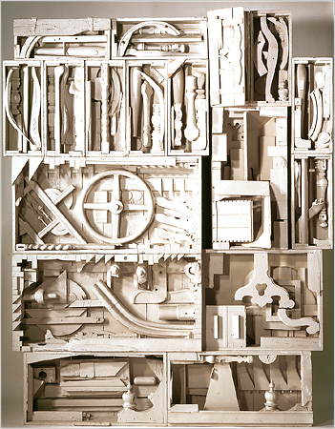
Nevelson used primarily three colors to paint her creations: black, white and gold. She stated that white represented a reflection of the universe.
See how shadows make the forms visible
"Dawn's Wedding Chapel IV," from "Dawn's Wedding Feast" (1959-60)

Slide 8
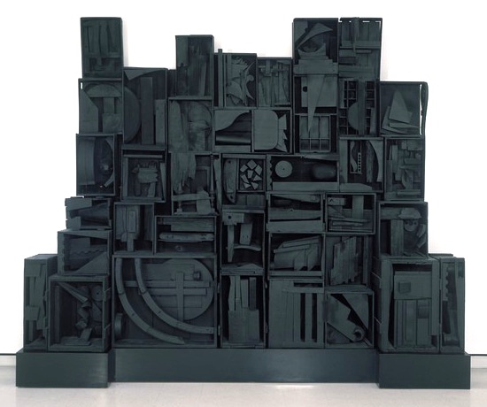

Slide 9
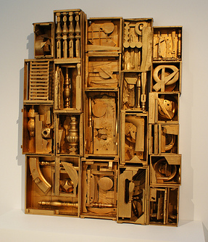
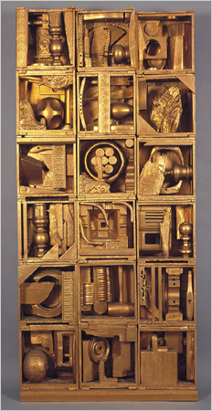
Nevelson chose to paint some creations gold to symbolize elements or representations of the sun, moon and stars.

Slide 10
Nevelson called herself "the original recycler" owing to her extensive use of discarded objects, and credited Pablo Picasso for "giving us the cube" that served as the groundwork for her cubist-style sculpture.

Slide 11
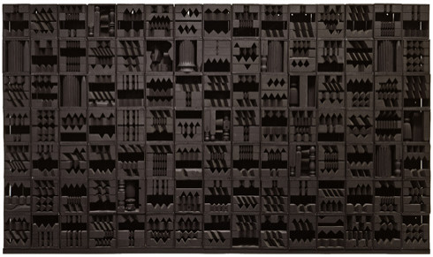
Wonderful VARIETY, PATTERN, and UNITY

Slide 12
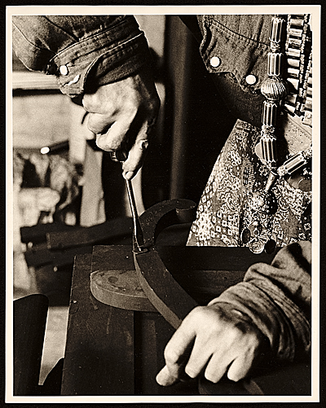
A strong artist who happened to be a woman, here are Louise Nevelson's hands at work, between 1964 and 1975,
Lewis Brown, photographer.

Slide 13
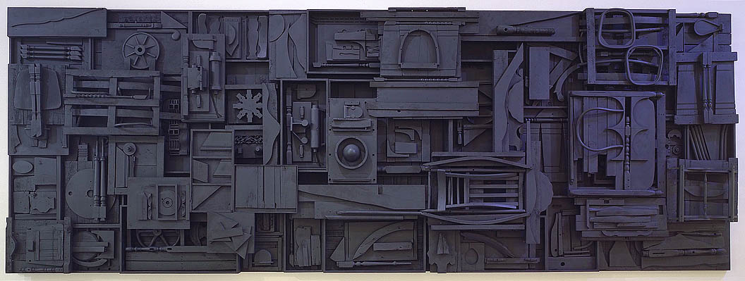

Slide 14
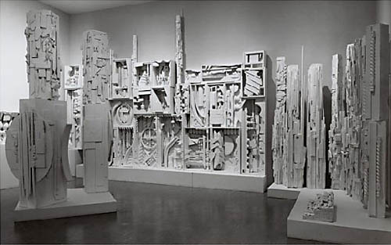

Slide 15
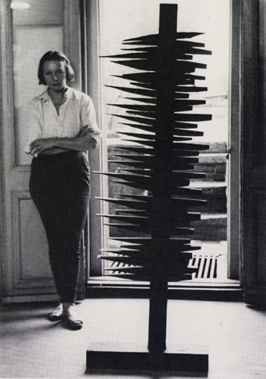
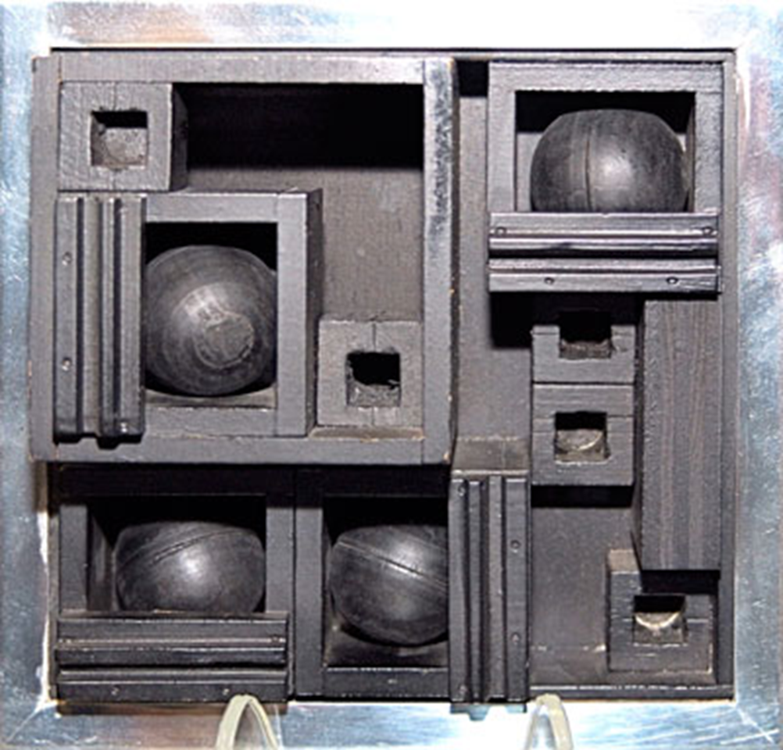

Slide 16
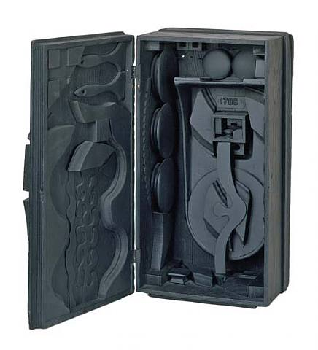

Slide 17
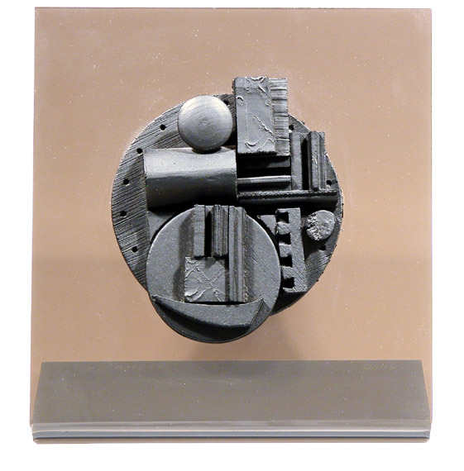

Slide 18
Your Turn…
Now, Lets try creating a Relief Sculpture in the style of Louise Nevelson, here are a few samples created by other students:

Slide 19
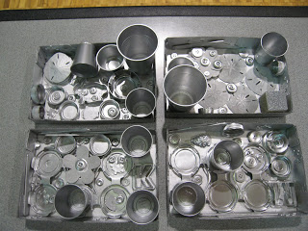
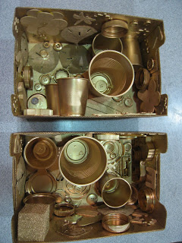

Slide 20
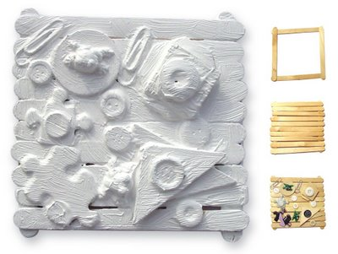

Slide 21
Louise Nevelson Art Projects
After choosing and gathering the objects, have students plan a way to use all the objects attached together to create a sculpture. Using a Board or a Box as a base or substrate then use craft glue or hot glue to join objects together. To further mimic Nevelson's style, have students spray paint the entire construction one color.

Slide 22
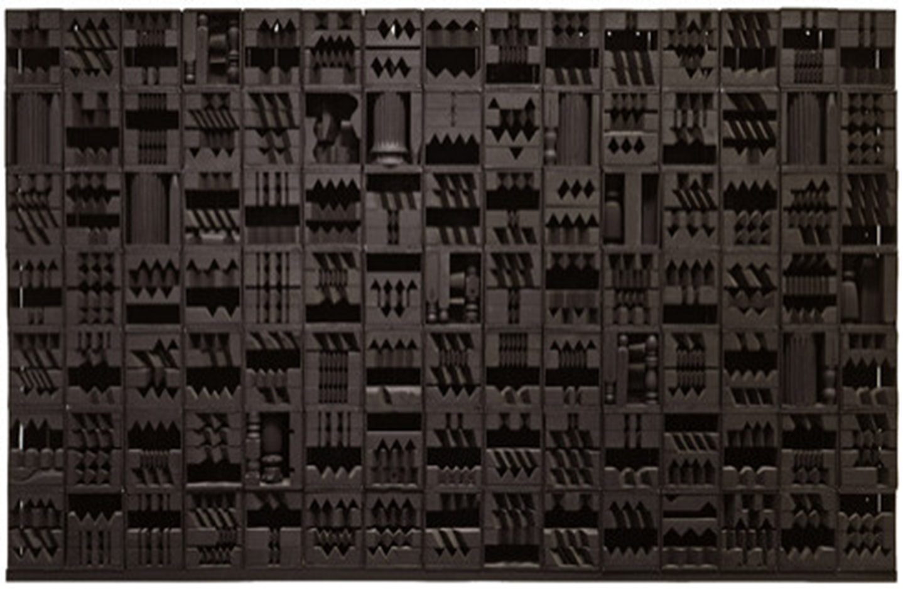
Louise Nevelson (September 23, 1899 – April 17, 1988) was an American sculptor known for her monumental, monochromatic, wooden wall pieces and outdoor sculptures. Born in Czarist Russia, she emigrated with her family to the United States in the early 20th century when she was three years old. Nevelson learned English at school, as she spoke Yiddish at home. By the early 1930s she was attending art classes at the Art Students League of New York, and in 1941 she had her first solo exhibition. She gained fame and fortune over her long life.

