Slide 1
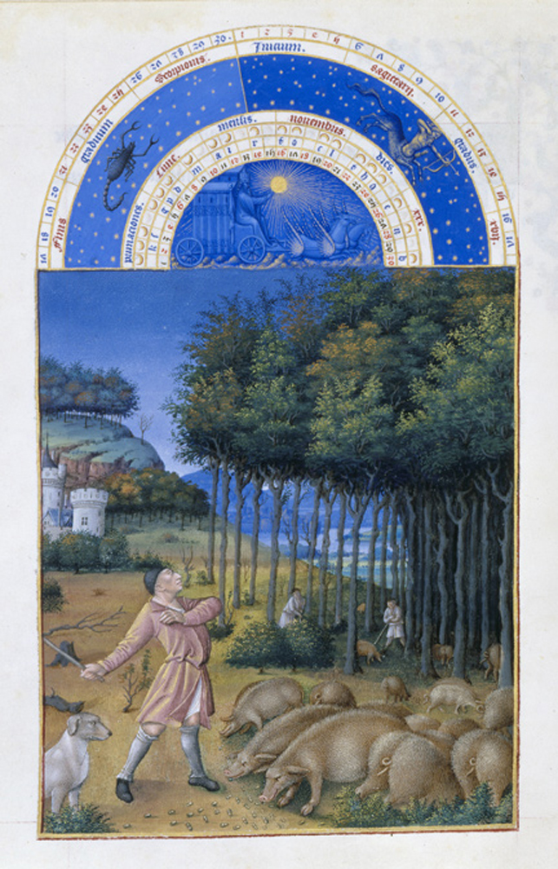
Take a minute to
Look at this picture.
What’s going on
in this picture?*
What do you
SEE that makes
you say that?
What more can
we find.
Paraphrase.
Point.
Link.
*For K-1, be more
Concrete and ask
“What do you SEE
in this picture.”

Slide 2
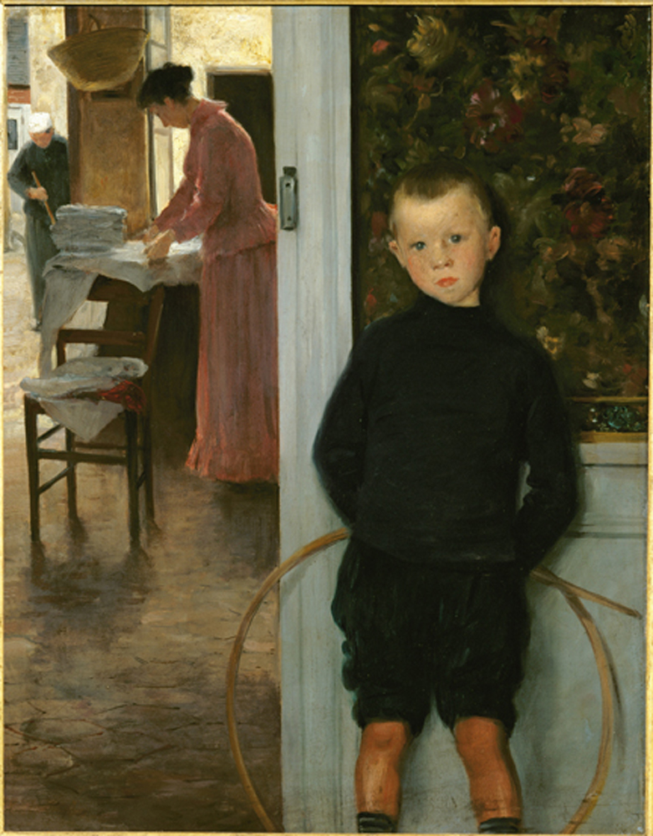
Take a minute to
Look at this picture.
What’s going on
in this picture?*
What do you
SEE that makes
you say that?
What more can
we find.
Paraphrase.
Point.
Link.
*For K-1, be more
Concrete and ask
“What do you SEE
in this picture.”

Slide 3
Lies My Parents Told Me
Folk Art Examples

Slide 4
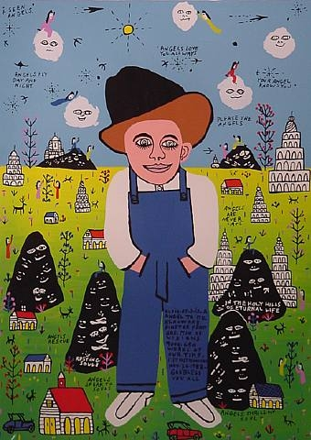

Slide 5
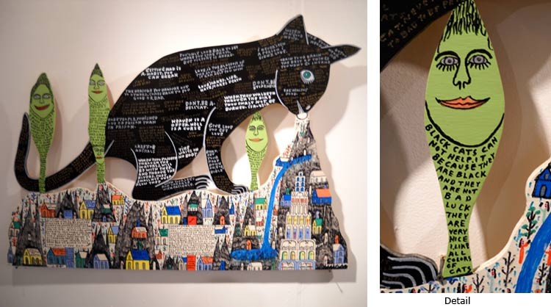

Slide 6
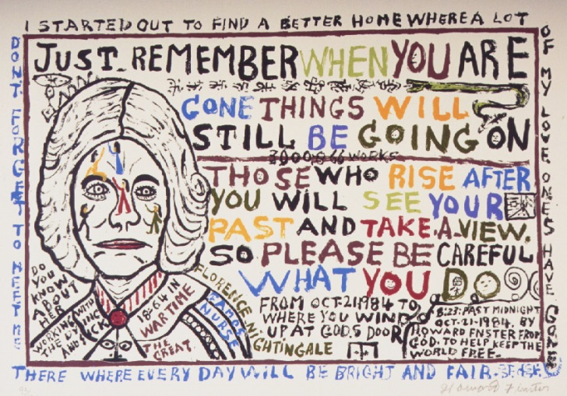

Slide 7
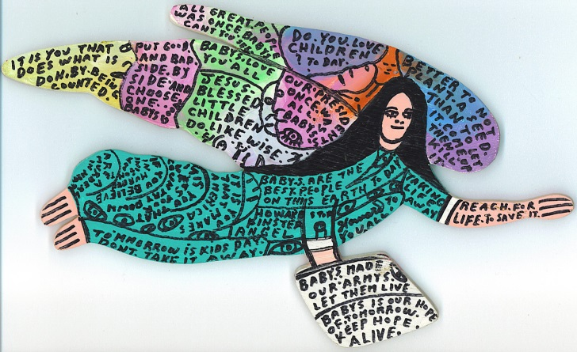

Slide 8
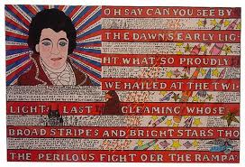

Slide 9
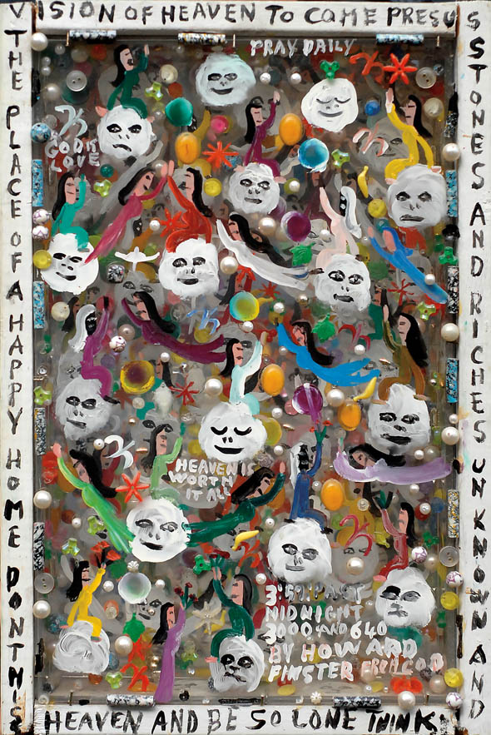

Slide 10
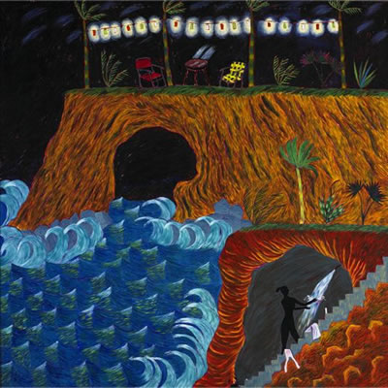
Hollis Sigler

Slide 11
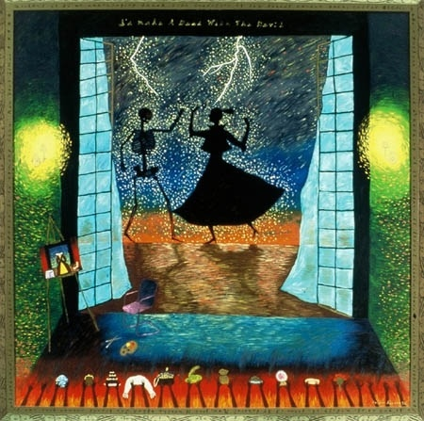

Slide 12
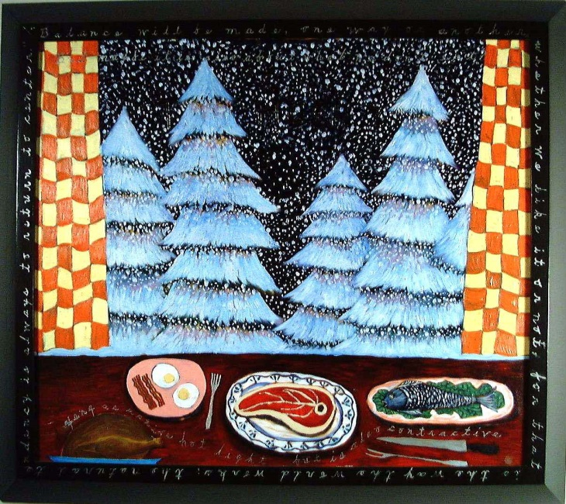

Slide 14
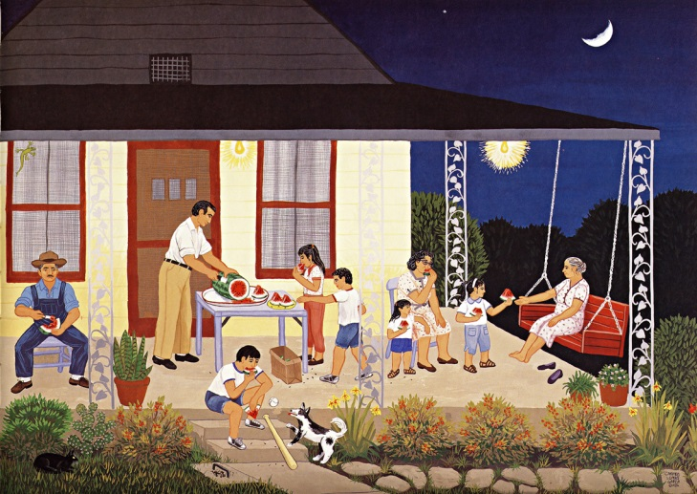
Carmen Lomas Garza

Slide 15
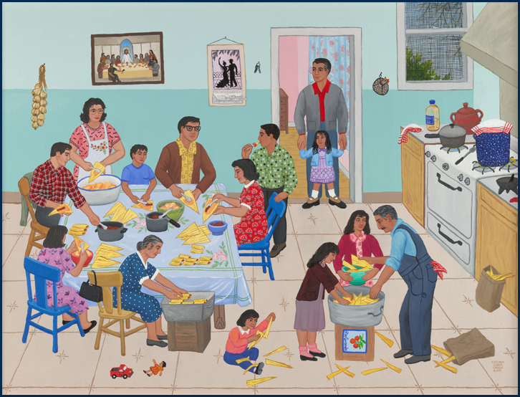

Slide 16
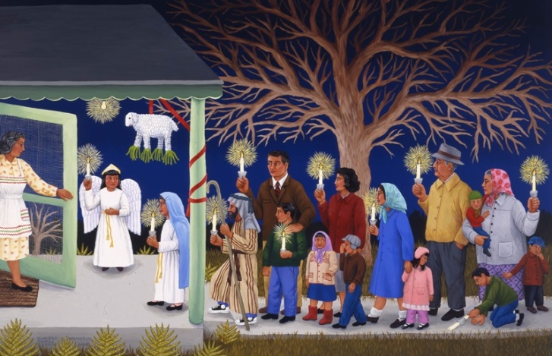

Slide 17
Alejandro Xul Solar

Slide 18
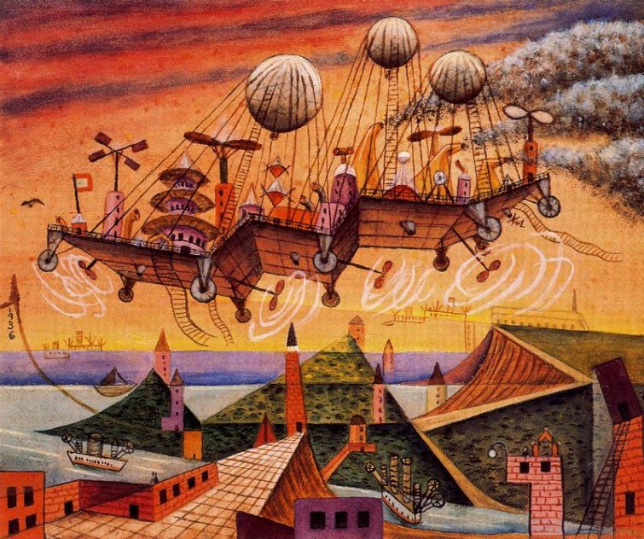

Slide 21
Idioms*, Folk Sayings, Maxims and Proverbs
A big wife and a big barn, will never do a man any harm.
A clean conscience makes a soft pillow.
A merry companion is music on a journey.
A poor excuse is better than none at all.
A wife that does not know how to keep house throws out more with a teaspoon than a man can bring in with a shovel.
A little too late is much too late.
A good deed is never lost.
A smile is worth a thousand words.
A person who gets all wrapped up in himself makes a mighty small package.
A false friend and a shadow stay only while the sun shines.
All is fair in love and war, but friendship there is truth.
A word of praise is equal to ointment on a sore.
A chain is as strong as it's weakest link.
A clock will run without watching it.
A man is judged by the company he keeps.
A good neighbor, a found treasure!
A friend to everyone is a friend to nobody.
*a group of words established by usage as having a meaning not deducible from those of the individual words (e.g., rain cats and dogs , see the light ).

Slide 22
Nothing ventured, nothing gained
Old habits die hard
The early bird gets the worm
As you make your bed, so you must lie in it
People who live in glass houses shouldn't throw stones
Too many cooks spoil the broth
Where there's a will there's a way

