Slide 1
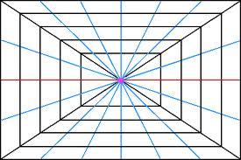
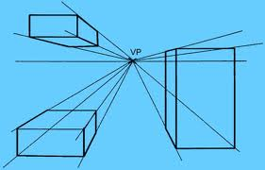
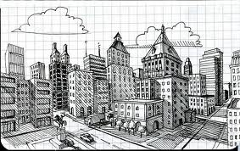
Finding Perspective

Slide 2
Vocabulary Words
Perspective – A way of making a flat artwork look as if it has depth. In a painting, an artist creates perspective by making far-away objects smaller and nearby objects larger.
Horizon Line – In an artwork, the line where the ground and sky meet.
Horizontal Line – A line that moves straight across from side to side, or left to right.
Vertical Line – A line that moves straight from up to down.
Parallel Lines - Lines that move side by side but never actually touch each other.
Perpendicular Lines – Lines that form a 90 degree angle.

Slide 4
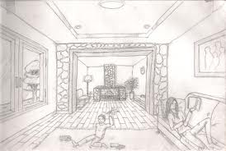
One Point Perspective

Slide 5
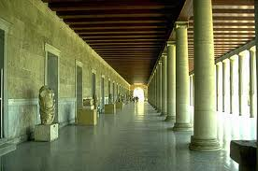
Look at the photograph below Can you find the Vanishing Point?

Slide 6
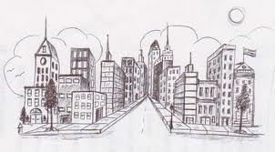
One Point Perspective – City drawing

Slide 7
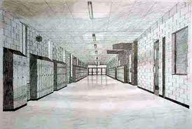
One Point Perspective – School hallway

Slide 8
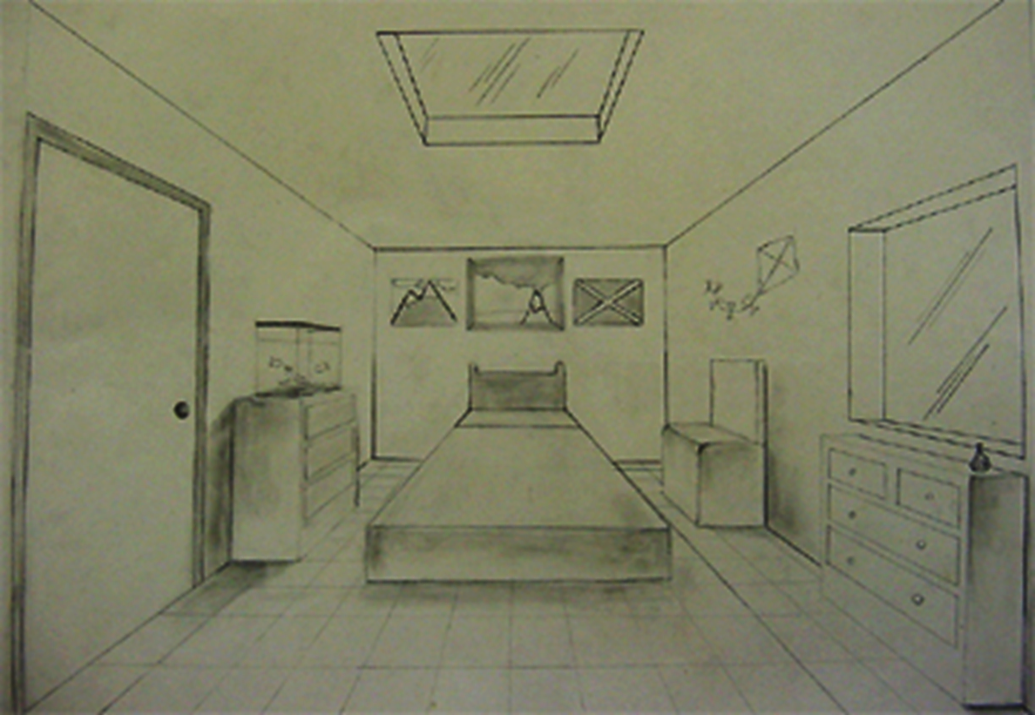

Slide 9
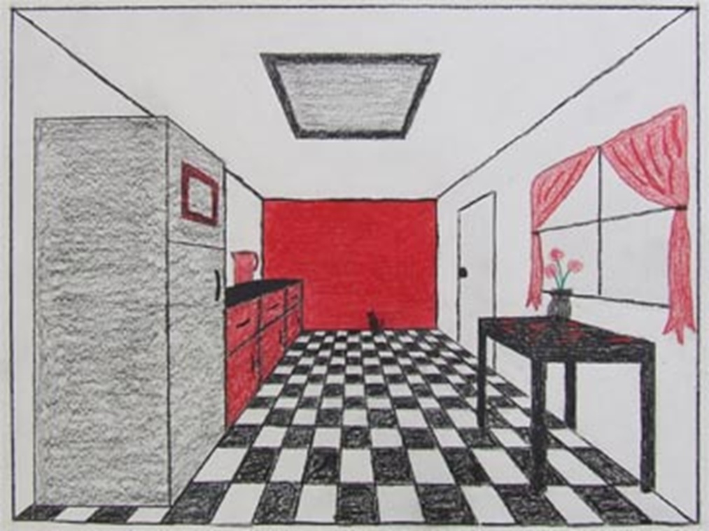

Slide 10
LET’S GET STARTED!

Slide 11
INTERACTIVE SITE
http://olejarz.com/arted/perspective/index.html

Slide 13
Two Point Perspective has two vanishing points. Can you find the vanishing points in this drawing?

Slide 14
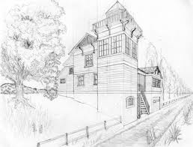
Can you find the vanishing points in this drawing?

Slide 15
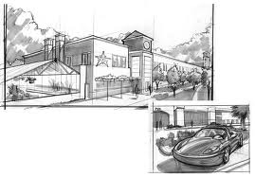
Find the vanishing points here…

Slide 16
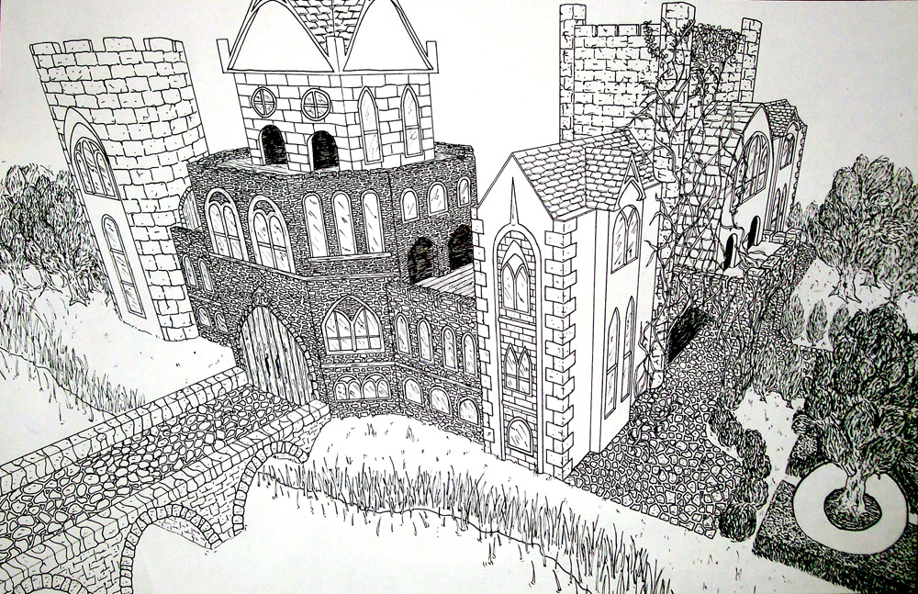
Three Point Perspective

Slide 17
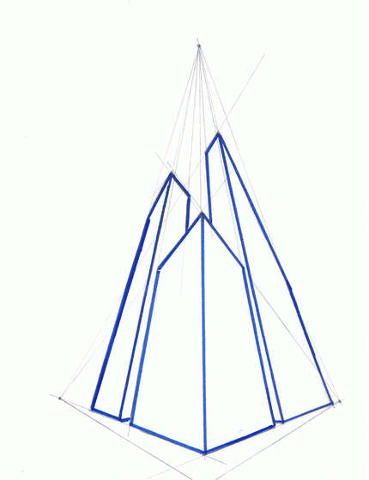
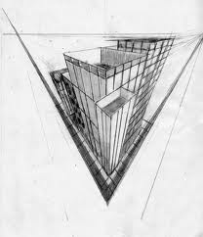
3 Point Perspective

Slide 18
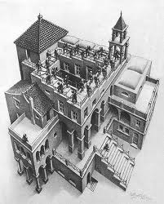
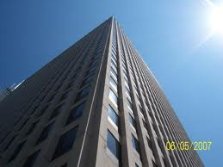
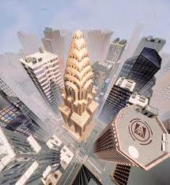
Can you find the 3 vanishing points in each image?

Slide 19
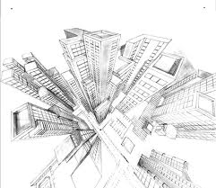
Can you find the 3 vanishing points?

