Slide 1
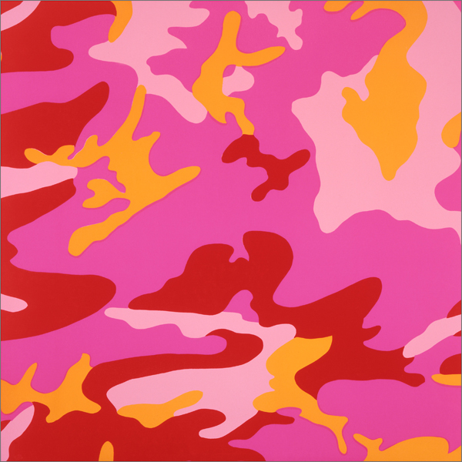
Colorific Spiral Saturday
The human eye can see about 2.5 million distinct colors!

Slide 2
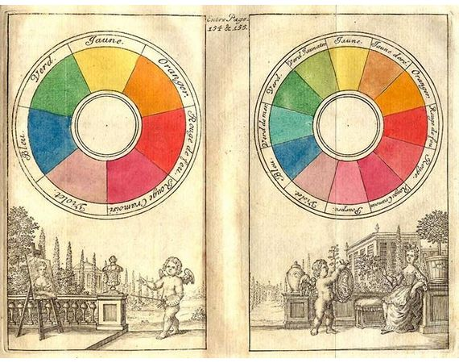
Why is color theory important?
Traité de la peinture en mignature, 1708, The Hague, reproduced in The Creation of Color in Eighteenth-Century Europe
Color theory has given western artists insight into their craft for centuries. During the Renaissance and throughout 17th and 18th century, the fundamentals of color theory helped artists skillfully render the observable world. However, as the era of Modern Art emerged, artists began to use color theory to diverge from reality, mine their emotions and experiment with visual perception.

Slide 3
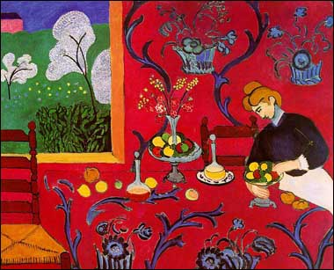
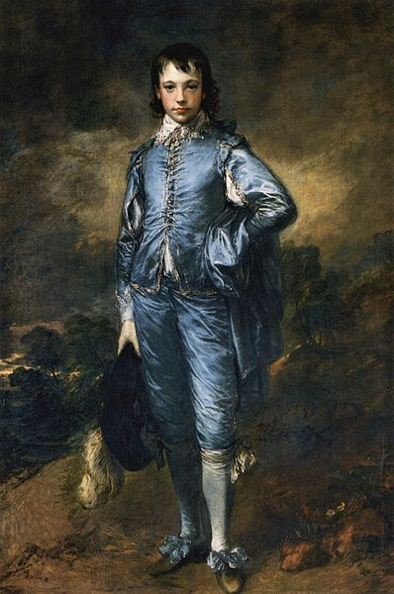
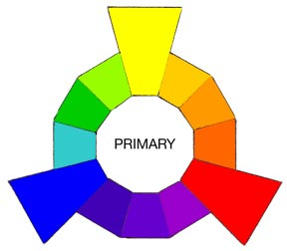
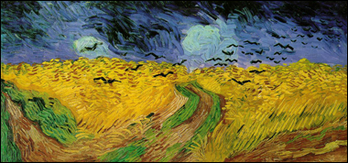
Primary Colors
A primary color is a “root” color that can be mixed with to make secondary and tertiary colors but cannot itself be made by mixing. On the painter’s color wheel they are:
Red Yellow Blue
Henri Matisse (French, 1869 -1954)
The Dessert Harmony in Red, 1908
Thomas Gainsborough (English, 1727 -1788)
Blue Boy, 1770
Vincent van Gogh (Dutch, 1853 -1890)
Wheat Field Under Threatening Skies, 1890

Slide 4
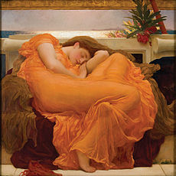
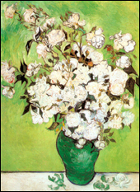
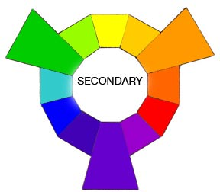
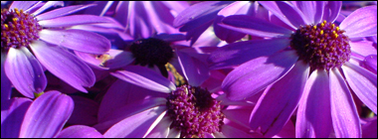
Secondary Colors
A secondary color is a color made by mixing two primary colors in a given color space. On a painter’s Color wheel they are:
Orange Green Violet
Sir Frederic Leighton (English, 1830 -1896)
Flaming June, 1895
Vincent van Gogh (Dutch, 1853 -1890)
Vase of Roses, 1895

Slide 5
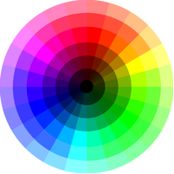
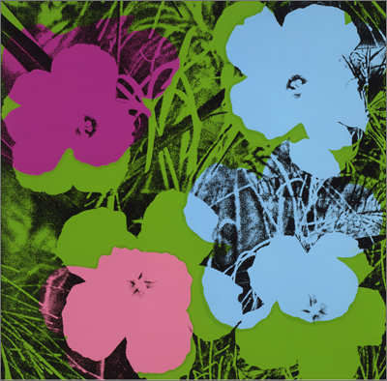
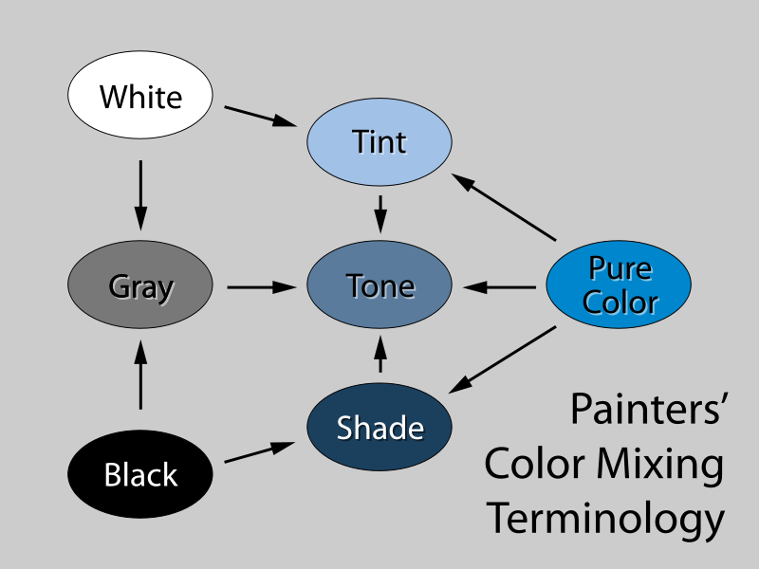
Tint and Shade
Andy Warhol (American, 1928-1987)
Flowers, 1970
Some Shades of blue.

Slide 6
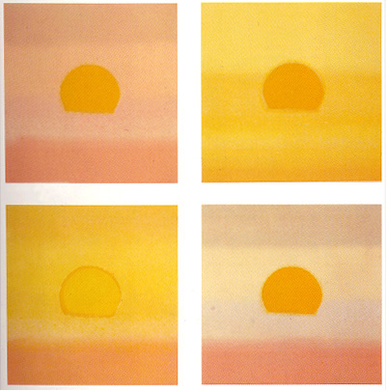
Monochromatic
Uses shades or tints from the same hue
Andy Warhol (American, 1928-1987)
Sunset, 1972

Slide 7
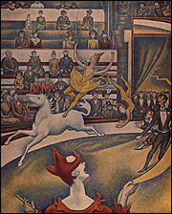
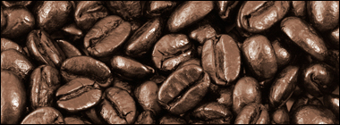
Neutral Colors
Neutral colors or earth tones are not seen on most color wheels. Black, gray, whites are neutral. Browns, beiges and tans are sometimes neutral too. Neutral colors can be made by mixing:
Black and white
Complementary colors
All three primaries together
Georges Seurat (French, 1859-1891)
Circus, 1891

Slide 8
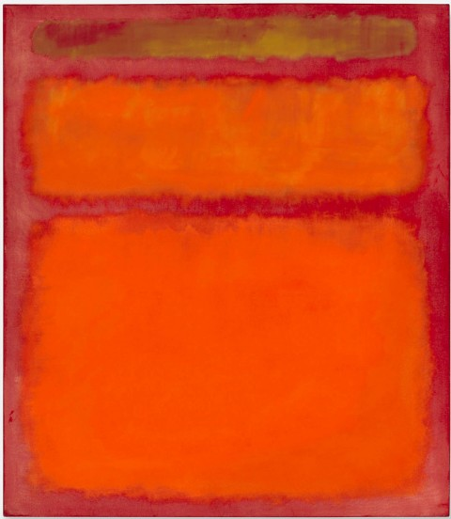
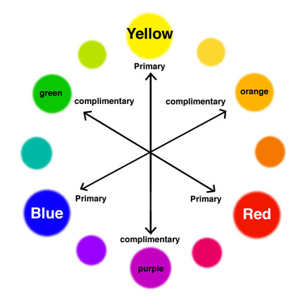
Analogous
Any three colors which are side by side on a 12 part color wheel, such as yellow-green, yellow, and yellow-orange. Usually one of the three colors predominates.
Mark Rothko (Russian -American, 1903 - 1970)
Orange, Red Yellow, 1961
Andy Warhol
(American, 1928-1987)
Camouflage, 1987

Slide 9
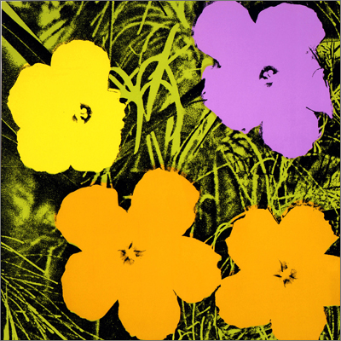
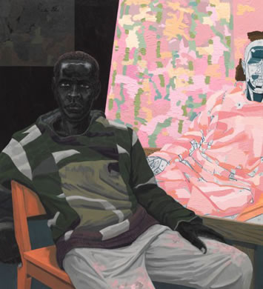
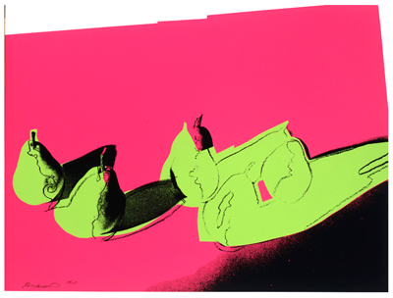
Complementary
Two colors that are the direct opposite of each other, such as red and green and blue-purple and yellow-orange. Complementary colors create the most contrast and balance in design.
Andy Warhol (American, 1928-1987) Flowers, 1970,
Space Fruit: Still Lives (Pears), 1979
Kerry James Marshall (American, 1955 – present) Untitled (Painter) 2010

Slide 10
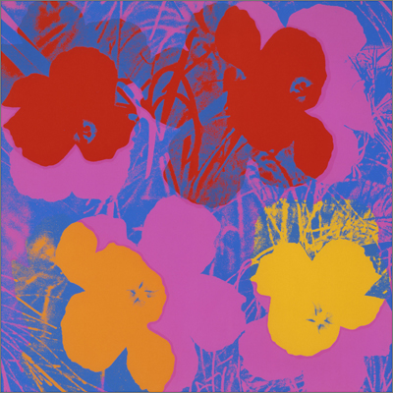
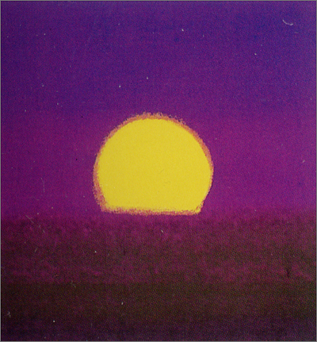
Analogous with Complementary emphasis
Andy Warhol
(American, 1928-1987)
Flowers, 1970
Andy Warhol
(American, 1928-1987)
Sunset, 1972

Slide 11
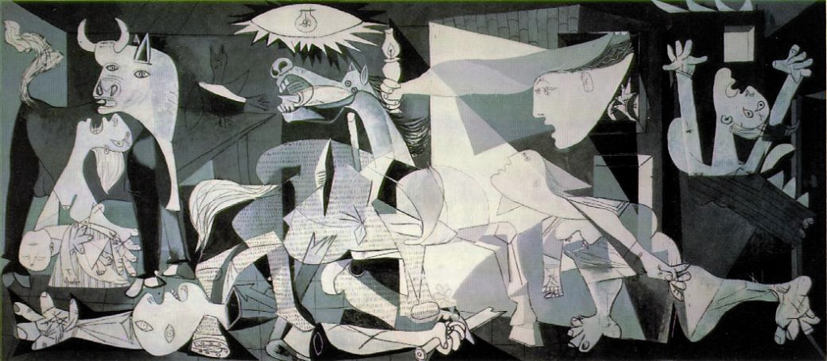
Value: the lightness or darkness of a color. Value is especially important in works of art when color is absent.
Pablo Picasso (Spaniard, 1881 -1973) Guernica, 1937

Slide 12
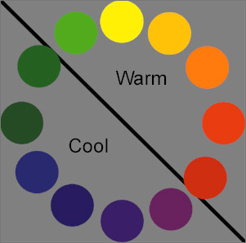
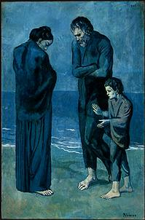
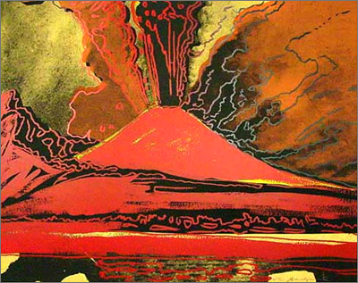
Temperature
Color temperature can help enhance the mood of an image.
Pablo Picasso (Spaniard, 1881 -1973) The Tragedy, 1903
Andy Warhol (American, 1928-1987) Vesuvius, 1985

Slide 13
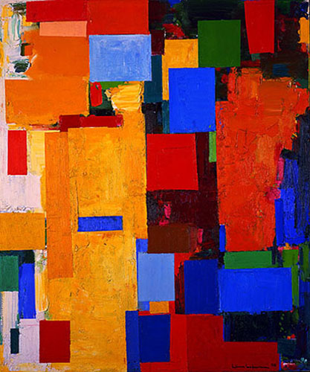
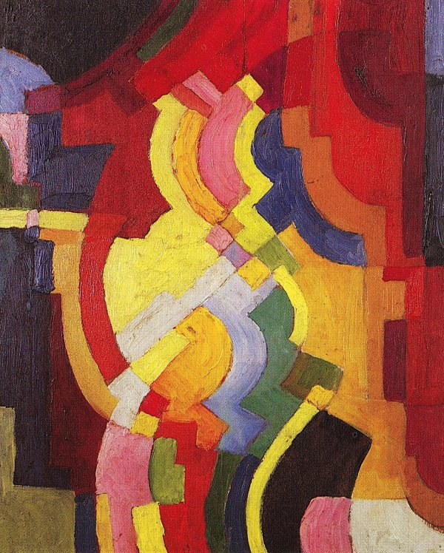
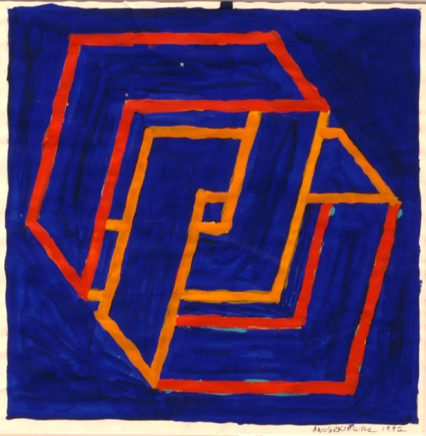
Color is the Subject!
Hans Hofmann (German - American, 1880-1966)
Equinox, 1958
Richard Anuszkiewicz
(American, 1930 - present)
Marriage of Reds and Oranges, 1992
August Macke (German, 1887-1914) Farbige Formen III 1913

Slide 14
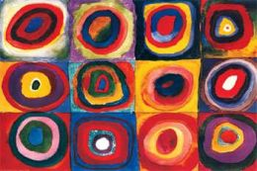
Wassily Kandinsky (Russian, 1866-1944)
Colour Studies: Squares and Concentric Circles, 1925
Play the video: Musicolor Kandinsky
http://www.youtube.com/watch?v=7d63qohWJ-o&feature=related

