Slide 1
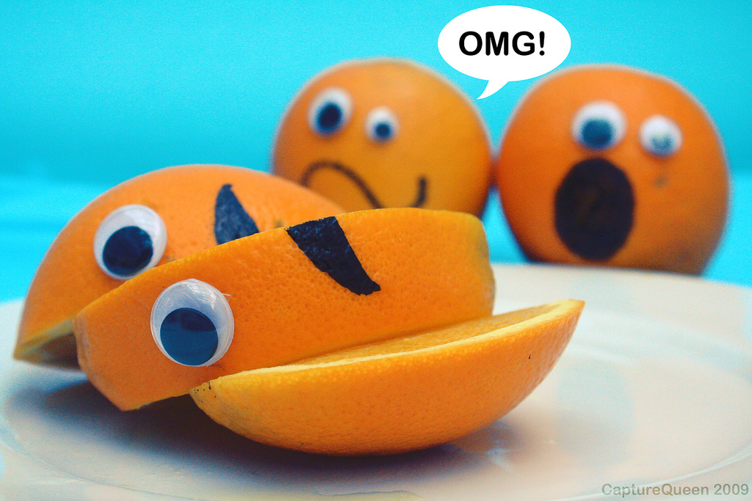
Creativity, Innovation and Design Raymond Veon

Slide 2
Surfing the information wave…
Notes:
This is not your father’s knowledge…a different paradigm of what it means to be educated.
Knowledge not about a list of stable facts
Knowledge is dynamic and changing
Today’s culture not just about internet
It’s about a transformation of values
Access to tools and information never before seen
Who are we in this?
What forms of thinking can best prepare designers to gain from and contribute to our evolving world

Slide 3
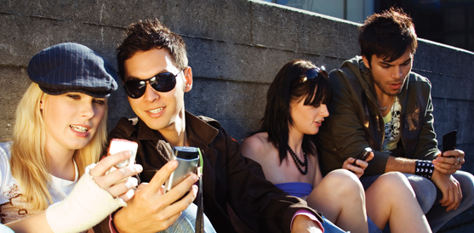
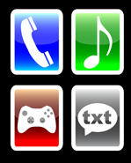
The Millennials
Notes:
Millenials are the current generation of students. They were born between and 1980 and 2000 into a world of CDs, cable television, Microsoft, personal computers, and they have grown up with email and computers that fit in their backpacks (Beloit College). Over 60% of all teens have posted a profile to a social networking website, and over half have posted a picture of themselves to the web (Lenhart, 2). Their media consumption is fundamentally different than that of previous generations; this has shaped their information seeking behaviors and how they learn. Are we prepared to help this generation learn how to navigate the current mediascape? This website contains compilations, resources, and ideas for teaching this newest generation.
This Internet experience has led students to have an “ATM attitude” towards research; they want it to be quick and easy. This expectation leads students to feel comfortable with a “compromise on quality in favor of low costs (in terms of time and effort) and convenience” (Gardner and Eng 8). Most problematic, and useful to keep in mind, is that Millennials believe they are research experts since they have such positive web experiences. Since they have a lifetime of experience searching the Internet, they may overestimate their ability to search, find, and evaluate information (Manuel 4).
The Millennial generation comes to the classroom with different technological experiences, a vast background in using the Internet, and expectations of achievement. They grew up in an environment filled with television, video games, computers, and sophisticated multimedia experiences (Manuel 7; Kipnis and Childs 3). This background has created a preference for holistic processing and nonlinear modes of instruction in which students would rather see the entire picture, and then learn details, concepts, and procedures (Manuel 8).
This multimedia background also has implications for reading versus seeing. Average students retain ten percent of what they read, but twenty to thirty percent of what they see (Manuel 6). Millennial students also do much of their reading on a computer screen, which is quite different from books. Links stand out as important and draw readers away from the topic at hand (Manuel 7). Students read bits and pieces of information as they come across them, without reading for context.
Finally, the professional literature indicates that Millennial students trust their peers and prefer to work with them in the learning process. Students may prefer approaching a peer to a librarian and may distrust authority figures like librarians and teachers (Gardner and Eng 9; Kipnis and Childs 6). A recent OCLC report shows that 67% of percent of college students learn about electronic information sources from friends, compared to 33% from librarians (DeRosa et al. 38). Providing opportunities for group work and problem solving allows for students to learn from others who share their values and are people they respect (Kipnis and Childs 6).
Millennial students tend to be motivated, ambitious, and high achievers (Gardner and Eng 3). They grew up with parents who taught them that they need to do a lot early in life in order to be successful later. This childhood period has been called “apprentice adulthood” by some (Merritt 5). A busy childhood means students begin college with credit hours, they expect value-added classes, and they expect that college will lead to graduate school or a job (Merritt 9). Students also expect personal support for their achievement. Millennials are used to parents doing a lot for them, and they anticipate other adults will help them through their education
The Millennials' expectation that achievements are important, and need to pay off with employability after they graduate, means that education needs to be focused on applicable skills that will help them meet their goals.
****Richardson proposes that today’s students need to become “literate” in editing, publishing, collaboration, and management of consumption (Richardson 126-127).
This experience has created high expectations for technology use in education. If teaching occurs in one channel, they are likely to be bored and uninterested. As their world is heavily shaped by technology, they expect integrated information technology into their classrooms and educational experiences (Merritt 9). Students are often so experienced with technology that they feel more advanced than their teachers and are unimpressed with the use of technology in the classroom (Gardner and Eng 7). Students who have been whizzing around their desktops may lose respect for a teacher who has trouble toggling between a PowerPoint presentation and websites. If they are experts at shortcuts and see the instructor has to take the long way to do something, they may feel that the instructor has nothing to teach them.
Students searching the Internet often see parts of the whole and read sections out of context; it’s rare they deal with an entire website, journal, or book (Gardner and Eng 6). Millennials experience “knowledge fragmentation” in which information is considered equally valid, whether it is thought of in context or not (Brower 7).
In one study of Millennials, all respondents said that the “huge increase in information sources that has come with the development of the Web” hasn’t affected their ability to judge the quality of information. 93% believed that since many people use the Internet, misinformation would likely be detected, and most thought they were “expert at searching the Web” (Manuel 4). A recent OCLC report stated that 93% of respondents “agree Google provides worthwhile information.” A 2000 survey of a basic information literacy course showed that 90% of students thought they were expert at searching the web, 63% thought efficient research starts with the web, and 28% believed that a “Central Internet Authority” checked websites for accuracy (Manuel 5).

Slide 4
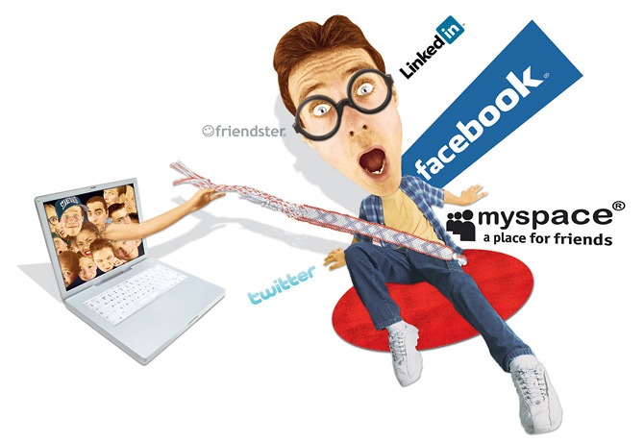
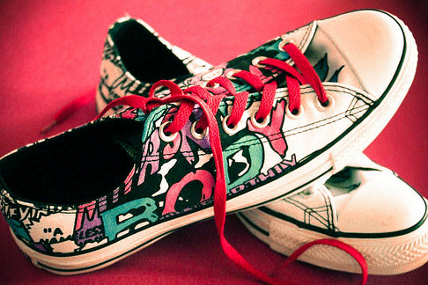
Does a traditional E&P based curriculum empower today’s students?
How relevant is art as self-expression?
Notes:
Students today are fully capable of expressing who they are without the E&P because they are in an unparalleled social and virtual network that allows them to manipulate their identities with the click of a button (friending)
Students today have many, many options for self-expression Twitter, Facebook, apps that can be personalized, etc.
Tools provided by technology might make the traditional idea of artistic self-expression less relevant in the overall lives of students.
It mean our approach to delivering art instruction should show students a means of not just articulating who they are (which young people can now do all day every day on their I Phones, etc) but of acquiring new perspectives and developing alternate systems of expression from which they grow into something more.
At the same time America has tilted toward teaching to the so-called basics—discrete bits of disconnected and isolated facts that can be quantitatively measured on standardized tests—a phenomenon that corresponds to the shift in American business to the Japanese model of efficiency and quantifying on-task employee behavior to identify ways of improving efficiency

Slide 5
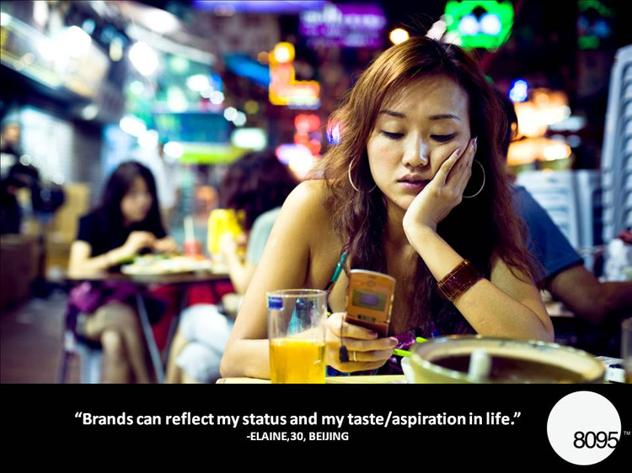

Slide 7
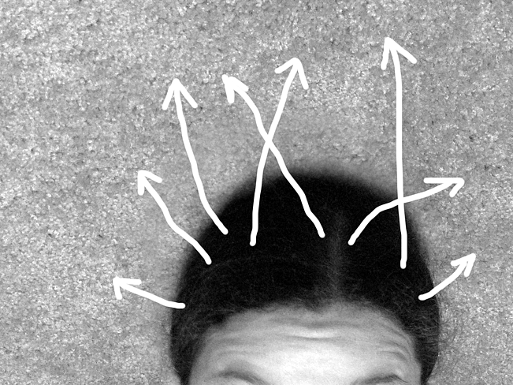
Creativity: An Overview
Creativity: An Overview
Term first applied to “man” (literally) during the Renaissance
USA: Mark of distinction in a meritocracy
Creativity as Self-Expression
Response to educational conformity of the 1800’s
Arose c. 1920’s
Embraced by the middle class
Build on child’s innate nature not suppress it

Slide 8
Creativity as Self Expression
Influences (c.1900-1950’s):
Reaction against uniformity and conformity of 19th cent. education
Freudian ideas about expression
Expressionism in Modern Art
Rise of artist as a cultural hero
Child as artist
Creative expression linked to psychological health
Notes:
Milbrandts: Creativity as Self Expression; Domain Change Creativity; Creativity as Problem Solving
In classroom, students view their art production as meaningful representations of their personal experiences

Slide 9
Domain Change Creativity
Mastery of basic skills prior to more creative activity

Slide 10
Creativity as Problem Solving
Problem finding, brainstorming, multiple solutions, iterative process

Slide 11
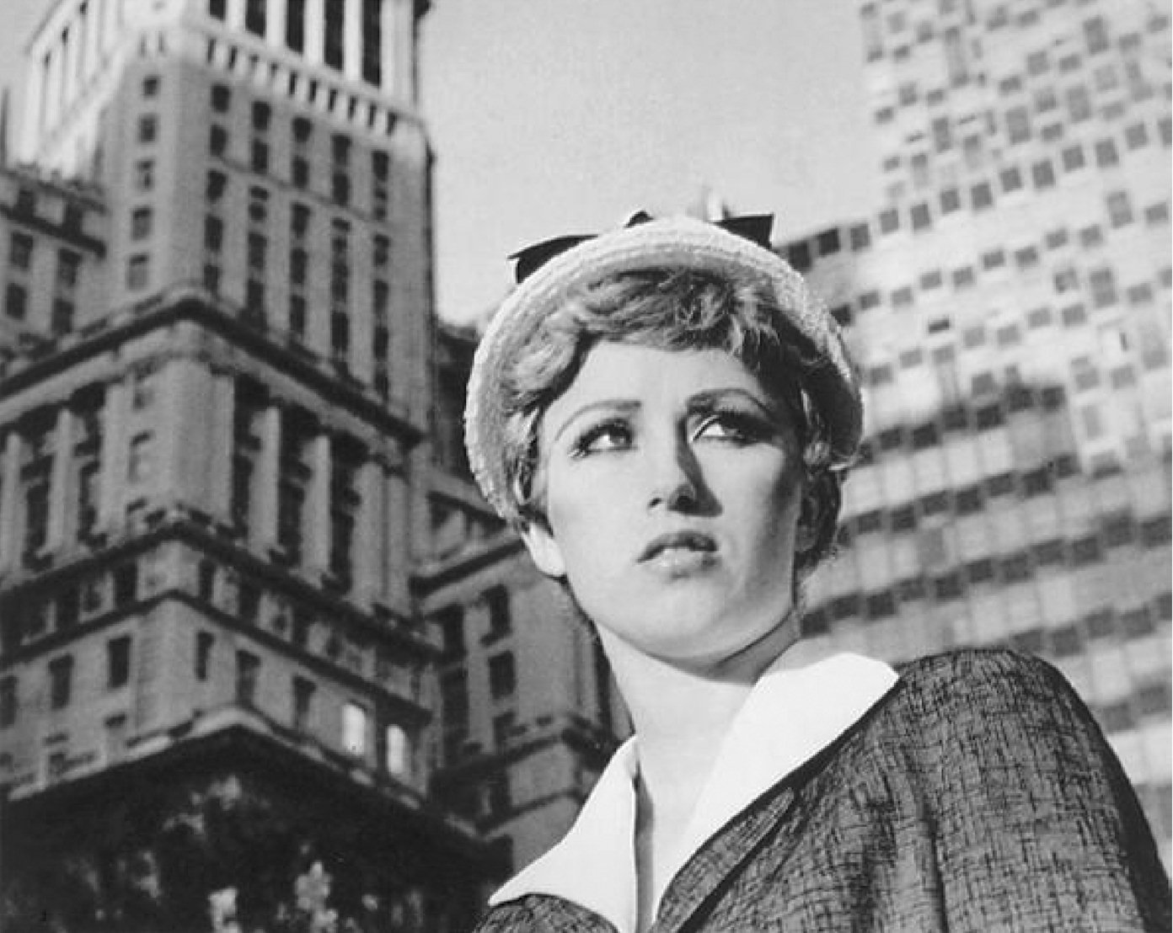
Postmodern Reassessment
Postmodern Reassessment of Creativity
Creativity involves critical reflection
Creativity depends on personal interest
Creativity is a process of learning
Creativity must be useful
Even if it is just useful for yourself
Kerry Friedman

Slide 12
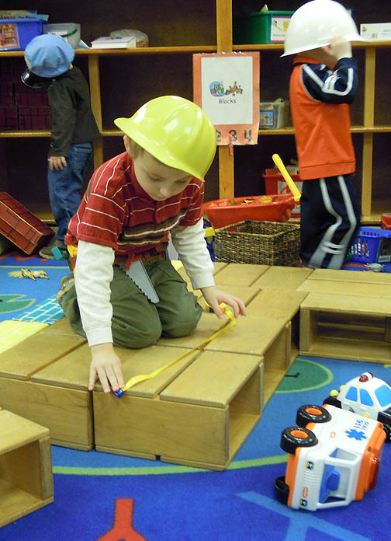
Environmental Perspectives
Pay attention to the environment, not personal characteristics
Environmental factors impacting creativity traditionally ignored
Real pedagogical problem: how do you deal with not-so-creative kids?
What are the conditions for creative behavior to happen?

Slide 13
Creativity as Socio-economic Value
Notes:
Arts warranted in education because they foster new ways of doing things
“Creativity”
Appropriated/reappropriated by diverse sectors so much that term has lost meaning

Slide 15
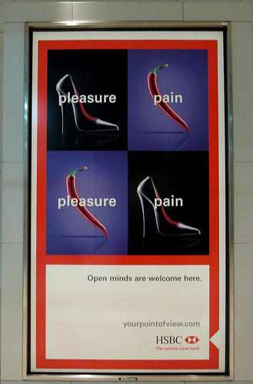

Slide 16
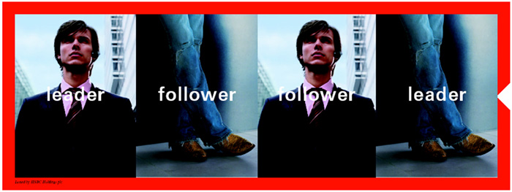

Slide 18
Notice the values being transmitted:
“Truth” depends on your perspective; respect for multiple points of view
Not all cultures or political systems tolerate such values
Tacit (via witty format): Imagination is a value? (Medium is message)
Double-edged: Pleases individual ego while promoting business goals

Slide 19
Design
Creativity
?

Slide 20
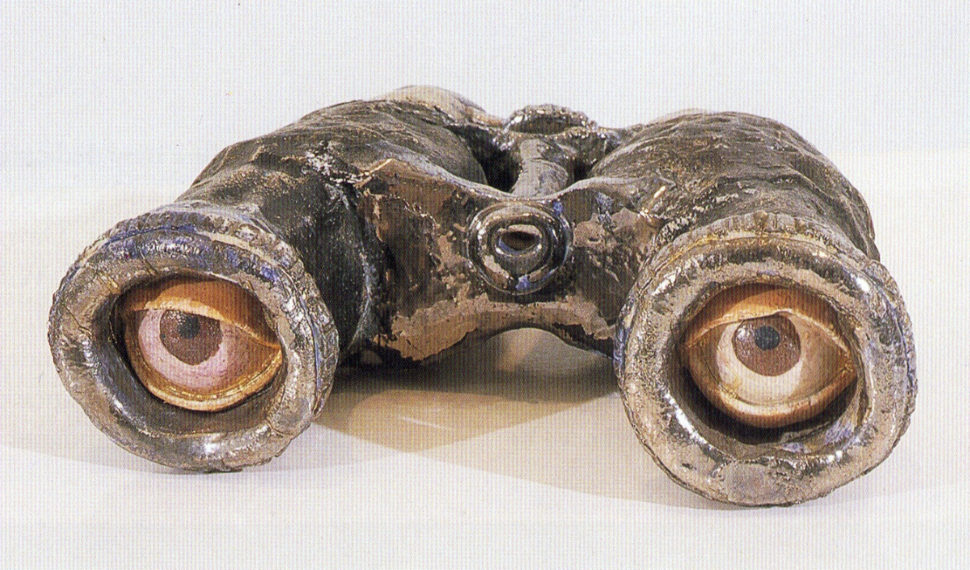
The intersection of creativity and design: Innovation
Constants
Parameters
Variables
Notes:
Vice president is the spare tire of government
Variable: detached eyes (normally a constant)
Parameter (chosen constraint or context): Binoculars (as opposed to glasses, microscope, telescope, camera lens)
Constant: Instruments of sight

Slide 21
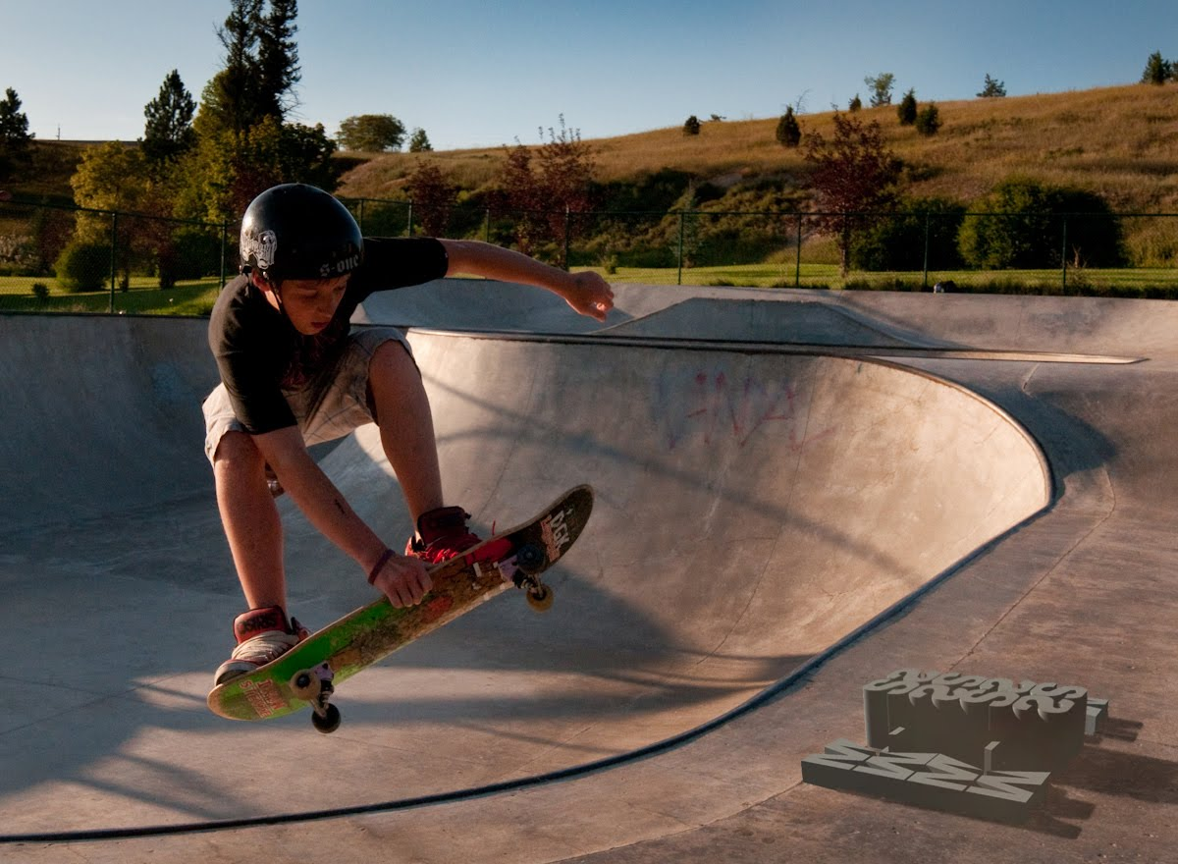
Parameters: What is the arena—what are the walls—within which we will act or react?

Slide 22
Innovation in Design
Constants and parameters determined by one or more of the following:
Final product/end state
Procedures, processes or standards
Initial problem statement
To what extent are these “open” ?or malleable?

Slide 23
Open-ended = Constants, Parameters, Constraints not pre-determined
Final product/end state predetermined
Problem statement or process could be “open”
Predetermined procedures, processes or standards
End state or problem statement could be “open”
Initial problem statement predetermined
Process or end state could be “open”

Slide 24
Innovation and Creativity in Design
Core metaphor:
Creativity as Orchestration;
Long term, thoughtful, iterative
Core activity:
Engaging the unknown/
indeterminate
Creativity
Meta-Cognition
Bloom’s Taxonomy
Affective Domain Skills
Basic Reasoning Skills
Psychomotor Skills

