Slide 1

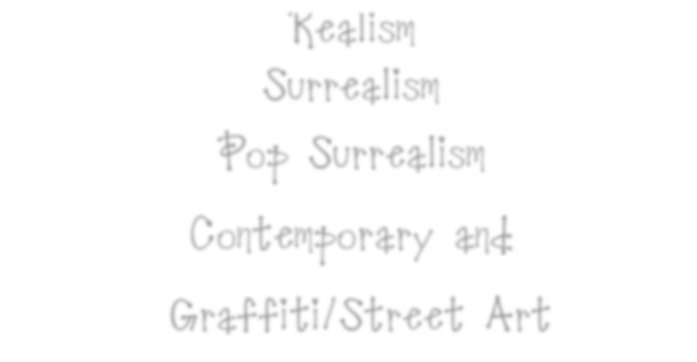
Portrait Styles: Collection and Inspiration
Realism
Surrealism
Pop Surrealism
Contemporary
Graffiti/Street Art

Slide 2

Realism-
In general, realists render everyday characters, situations, dilemmas, and objects, all in a "true-to-life" manner. Realists tend to discard theatrical drama, lofty subjects and classical forms of art in favor of commonplace themes. The term is applied to, or used as a name for, various art movements or other groups of artists in art history. The artists at this time "told it as it is" so to speak. They drew what they had seen without any bias added. The artists simply focused on what was happening in front of them.

Slide 3
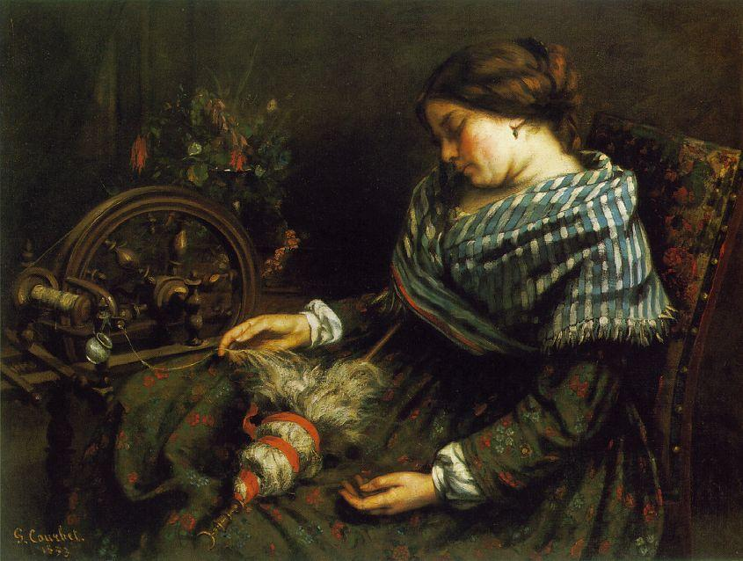
Realism is a style of art that depicts what the eye can see. It tries to capture every-day people doing every-day ordinary things.
The Sleeping Spinner
by Gustave Courbet

Slide 4

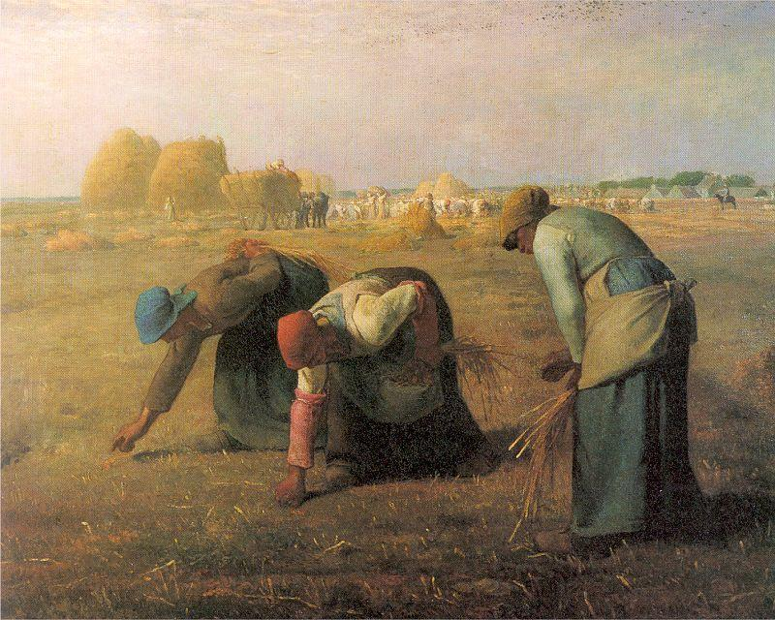
Examples of Realism:
The Gleaners
by Jean-François Millet

Slide 5
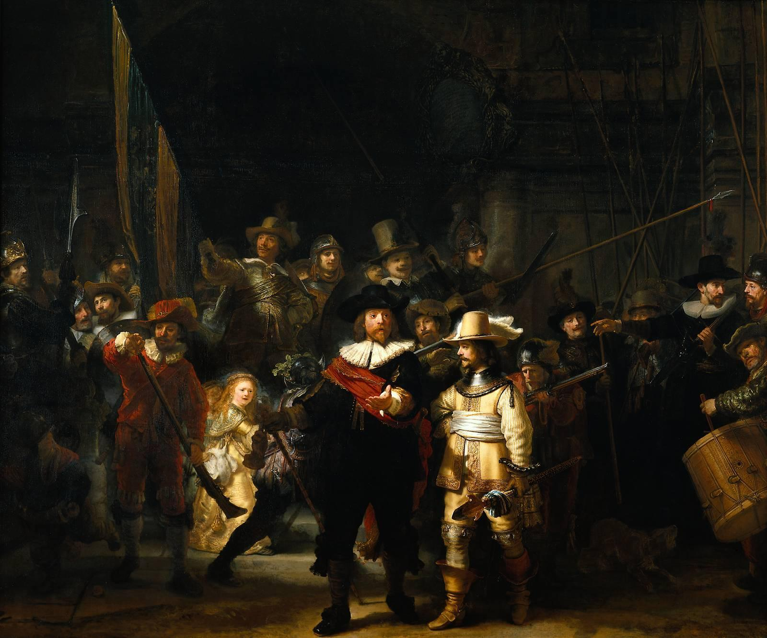
Everyday life was shown in images of people working, instead of the ideal. True life in all its harsh reality was the focus of many of realist artists.

Slide 6
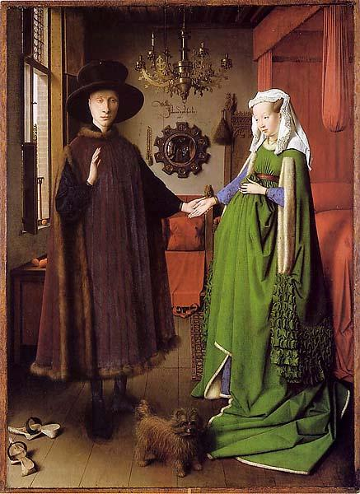
Examples of Realism:
The Arnolfini Marriage
by Jan Van Eyck (YAHN van IKE)

Slide 7
Examples of Realism:
In The Arnolfini Marriage all the objects in the room have meaning. Oranges and lemons were very expensive because they had to be imported from Spain. There are four oranges in the picture suggesting the wealth of the couple. The little dog is also an expensive breed.
The way the women wore their dresses gathered up in front made them look pregnant whether they were or not. The painting was a method of recording the marriage.

Slide 8
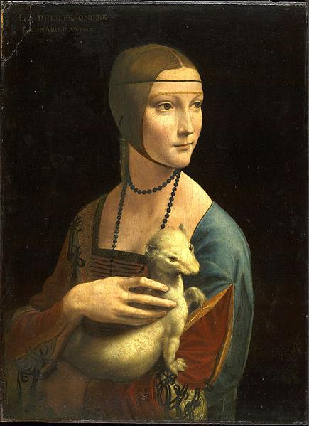
Examples of Realism:
Lady with an Ermine is a painting by Leonardo da Vinci,

Slide 9
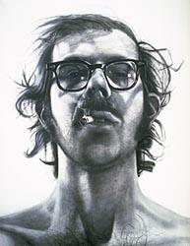
Examples of Realism:
Chuck Close
Big Self-Portrait, 1968
acrylic on canvas
107 1/2 x 83 1/2 in.

Slide 10
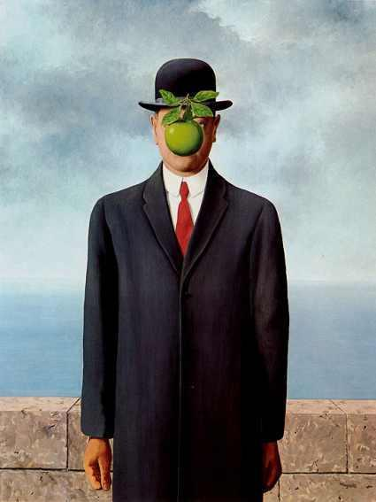
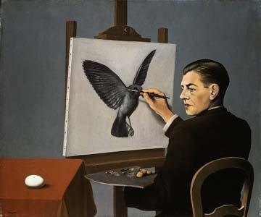
Surrealism
Surrealism was started in the 1920s. It focuses on things found in the imagination or fantasy. You might find every day-objects, but the subject matter or scene depicted is not ordinary.
Rene’ Margritte

Slide 11
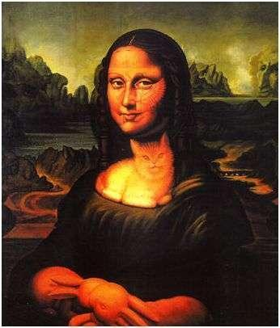
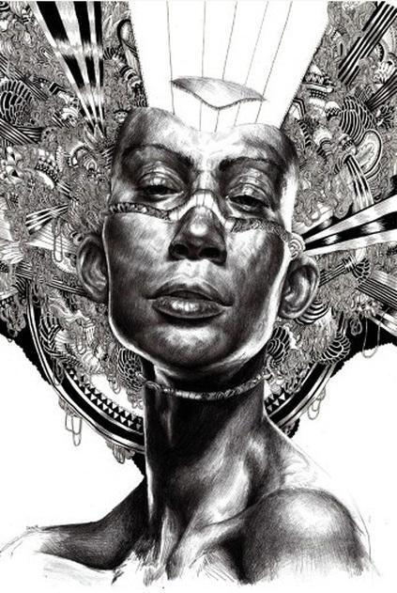
In painting, surrealism is the depiction of real or imaginary objects juxtaposed with objects that are not normally seen in the same context ."Surrealism" literally means "above reality".

Slide 12
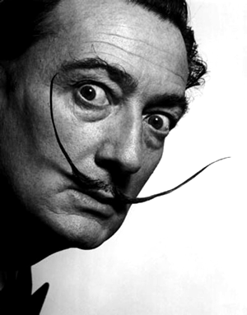
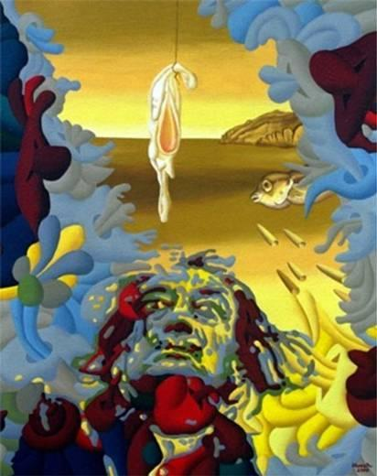
Spanish artist, Salvador Dali, is the name
that first comes to mind for many people
when they think of Surrealism.
Self Portrait by Salvador Dali

Slide 13
Surrealism
Look closely. What's happening in this painting? What makes you say that?…look again…..

Slide 14
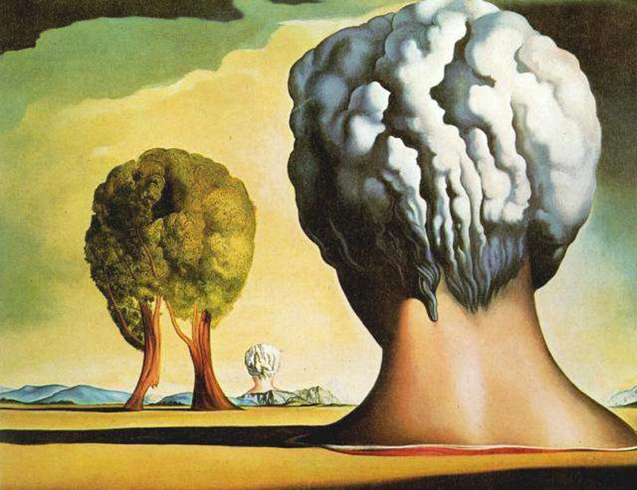
To create a surreal painting, you have to paint somewhat realistically so that at first glance the viewer thinks the painting shows real objects. Perhaps it is a painting of a real object, but upon closer inspection, the viewer realizes the situation depicted is impossible. Mystery is a big part of surreal painting. The artist keeps the viewer guessing.

Slide 15
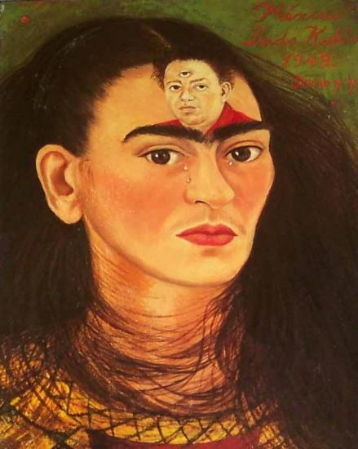
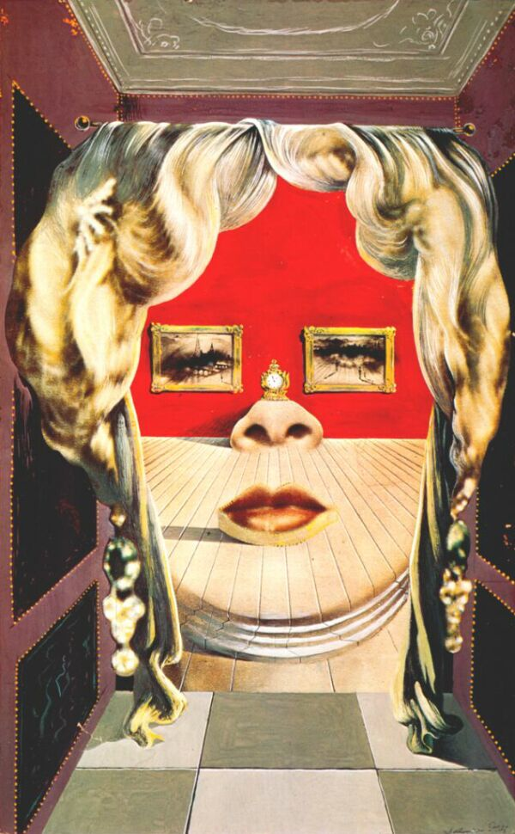
Surrealism
dali-face_of_mae_west_which_may_be_used_as_surrealist_apartment-1934-5.jpg
—Artist: Frida Kalo

Slide 16
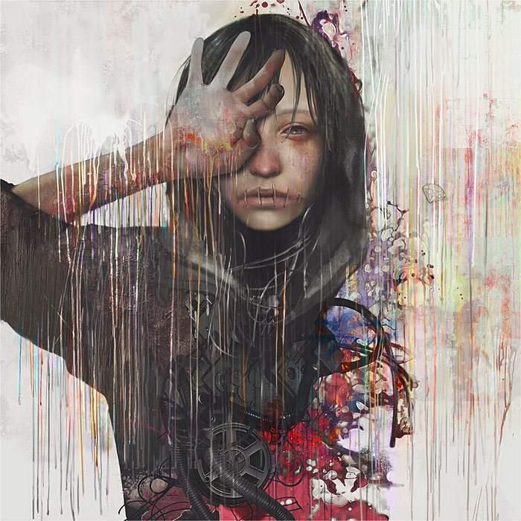
YDK Morimoe Japanese digital artist with a very personal style, surreal and captivating
http://surrealismtoday.com/50900506

Slide 17
Tips : Connect to the subconscious mind/ Creating dream-like scenes.
One way to evoke the subconscious is to tear out all kinds of pictures from magazines, and cut the subjects out. Place the images next to each other randomly. The strange combinations evoke mysterious emotions and memories, and some seem to go with others. Glue them down, and you have the beginning of a surreal picture.
Another way to find surreal subject matter is to recall your dreams. Dreams are products of the subconscious/unconscious mind and are often surreal. Everyone dreams, so any person is capable of producing surreal subject matter. The primary difference between surreal art and realistic or abstract art is that the surreal artist places real objects in strange places, creates unexpected juxtapositions, and/or has changed the objects to be slightly abnormal, although still recognizable.

Slide 18
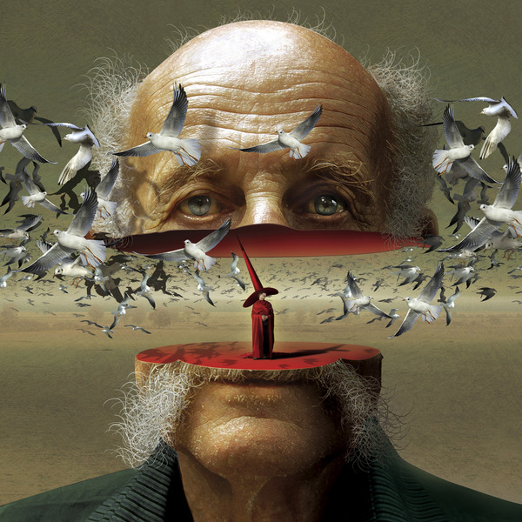
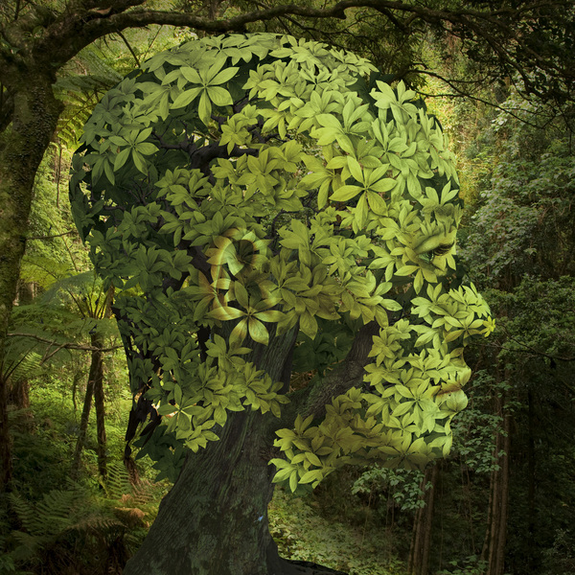
Surrealism
http://www.juxtapoz.com/Current/surreal-paintings-by-igor-morski

Slide 19
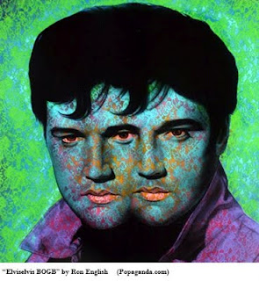
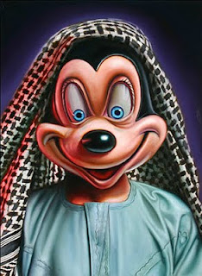
NEO POP SURREALISM
http://www.thedailytelecraft.com/2011/06/art-history-snippet-pop-surrealism.html
One of the major themes behind Pop Surrealism is criticism of corporate America. Pop surrealist work is often controversial because of its edgy political, violent, or sexual nature. Each work creates a narrative.

Slide 20
Pop Surrealism- A.K.A. Lowbrow Art
What are the characteristics of "Lowbrow"?
Lowbrow was born of underground or "street" culture.
The single most common tactic that Lowbrow artists employ is to poke fun at convention. They know the "rules" of art, and consciously choose not to abide by them.
Lowbrow art has a sense of humor. Sometimes the humor is gleeful, sometimes it's impish and sometimes it's born of sarcastic comment, but it is always present.
Lowbrow draws heavily on icons of popular culture, particularly those now commonly known as "Retro." Tail-end "Baby Boomers" will recognize them straight away, unless said Boomers were raised in an environment that disallowed outside influences.

Slide 21
Pop Surrealism
Early on it was influenced by underground comics, punk and rock music, vintage pinups, and the 1960’s hot rod culture. Pop Surrealism has began to morph into much more. It is about culture with a distorted or surreal vision. Pop Surrealism is often dreamy, slightly comical or even cartoonish with characters that look like dolls.
http://www.easycoursesportal.com/howtopaintpopsurrealismcourse/coursec/Less-1.htm

Slide 22
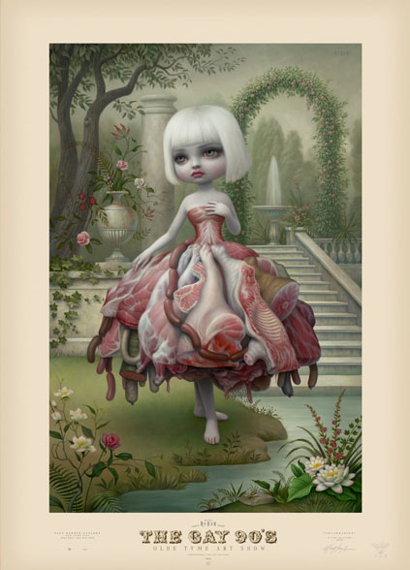
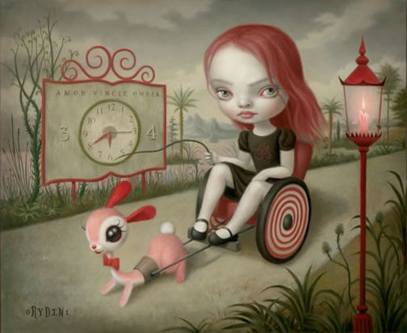
Pop Surrealism
In Mark Ryden's world, cherubic girls rub elbows with strange and mysterious figures.

Slide 23
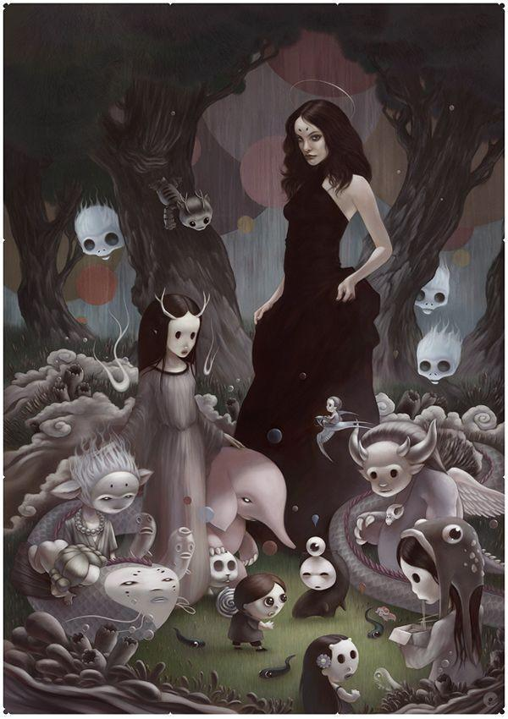
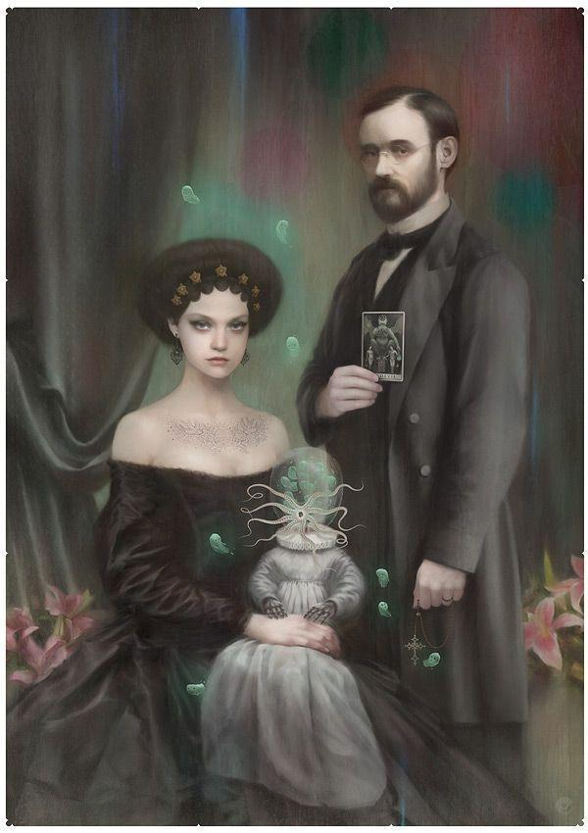
Bagshaw- Pop Surrealism

Slide 24
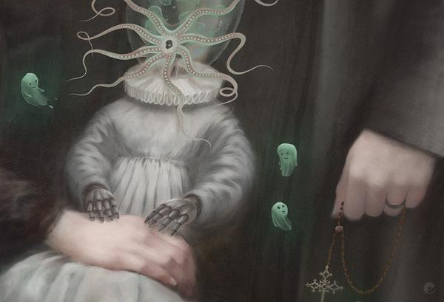
Detail of Bagshaw's work

Slide 25
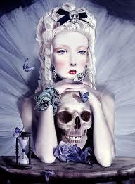
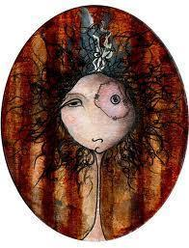

Slide 26
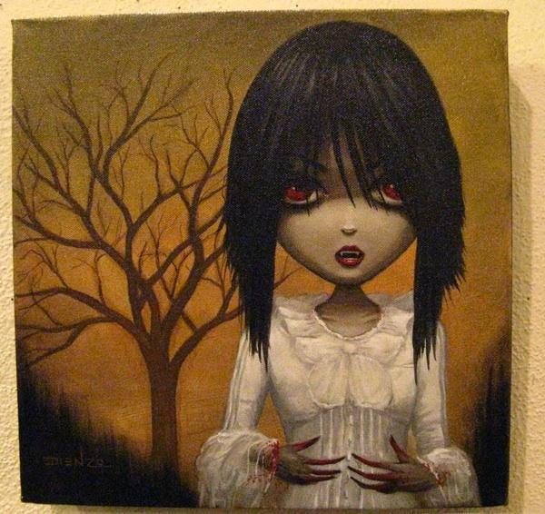
Pop Surrealism

Slide 27
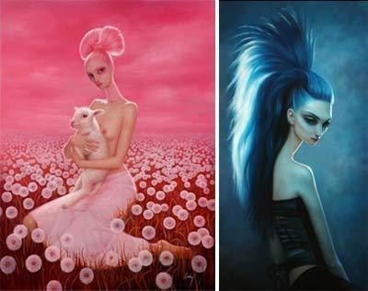
Pop Surrealism

Slide 28
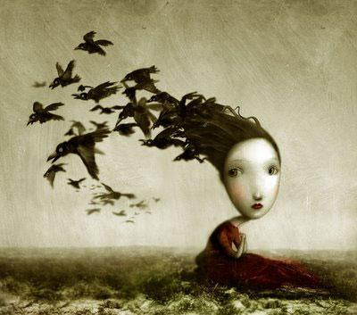
Pop Surrealism

Slide 29
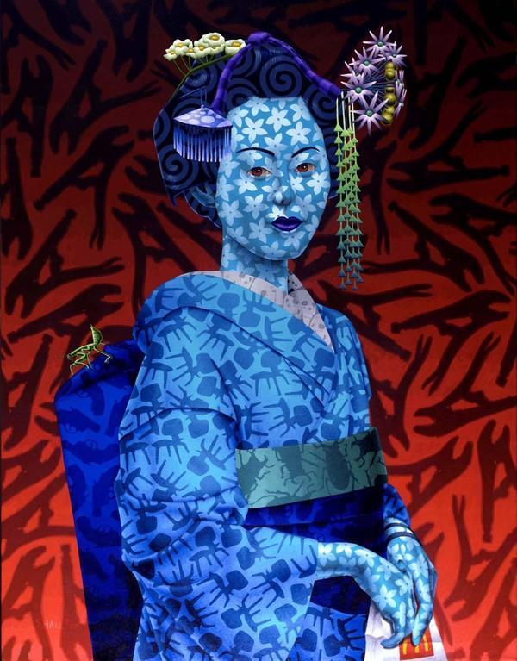
Surrealism
POP SURREALISM
Stephen Hall
"His large canvases in vividly saturated acrylic show cultural conflict and homogenization: a Japanese woman who, on closer examination, wears a pattern of Eames chairs in her kimono and is clutching McDonald's fries"- New York Times, Tues November 22nd, 2011
http://www.stephenhallart.com/default.html

Slide 30
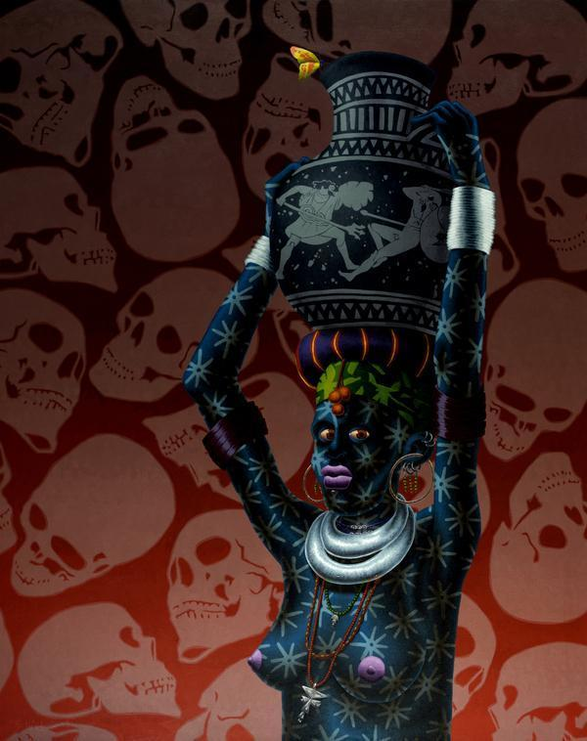

Slide 31
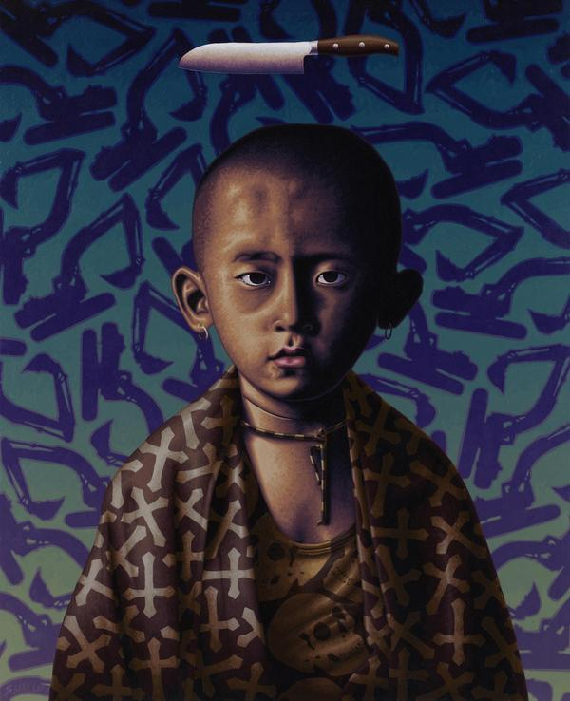

Slide 32
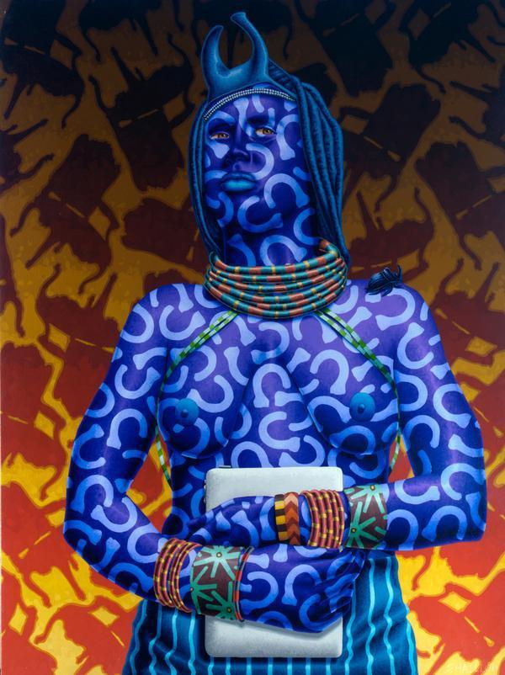

Slide 33
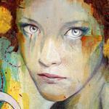
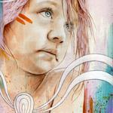
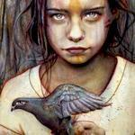
Contemporary Artists-
Contemporary art is highly individualistic. It is about freedom of expression, the chance to make one’s mark, and speaking with a distinctive voice.
Michael Shapcott

Slide 34
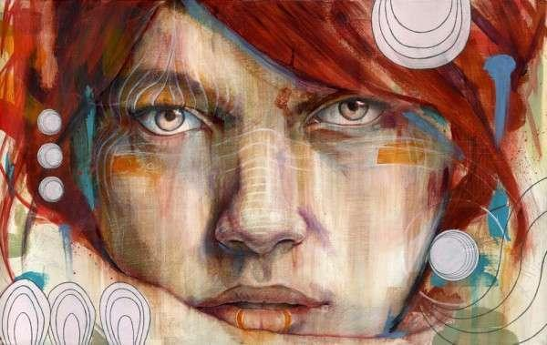
Michael Shapcott (born June 6, 1982 in Hartford, Connecticut) is a Central Connecticut-based painter, known for his daring color palette and emotionally charged portraits. His work deals with highly detailed graphite drawings which he then paints with colorful washes in oil and acrylic paints
Contemporary Artists

Slide 35
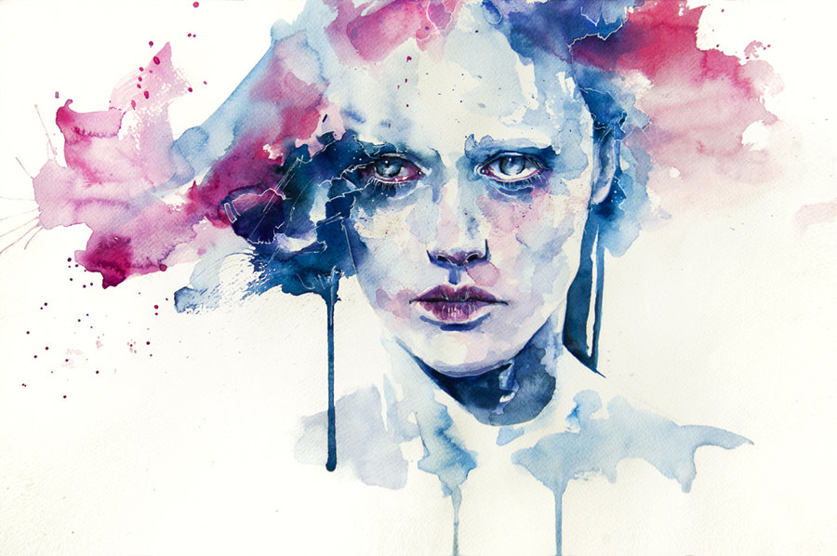
Contemporary Artists
http://www.youtube.com/watch?v=g857UNIKQsM
http://mayhemandmuse.com/agnes-ceciles-world-of-watercolor/
Agnes Cecile is a pseudonym for Italian artist Silvia Pelissero

Slide 36
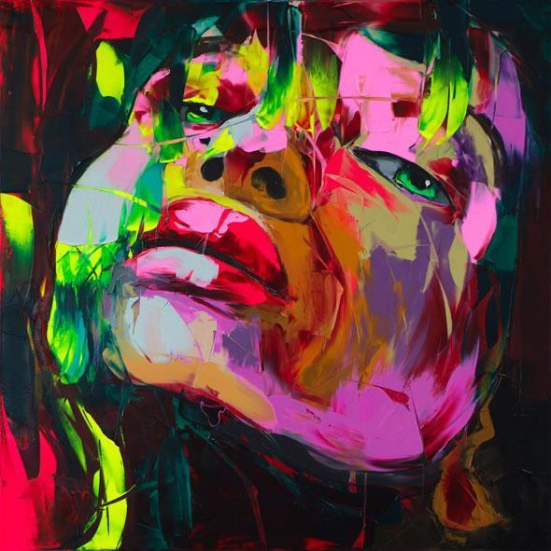
Oil painting with a knife by Francoise Nielly.
Françoise Nielly’s painting is expressive, exhibiting a brute force, ans fascinating vital energy. Oil and knife combine to sculpt her images.
Contemporary Artists
Francoise Nielly

Slide 37
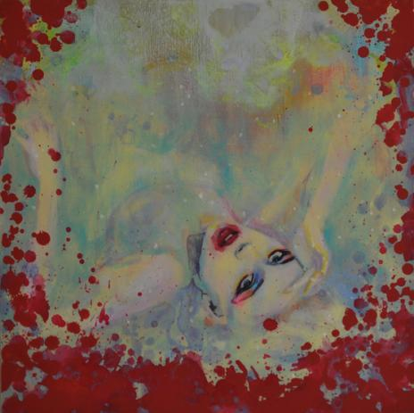
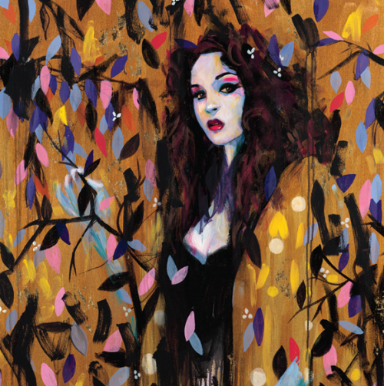
Contemporary Artists
Joshua Petker- is an artist influenced by graffiti, Gustav Klimt and Pop Art amongst others.
http://www.culturazzi.org/art/rainbow-of-colors-artwork-joshua-petker

Slide 38
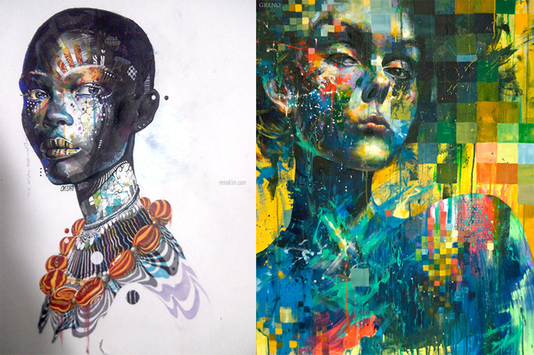
Minjae Lee’s work focuses on ethereal female forms that are highly expressive and focus on human emotion, the blending of cultures, and the concept of the soul.
Contemporary Artists
http://www.visualnews.com/2012/07/02/artist-spotlight-minjae-lee/
http://turningcolors.blogspot.com/2010/11/minjae-lee.html

Slide 39
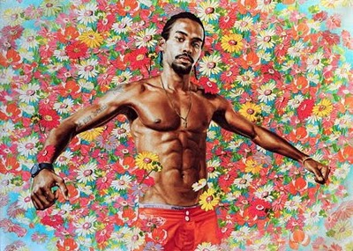
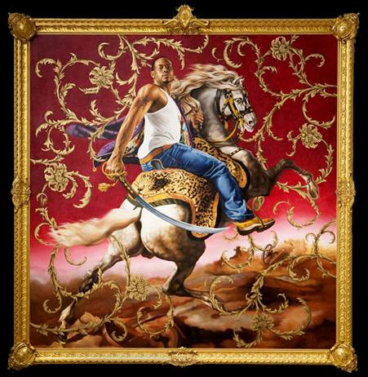
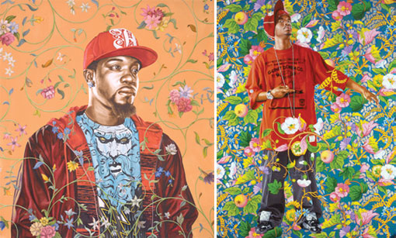
Contemporary Artists
KEHINDE WILEY http://analoguechic.com/tag/kehinde-wiley/
His portraits are based on photographs of young men who Wiley sees on the street. He painted men from Harlem’s 125th Street, then South Central neighborhood where he was born. Dressed in street clothes, his models were asked to assume poses from the paintings of Renaissance masters, such as Tiziano Vecellio and Giovanni Battista Tiepolo.

Slide 40
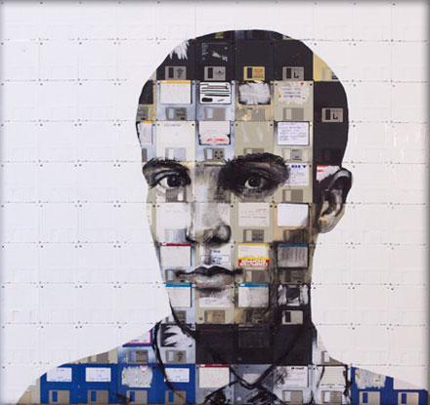
Nick Gentry
Nick Gentry is a British artist from London. Much of his artistic output has been generated with the use of contributed artifacts and materials. He states that through this process "contributor, artist and viewer come closer together". His art is influenced by the development of consumerism, technology and cyberculture in society, with a distinctive focus on obsolete media.
He is best known for his floppy disk paintings, placing an emphasis on recycling and the reuse of personal objects as a central theme. Such artistic works of social commentary have been featured in galleries in the UK, USA and in cities throughout the world. His work has been exhibited alongside established street artists and as such has been linked to the urban art scene in London.

Slide 41
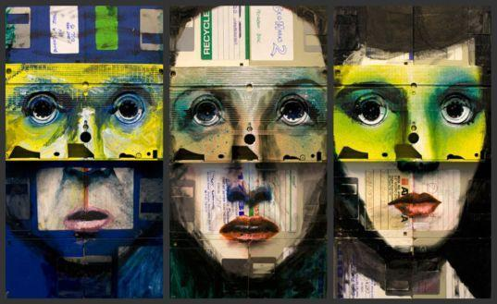
The artist uses old technology such as floppy disk as the support for his work.

Slide 42
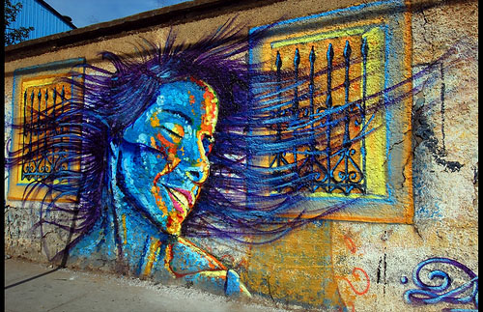
Street Art/Graffiti
Forms of Street Art-----
Traditional- Painting on the surfaces of public or private property that is visible to the public, commonly with a can of spray paint or roll-on paint. It may be comprised of just simple words (commonly the writer’s name) or be more artful and elaborate, covering a surface with a mural image.
http://www.flickr.com/groups/atlantagraffiti/

Slide 43

Street Art/Graffiti
http://www.banksy.co.uk/
Forms of Street Art-----
Stencil-
Painting with the use of a homemade stencil, usually a paper or cardboard cutout, to create an image that can be easily reproduced. The desired design is cut out of a selected medium, and the image is transferred to a surface through the use of spray paint or roll-on paint.
Banksy is one the most famous graffiti/ street artist. He often uses stencils to create his art that usually is based in social/political commentary.

Slide 44

Street Art/Graffiti
http://www.obeygiant.com/
Forms of Street Art-----
Sticker made by artist Sheppard Fairey A.K.A. Obey. He is most famous for his Obama poster.
Sticker- (aka sticker bombing, slap tagging, and sticker tagging) Propagates an image or message in public spaces using homemade stickers. These stickers commonly promote a political agenda, comment on a policy or issue, or comprise an avant garde art campaign. Sticker art is considered a subcategory of postmodern art.

Slide 45

Street Art/Graffiti
Noted São Paulo muralist, Eduardo Kobra's work is characterized by an impressive range of depth and realism. Kobra’s brightly hued murals pay homage to NYC’s history.

Slide 46

Graffiti
Here street graffiti turns an ordinary wall into a work of art

Slide 47

Detail of Mural....

Slide 48

Street Art

Slide 49


Slide 50

Street Art/Graffiti

Slide 51

Street Art/Graffiti

Slide 52

Street Art/ Graffiti

Slide 53

Street Art/ Graffiti

Slide 54

Street art

Slide 55

Street Art

Slide 56

Street art
Graffiti may be expressive, decorative, territorial, socio-political commentary, advertising or vandalism.

Slide 57

Street art/graffiti

Slide 58

Graffiti

Slide 59

Graffiti

Slide 60

Street art

Slide 61

Street art

