Slide 1
What is a Portrait?

Slide 2
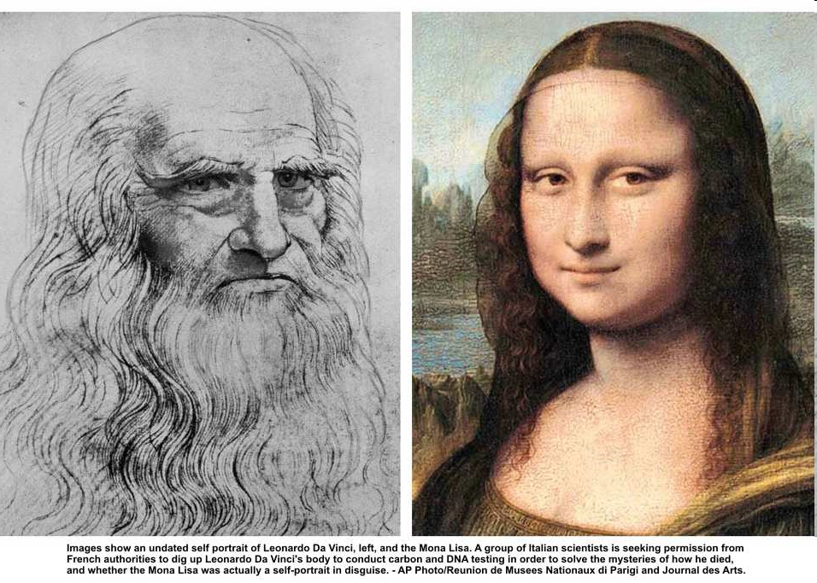

Slide 3
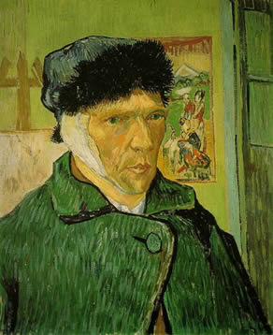
Vincent Van Gogh, Self-Portrait

Slide 4
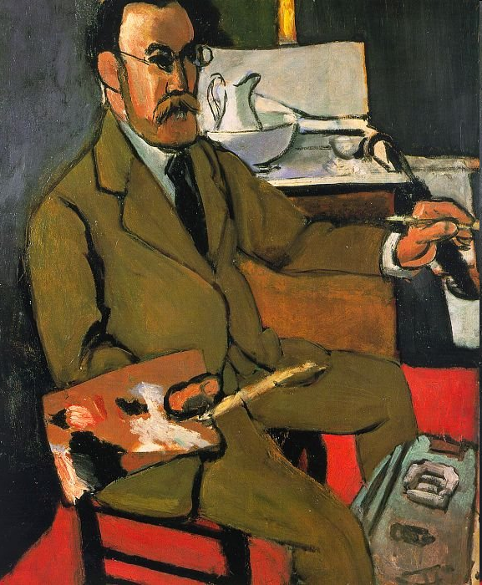
Henri Matisse, Self-Portrait

Slide 5
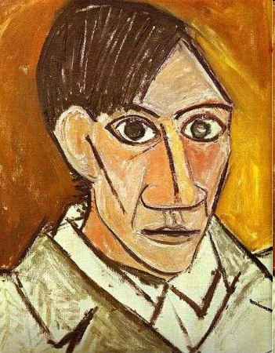
Pablo Picasso, Self-Portrait

Slide 6
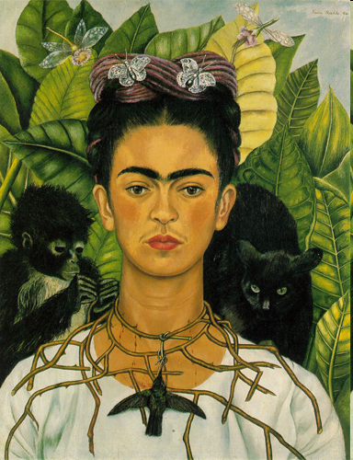
Frida Kahlo, Self-Portrait

Slide 7
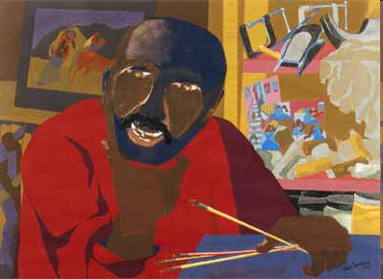
Jacob Lawrence, Self Portrait

Slide 8
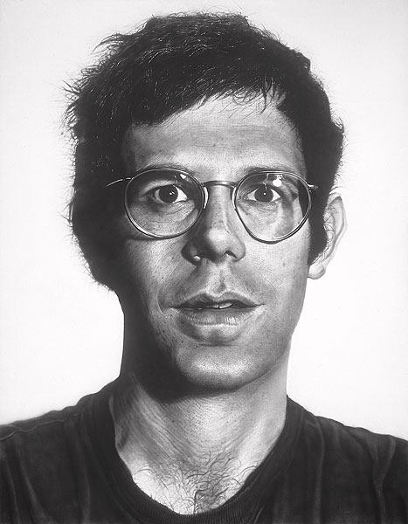
Chuck Close, Self-Portrait

Slide 9
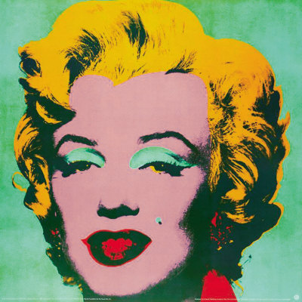
Portrait of Marilyn Munroe by Andy Warhol

Slide 10
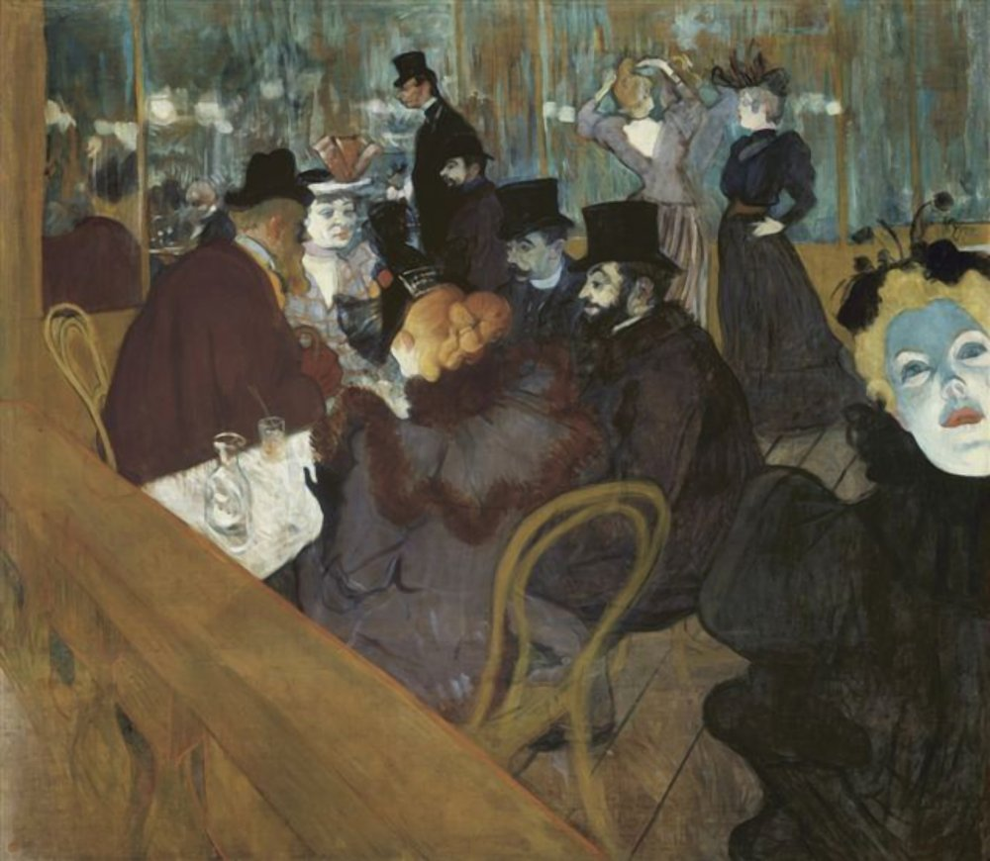
Edgar Degas, Café Scene

Slide 11
Leonardo Da Vinci
An Italian painter, sculptor, architect, scientist, inventor, etc.
Lived from the 1450’s- 1510’s
Known for his work with human proportions and his study of anatomy.

Slide 12
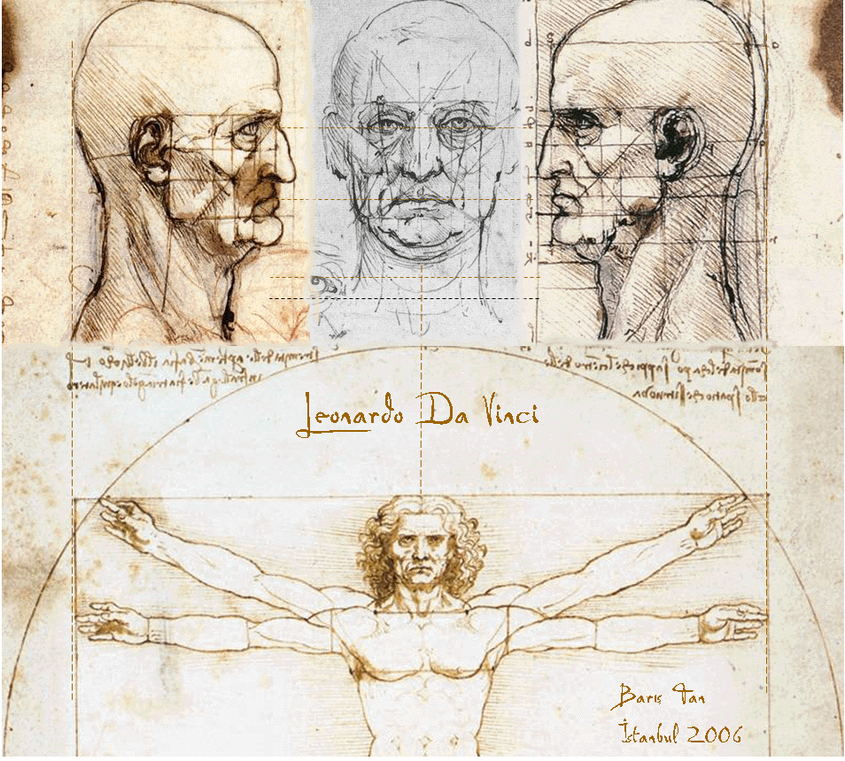

Slide 13
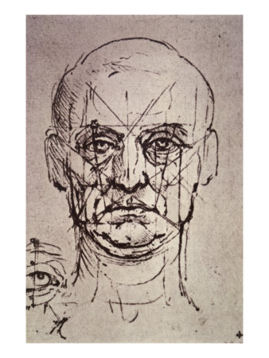
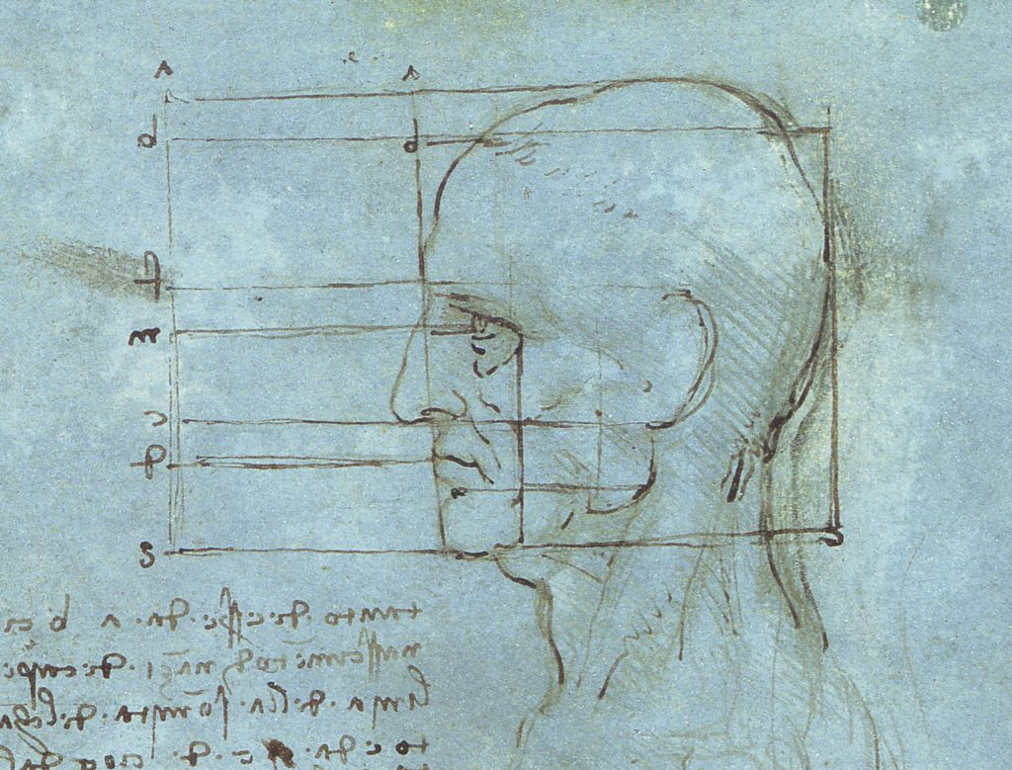

Slide 14
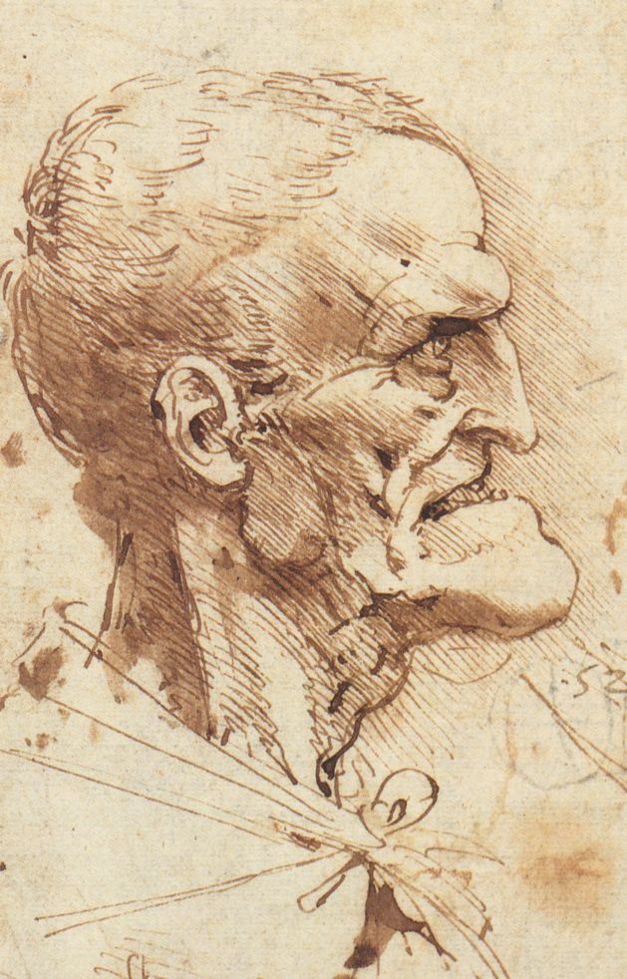

Slide 15
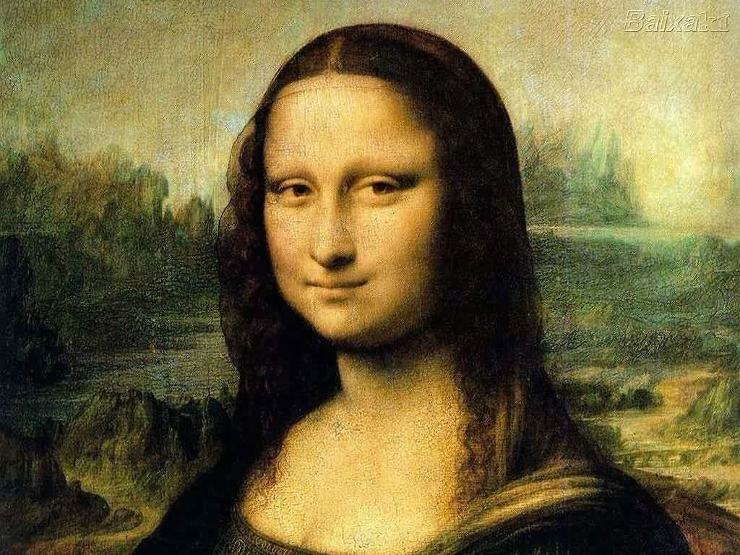
Rule of Halves or
Facial Proportions

Slide 16
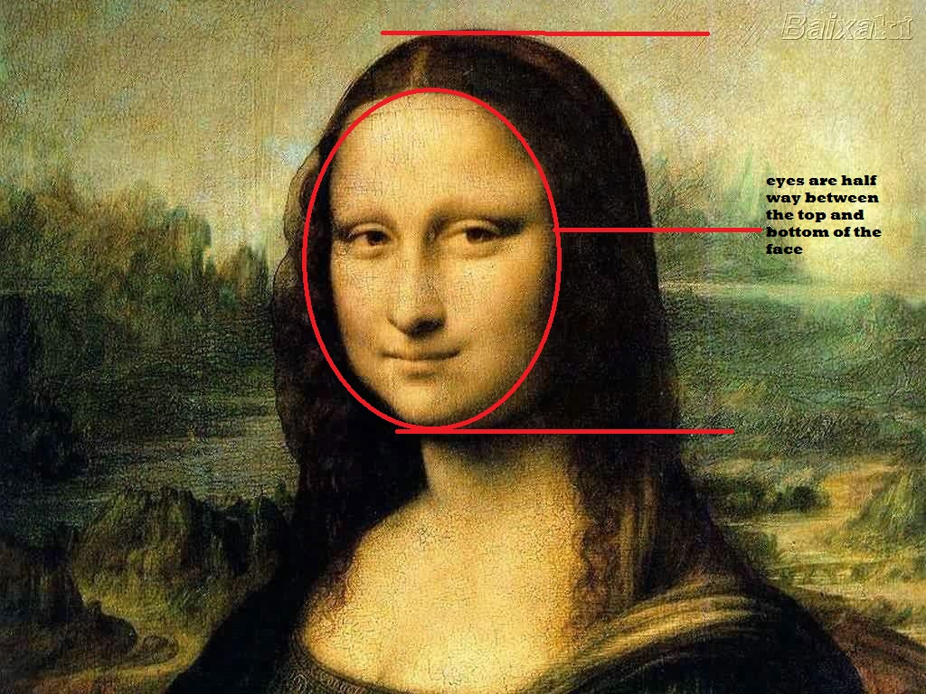

Slide 17
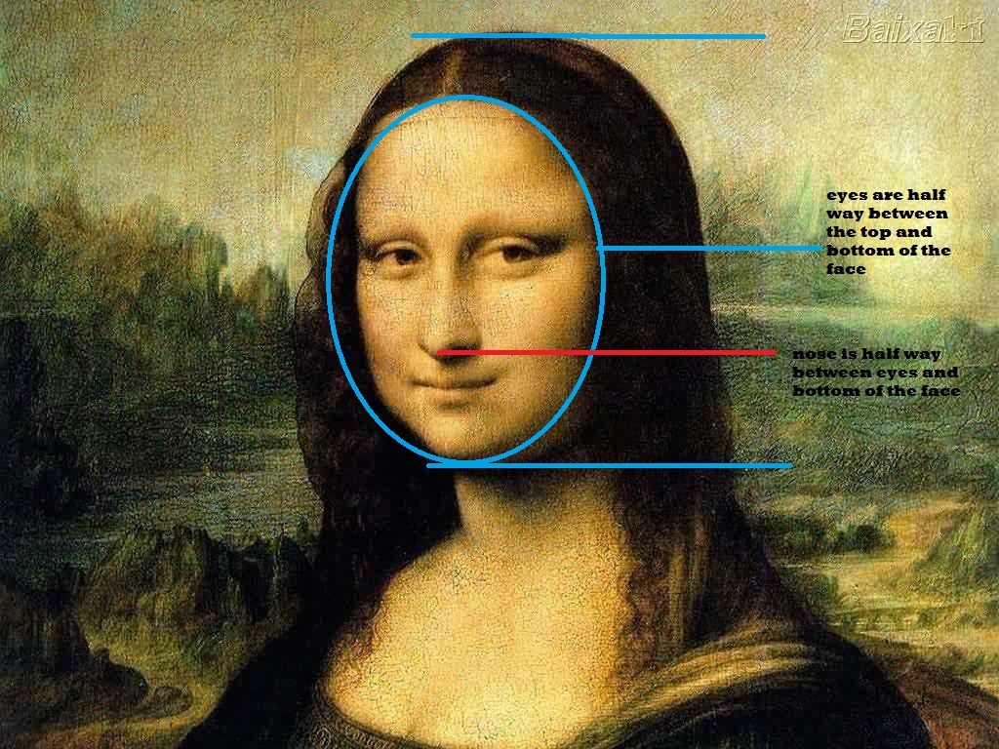

Slide 18


Slide 19


Slide 20
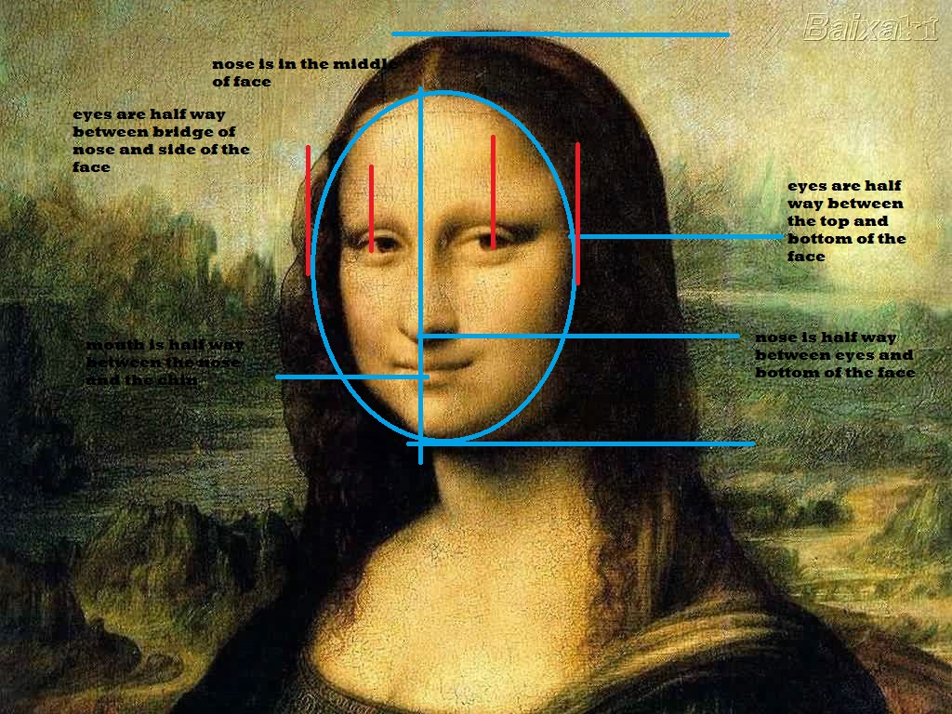

Slide 21


Slide 22
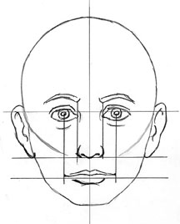

Slide 23
